Slide 1
Intelligent Buildings Council (IBC)
Chair: Trevor Nightingale (National Research Council)
Vice-Chair: Harsha Chandrashekar (Honeywell International Inc)
Vice-Chair: Robert Lane (Robert H. Lane and Associates Inc.)
Vice-Chair: Bob Allan (The Siemon Company)

Slide 2
1. Agenda Greg Walker (CABA)
1. Agenda
2. Call to Order, Welcome, Introductions, about IBC
3. Administrative
“Wireless Power Enables Dynamic Digital Displays in Smart Retail” (30 min)
Sanjay Gupta (AirFuel Alliance)
5. Research Update
6. White Paper Sub-Committee Update
7. New Business
8. Announcements
9. Adjournment

Slide 3
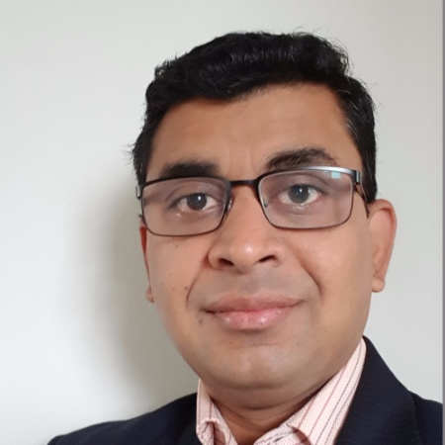
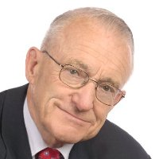
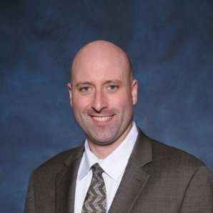
2. Call to Order, Welcome, Introductions, About the IBC Trevor Nightingale (National Research Council)
IBC Chair
Trevor Nightingale
Director
National Research Council
IBC Vice-Chair
Harsha Chandrashekar
Product Approvals & Regulatory Leader
Honeywell International Inc
IBC Vice-Chair
Robert Lane
President & Managing Partner
Robert H. Lane and Associates Inc.
IBC Vice-Chair
Bob Allan
Global Business Development Manager, Intelligent Buildings
The Siemon Company
The CABA Intelligent Buildings Council works to strengthen the large building automation industry through innovative technology-driven research projects. The Council was established in 2001 by CABA to specifically review opportunities, take strategic action and monitor initiatives that relate to integrated systems and automation in the large building sector. The Council's projects promote the next generation of intelligent building technologies and incorporates a holistic approach that optimizes building performance and savings.
www.caba.org/ibc

Slide 4
3. Administrative Trevor Nightingale (National Research Council)
3.1 Motion to approve past IBC Minutes: www.caba.org/ibc

Slide 5
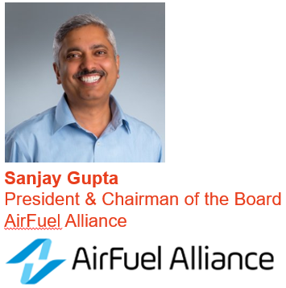
4. Keynote Speaker Bob Allan (The Siemon Company)
“Wireless Power Enables Dynamic Digital Displays in Smart Retail” (30 min)

Slide 6
Wireless Power Enables Dynamic Digital Displays in Smart Retail
May 8, 2019
Sanjay Gupta

Slide 7
The Wireless Power Universe
500 million devices last year
40% increase this year
SIZE
2 billion receivers &
transmitters by 2022
$12B USD by end of 2022
AR/VR
Automotive
Industrial
Robotics
Healthcare
IoT
Aerospace/
Defense
SCOPE
Notes:
The global wireless charging market is expected to reach $24B by the end of 2023 with 32.56% CAGR during the forecast period of 2017-2023 according to Market Research Future.
The use cases for wireless power extend far beyond smartphones and tablets. Wireless powering technologies are revolutionizing the capabilities of major industries including commercial, industrial, medical, IoT and more.

Slide 8
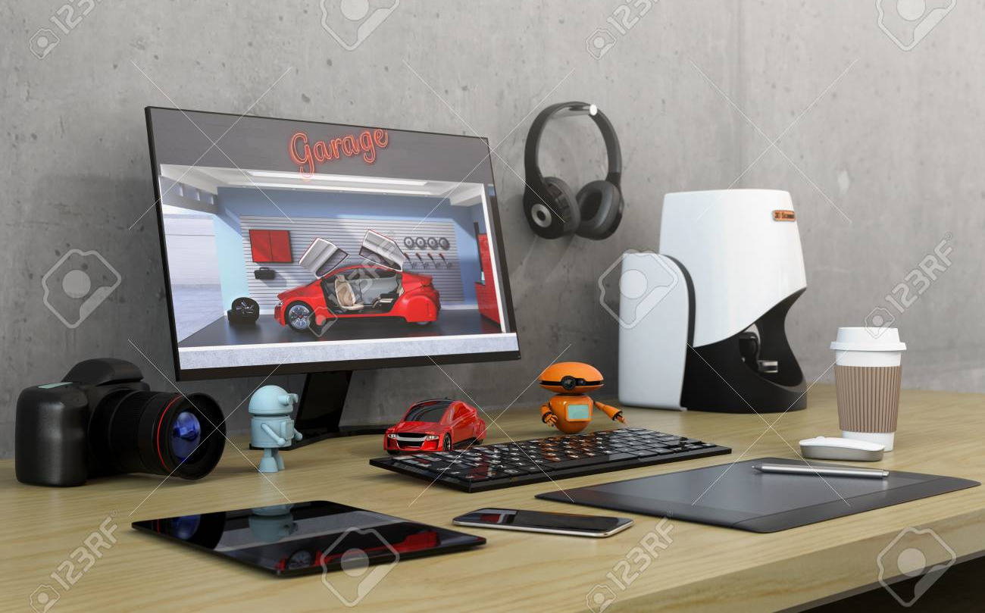
What Consumers Want
Interoperability
Versatility
Fast
Notes:
AFA’s network specifications help members create and deploy solutions that are interoperable, versatile, fast and secure – giving diverse markets the ability to wirelessly power up in public and private places.
Through thick surfaces – no drilling, no mess
Multiple Devices, All Power Levels
Industrial Design
Thin and Flexible
Non-Planar

Slide 9
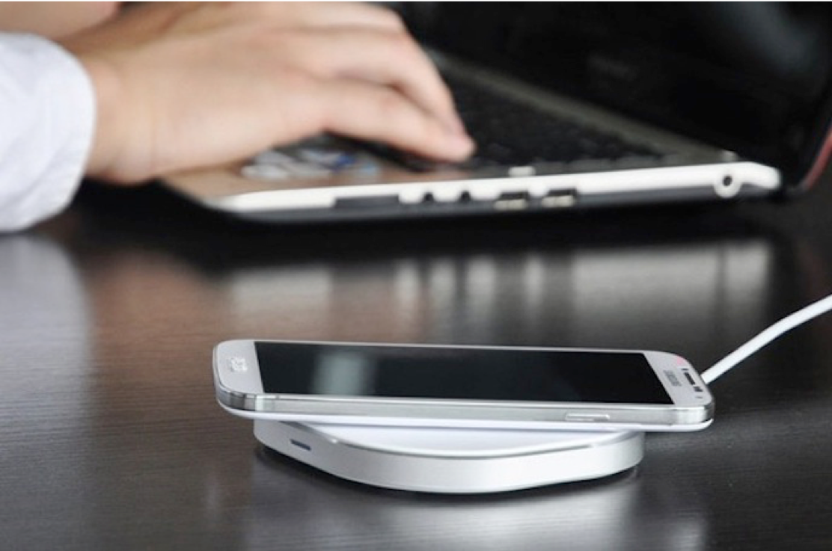
We Need A Technology Evolution
WP1.0
WP2.0
Inductive
100-300KHz
Magnetic
Resonance
6.78MHz
RF
900MHz and higher
Notes:
There is not a “one size fits all” solution for wireless power. AFA supports the spectrum of technologies available, recognizing that different uses demand varying solutions.
AFA is currently focused on Magnetic Resonance & RF solutions because these technologies are ready for deployment, offer the most varied applications, and address key market demands including increased spatial freedom, flexibility and device compatibility.

Slide 10
The AirFuel Alliance – Who We Are
Global coalition of innovative companies committed to a world where we can power up without plugging in
Standards development for leading edge wireless power technologies and acceleration of their deployment.
Diverse membership representing the full spectrum of the wireless power value chain
Notes:
AFA provides technical requirements, specifications and guidelines that members can use to ensure wireless charging products interoperate with one another and that wireless power technology is high quality, safe and reliable.

Slide 11
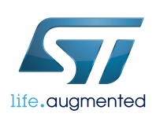
Ecosystem
semiconductors
components
Engineering support
Test
Reference designs
Resonators/ materials
Production
Notes:
AirFuel members represent the full value chain – from semiconductor and device manufacturers to automotive and infrastructure solutions providers – including a mix of large, mid-size and start-up organizations.

Slide 12
Making Spaces Smart
Smart Buildings
Smart Retail
Sensors
Sensor
IOT
Smart Offices
Big Data
Cloud Platform
IOT
Device
Smart Health
AI
Services
Connectivity

Slide 13
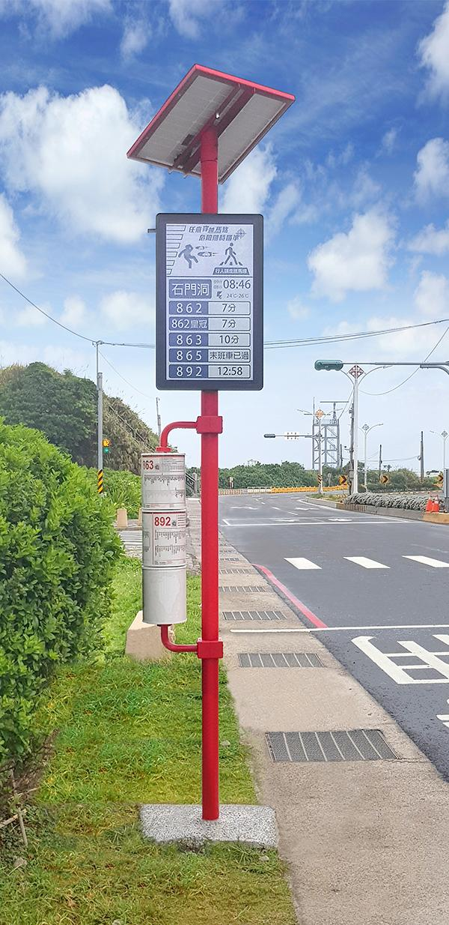
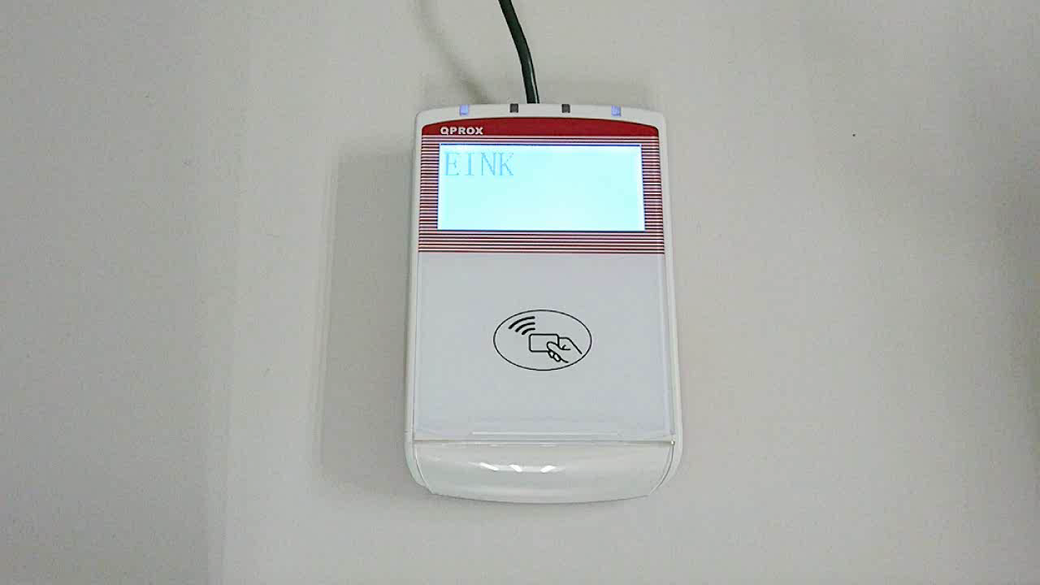
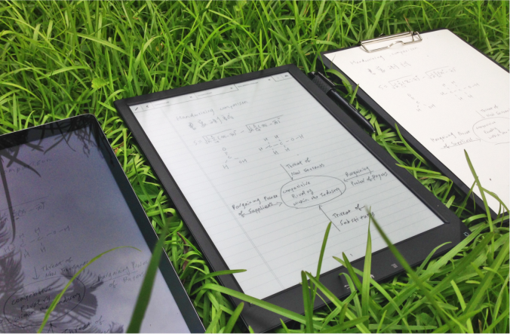
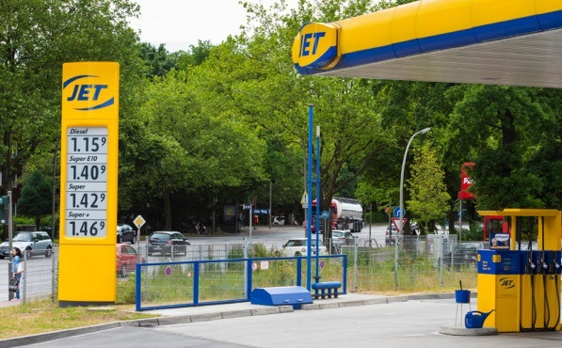
ePaper Displays: Naturally Suitable for IoT
Bi-Stable: Zero power needed to hold an image
Reflective Display: No backlight, No Blue Light Hazard
Ultra Low Power Consumption
Bi-Stable
Reflective
Low Power
Consumption
Easy on The Eyes
Sunlight
Readable
Outdoor Readability
Traditional Paper
EPD
Always On
Paper-Like
Wide Viewing
Angle
LCD
Flexible
Light
Weight
Shatter
proof

Slide 14
Benefits of Batter Free IOT Devices
1
Long Product Life
2
Environmentally Friendly
3
Thin , Flexible, and Light
4
Low Cost
5
Safe

Slide 15
Smart Retail Needs Smart Displays

Slide 16
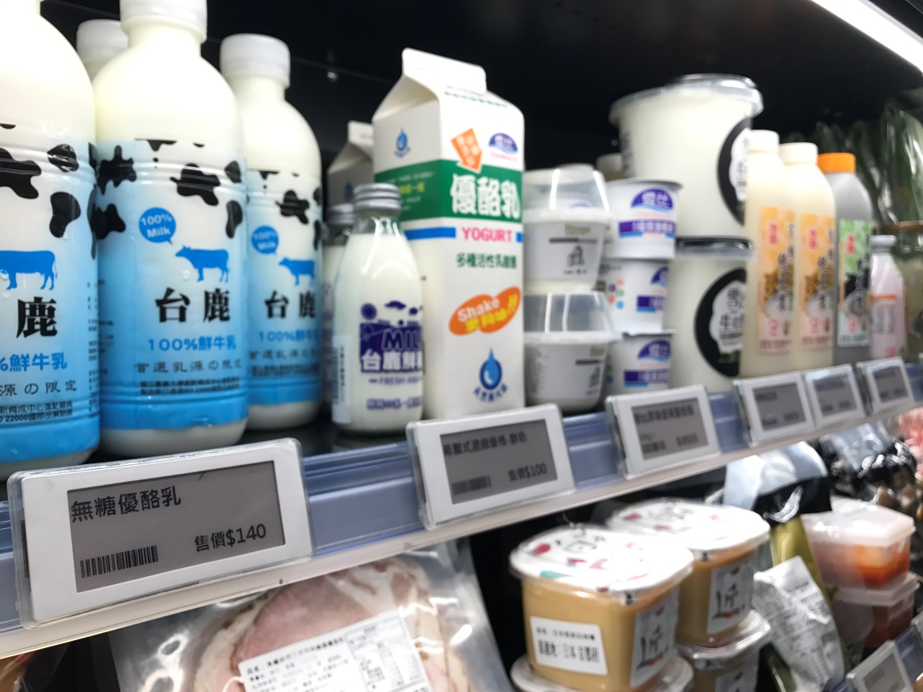
Smart Display Power Requirements
Distance ~10M
One to Multi charging
Target update time <3sec for each
One chip with high power & high transmission speed solution

Slide 17
AirFuel Uncoupled/RF Powers Smart Retail
Power delivery during normal use
Spatial freedom in all dimensions
Low cost & eco friendly
Technology | Radio Frequency
Max Power Delivered | few watts
Spatial Freedom | 3D, Far Field
Simultaneous Receivers | Multiple
Communication | Out of band (BT4.0/BLE)
Frequency | 900MHz and higher
Notes:
RF works particularly well for wearables, medical devices and other devices that need the broadest spatial freedom.
RF uses a radio frequency transmitter and a receiver embedded within a device (not a coil) to pick up RF energy and convert it to power.
RF provides low power at distances ranging from a few centimeters to a meter, delivering true spatial freedom.

Slide 18
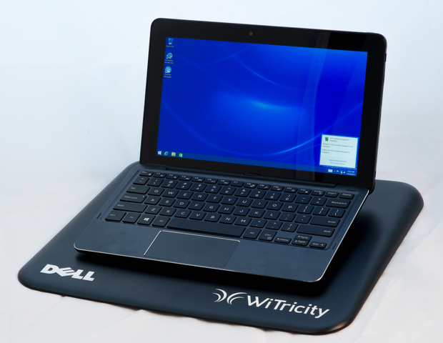
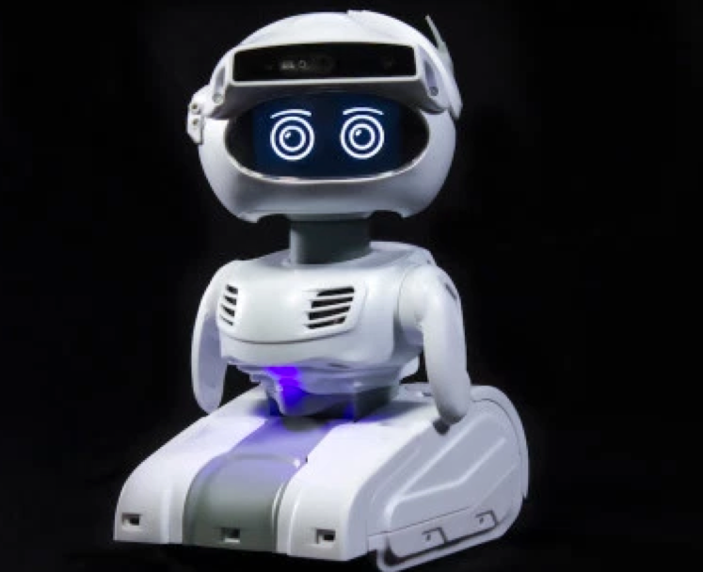
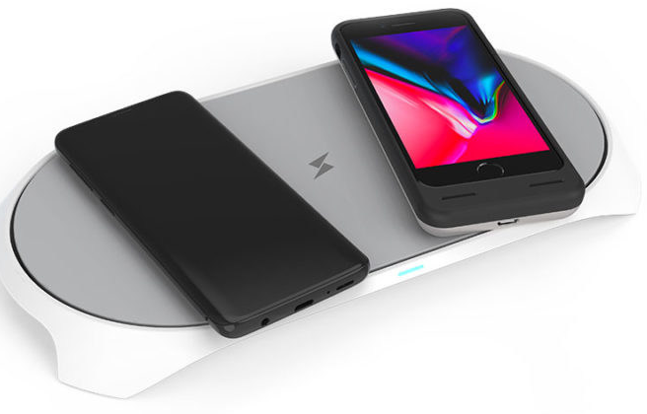
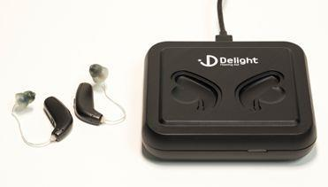
AirFuel Resonant and AirFuel RF in Action
Notes:
We’ve only just begun to discover what’s possible with wireless technologies and how new innovations will advance industries beyond our imagination.
The AirFuel Alliance is proud to help lead the charge.

Slide 19
The Future of Wireless Power is Here.
Join Us...

Slide 20
4. Keynote - Questions? Bob Allan (The Siemon Company)

Slide 21
5. Research Update Trevor Nightingale (National Research Council)
5.1 2019 IBC Landmark Research “Evidence for Building Retrofits that Improve Organizational Productivity (Phase 2)”
Free Download of Phase 1: www.caba.org/productivity
www.caba.org/research

Slide 22
6. White Paper Sub-Committee Update Ken Wacks (Ken Wacks Associates)
6.1 Recently Completed:
“Impacts of Automated Shading in Building Projects”
Hello Axis
Ecotay Inc.
Hunter Douglas
Ken Wacks Associates
Lawrence Berkeley National Laboratory (LBNL)
Legrand
Lutron Electronics Co., Inc.
Springs Window Fashions/Mecho
NYSERDA (New York State Energy Research and Development Authority)
PLC Multipoint, Inc.
Savant Systems
Screen Innovations
Siemens Industry, Inc.
Somfy Systems, Inc.
Sustainable Resources Management Inc.
TRC Energy Services
Vistar Energy Consulting
Window Products Management, Inc.
www.caba.org/WhitePapers

Slide 23
6. White Paper Sub-Committee Update Ken Wacks (Ken Wacks Associates)
6.2 In Progress:
“Energy Metering and Power Quality Metering in North America”
ArcoLogix LLC
Asian Institute of Intelligent Buildings
Brainwave Research Corp.
CMG
Convergint Technologies
CopperTree Analytics Inc.
Current, powered by GE
Cyber Power Systems, Inc.
Domotz
Enercare Connections Inc.
EZ Meter Technologies
Honeywell International Inc.
Ken Wacks Associates
Public Works and Government Services Canada
Renesas Electronics America Inc.
Robert H Lane and Associates Inc.
Schneider Electric
Sustainable Resources Management
Triacta Power Solutions
Zinwave
www.caba.org/WhitePapers

Slide 24
6. White Paper Sub-Committee Update Ken Wacks (Ken Wacks Associates)
6.2 In Progress:
“IoT Cyber Security Guidelines, Standards and Verification Systems”
Agelight Digital Trust Advisory Group
ARC Advisory Group
ArcoLogix LLC
Automation Standards Compliance Institute
BC Hydro
CANASA (Canadian Security Association)
Compass Intelligence, LLC
Consultant
Control4
CopperTree Analytics Inc.
CSA Group
Domotz
eMcRey
EXP
George Brown College
Honeywell International Inc.
Johnson Controls Inc.
Ken Wacks Associates
LonMark International
National Electrical Manufacturers Association (NEMA)
RYCOM Corporation
Sustainable Resources Management Inc.
Syska Hennessy Group
TC9, Inc
The Siemon Company
www.caba.org/WhitePapers

Slide 25
6. White Paper Sub-Committee Update Ken Wacks (Ken Wacks Associates)
All proposals and previously completed IBC White Papers can be downloaded at:
www.caba.org/whitepapers

Slide 26
7. New Business Ken Wacks (Ken Wacks Associates), Andrew Glennie (CABA)
7.1 Featured CABA Member Benefit
The Continental Automated Buildings Association publishes its own white paper series focused on both connected homes and intelligent buildings. The reports serve as authoritative guides to assist industry stakeholders make decisions about particular products, services and technologies.
www.caba.org/whitepaper

Slide 27
7. New Business Harsha Chandrashekar (Honeywell)
7.2 Keynote Selection Task Force

Slide 28
7. New Business Harsha Chandrashekar (Honeywell)
7.3 Other new IBC business?

Slide 29
8. Announcements Ron Zimmer (CABA)
8.1 Past Event Overview:
International Wireless Communications Expo (IWCE), Mar 4-8, Las Vegas, NV
ISH, Mar 11-15, Frankfurt, Germany
The DesignLights Consortium® (DLC), April 1-3, St. Louis, MO
BuildingsNY, April 2-3, New York, NY
IFMA's 2019 Facility Fusion Conference & Expo, April 8-10, Atlanta, GA
ISC West - International Security Conference & Exposition, Apr 10-12, Las Vegas, NV

Slide 30
8. Announcements Ron Zimmer (CABA)
8.2 Upcoming events:
2019 Haystack Connect, May 13-15, San Diego, CA
Internet of Things World, May 13-16, Santa Clara, CA
LIGHTFAIR International 2019, May 21-23, Pennsylvania, PA
REMI/ISSA/IFMA '19 Shows, June 11-13, Toronto, ON
Realcomm/IBcon, June 13-14, Nashville, TN
CABA Smart Buildings Summit (SBS), September 15-17, Ponte Vedra, FL

Slide 31
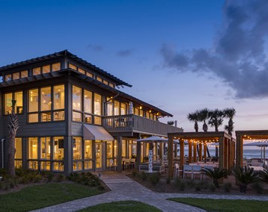
CABA Smart Buildings Summit, produced by AGORA Ron Zimmer (CABA)
CABA
SMART BUILDINGS
SUMMIT
PRODUCED BY:
September 15-17, 2019
Sawgrass Marriott Resort & Spa | Ponte Vedra Beach, FL
31

Slide 32
9. Adjournment Trevor Nightingale (National Research Council)
Next IBC Meeting, August 8, 2019
Continental Automated Buildings Association (CABA) caba@caba.org www.CABA.org
www.caba.org/ibc
Connect to what’s next™

