Slide 1
Intelligent Buildings Council (IBC)
Chair: Trevor Nightingale (National Research Council)
Vice-Chair: Robert Lane (Robert H. Lane and Associates Inc.)
Vice-Chair: Bob Allan (The Siemon Company)
Vice-Chair: Harsha Chandrashekar (Honeywell International Inc)

Slide 2
1. Agenda Greg Walker (CABA)
1. Agenda
2. Call to Order, Welcome, Introductions, about IBC
3. Administrative
“Impacts of Automated Shading in Building Projects” (30 min)
Justin Fransila (Somfy Systems, Inc.) Mudit Saxena (Vistar Energy Consulting) John Edwards (Window Products Management)
5. Research Update
6. White Paper Sub-Committee Update
7. New Business
8. Announcements
9. Adjournment

Slide 3
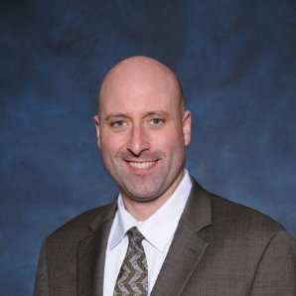
2. Call to Order, Welcome, Introductions, About the IBC Trevor Nightingale (National Research Council)
IBC Vice-Chair
Trevor Nightingale
Director
National Research Council
IBC Vice-Chair
Robert Lane
President & Managing Partner
Robert H. Lane and Associates Inc.
IBC Vice-Chair
Bob Allan
Global Business Development Manager, Intelligent Buildings
The Siemon Company
IBC Vice-Chair
Harsha Chandrashekar
Product Approvals & Regulatory Leader
Honeywell International Inc
The CABA Intelligent Buildings Council works to strengthen the large building automation industry through innovative technology-driven research projects. The Council was established in 2001 by CABA to specifically review opportunities, take strategic action and monitor initiatives that relate to integrated systems and automation in the large building sector. The Council's projects promote the next generation of intelligent building technologies and incorporates a holistic approach that optimizes building performance and savings.
www.caba.org/ibc

Slide 4
3. Administrative Trevor Nightingale (National Research Council)
3.1 Motion to approve past IBC Minutes: www.caba.org/ibc

Slide 5
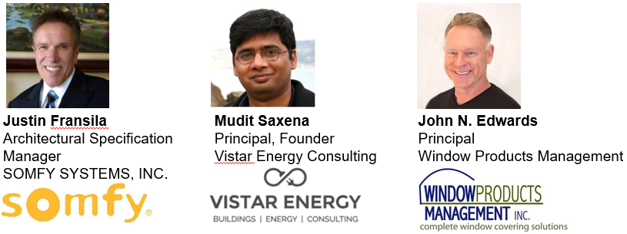
4. Keynote Speaker Harsha Chandrashekar (Honeywell International Inc.)
“Impacts of Automated Shading in Building Projects” (30 min)

Slide 6
Mudit Saxena
Vistar Energy Consulting

Slide 7
We Spend Over 80% of Our Lives Inside Buildings …

Slide 8
Windows - An Essential Element of Our Indoor Experience
Views provide an essential link to the outside world
Exposure to daylight kickstarts internal circadian cycles

Slide 9
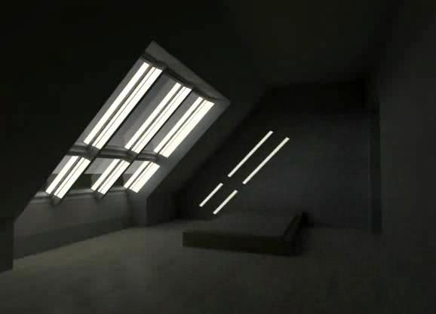
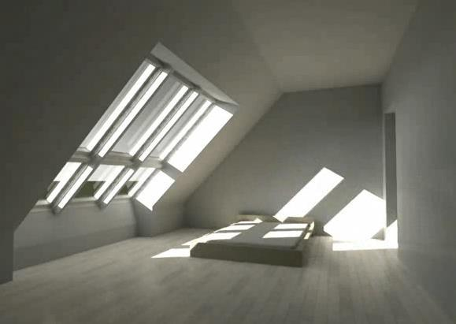
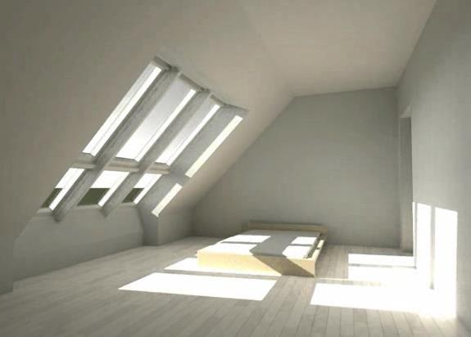
But Designing Windows Can Be Challenging
Light, heat and glare from a window changes multiple times over a single day
And in unpredictable ways!

Slide 10
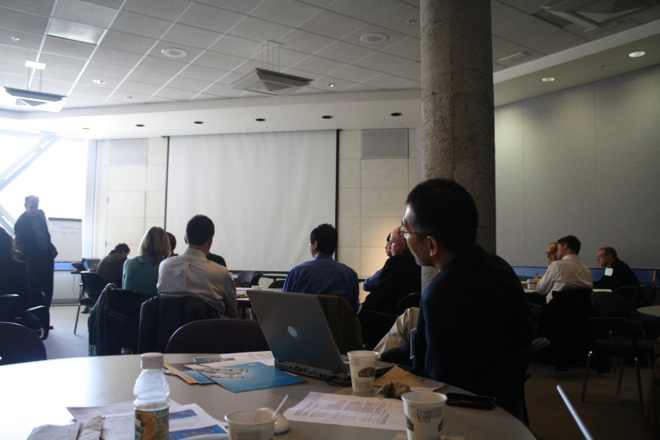
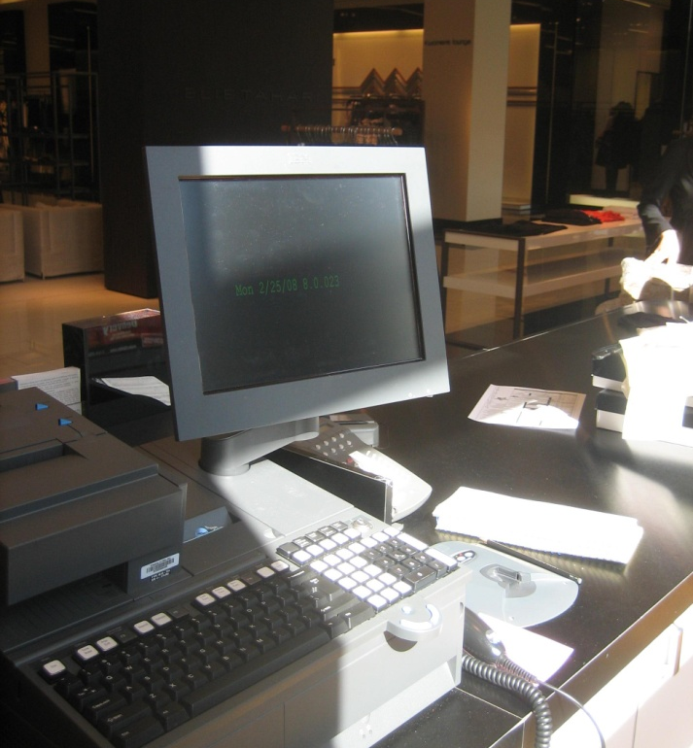
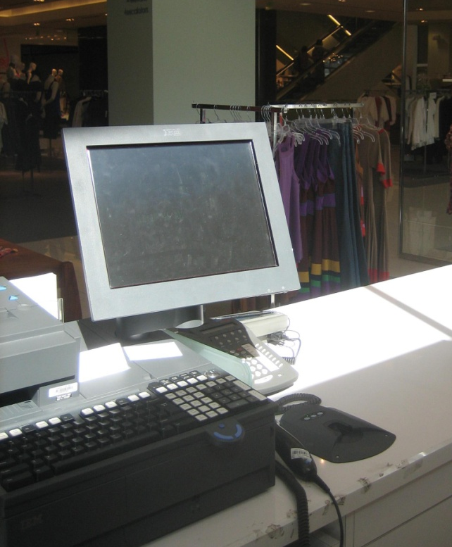
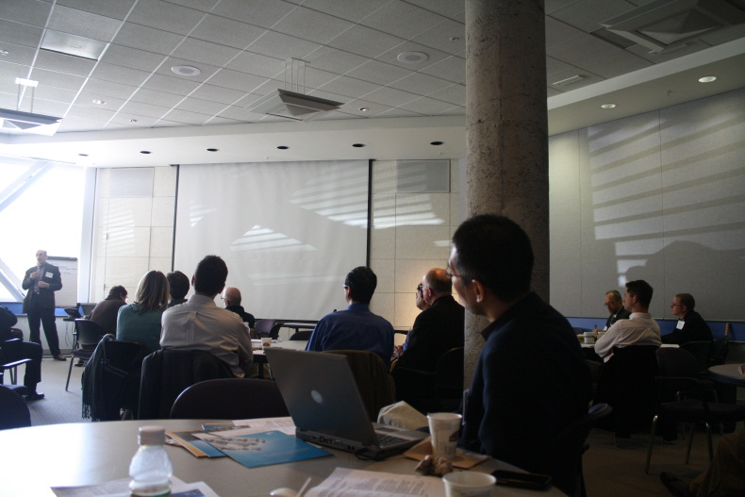
Are We Asking Too Much from A Window?
A window is a static solution to an essentially “dynamic” problem …

Slide 11
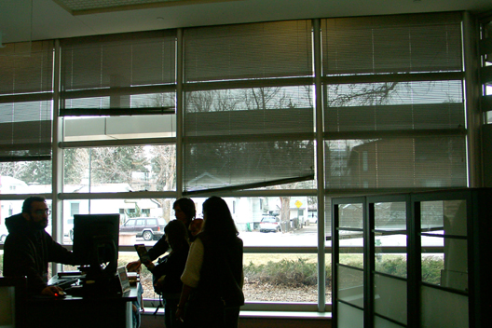
Our Solution Has Been Manual Blinds/Shades
So … What’s wrong with manual blinds/shades??

Slide 12
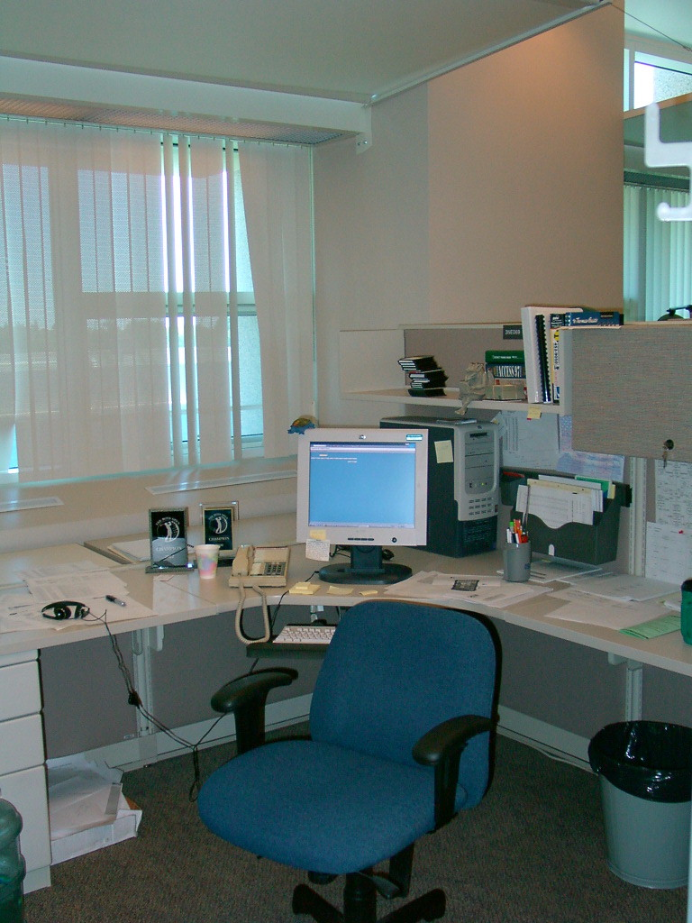
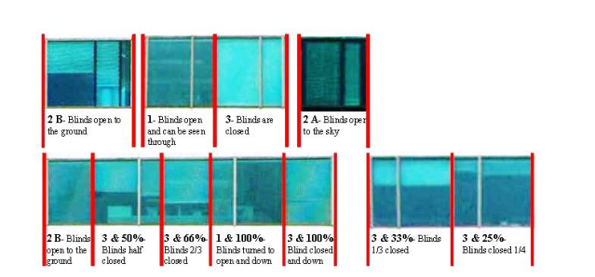
Can We Really Rely On People to Operate Shades Efficiently?
2017 Study by Univ. of Oregon:
51% of occupants did not change their window shades position even once.
20% adjust the shades once or so annually
24% seasonal users
6% actively adjusting shades daily
Unoccupied cubicles
… blinds left closed all day?
Nezamdoost, Amir, and Kevin V.W. Wymelenberg. 2017. "Blindswitch 2017: Proposing A New Manual Blind Control Algorithm for Daylight and Energy Simulation." 2017 IES Annual Conference Proceedings.

Slide 13
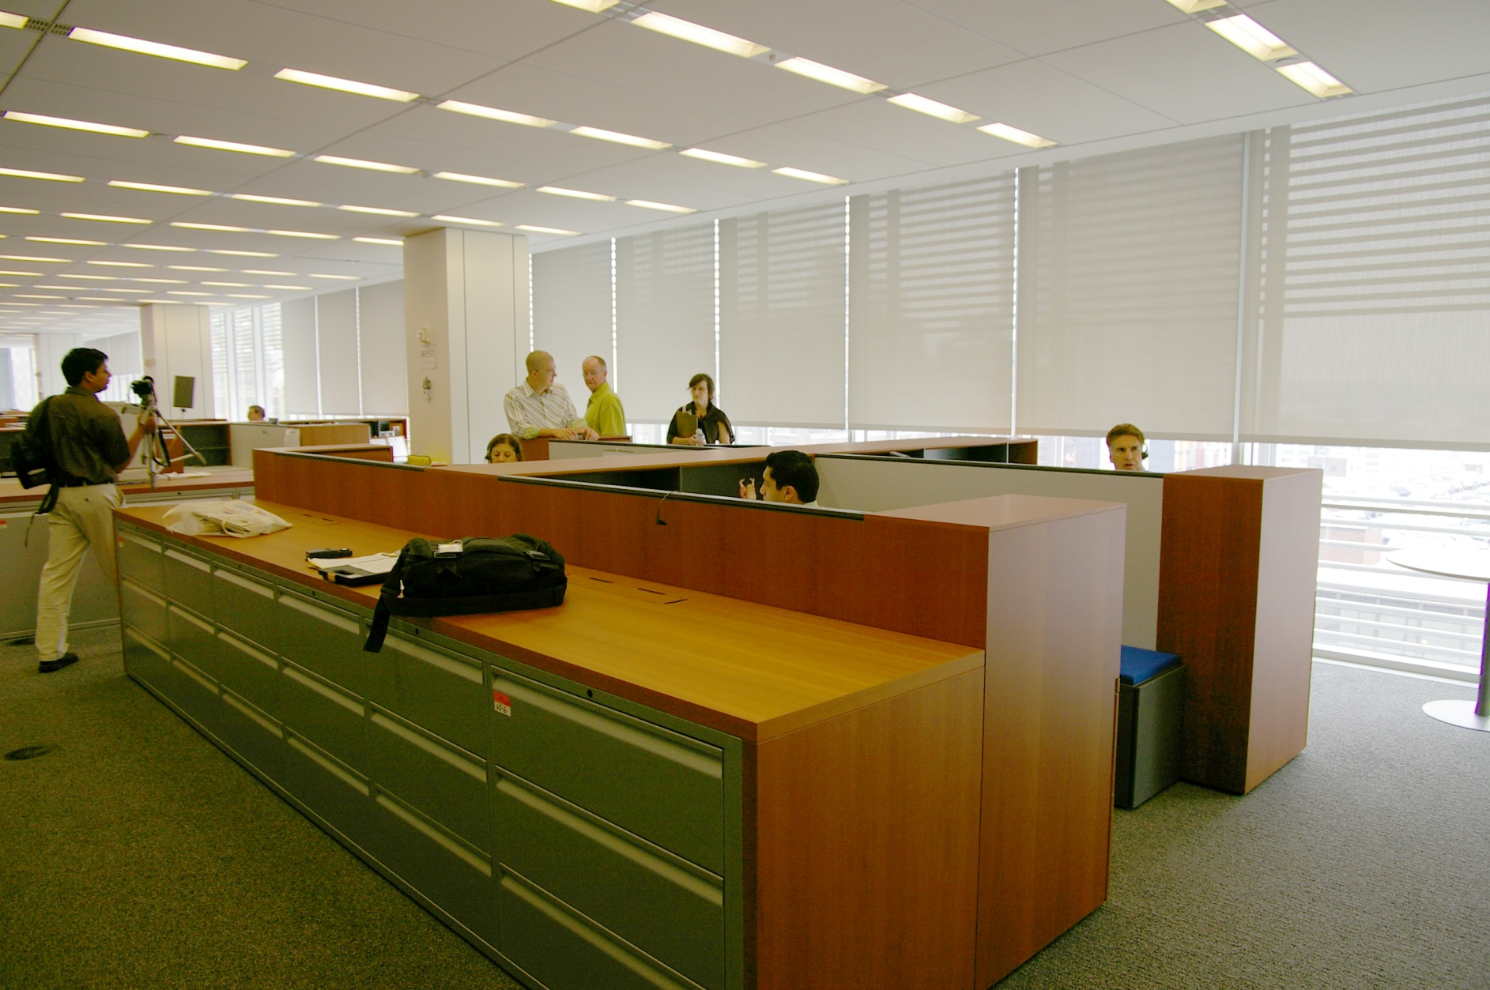
Benefits of Automating Window Shades
Energy Benefits
More predictable Indoor Illuminance – Daylight is better managed, removing uncertainty (Studies* show up to 37% increased lighting energy savings)
Better Occupant Comfort – Consistent indoor climate and reduced exposure to direct sun
Better Management of Window Heat Exchange – Shades deployed at the right time rejects excess heat gain
Automated shades in New York Times Building, NY
* Saxena, Mudit, Stephanie Berkland, and Peter Turnbull. 2014. "Measuring the Daylighting Impact of Automated and Manually Operated Shades." 9th Energy Forum - Advanced Building Skins Conference.

Slide 14
Benefits of Automating Window Shades
Productivity Benefits
Higher student performance – in glare-free daylit classrooms (Studies* show increase of 7% - 21%)
Higher office worker performance – with better access to views and windows (Studies** show productivity increase of 6% - 12%)
* Heschong Mahone Group. 2003. Windows and Classrooms: A Study of Student Performance and the Indoor Environment. (CEC PIER).
** Heschong Mahone Group. 2003. Windows and Offices: A Study of Office Worker Performance and the Indoor Environment. (CEC PIER)
$30 spent on rent
$300 spent on employee salary & benefits
$3 spent on utilities
3 – 30 – 300
Rule

Slide 15
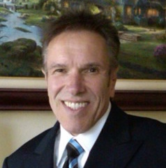
Justin Fransila
Somfy Systems Inc.

Slide 16
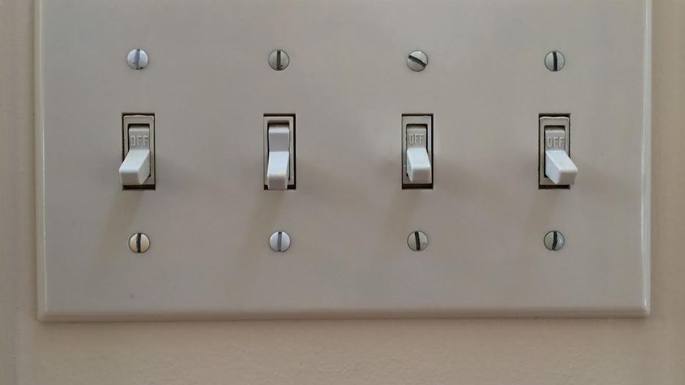
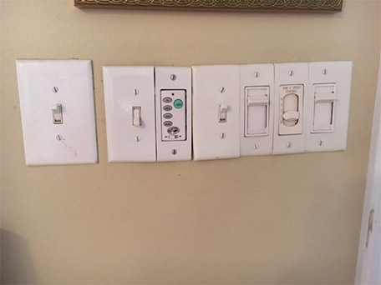
Benefits of Automating Window Shades
Technology Evolution in the early years :
Automation was cumbersome and costly
Systems were not versatile – one switch per motor
Line Voltage motors only
Motors were noisy and not acceptable in certain environments
Integration was not possible

Slide 17
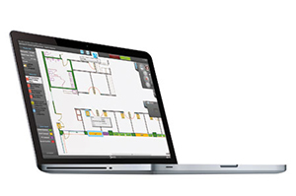
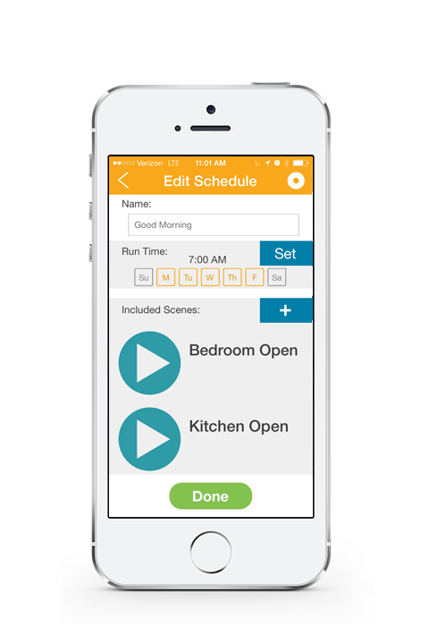
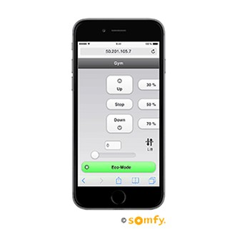
Benefits of Automating Window Shades
Technology Today:
Costs have come down considerably and are much less complex
Systems can be controlled in any configuration
Motors available in all typical power options – AC/DC/Battery/Solar/POE
Motors are virtually silent
The “internet of things” includes automating window shades

Slide 18
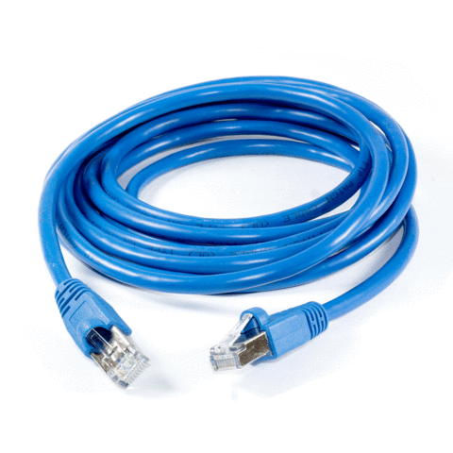
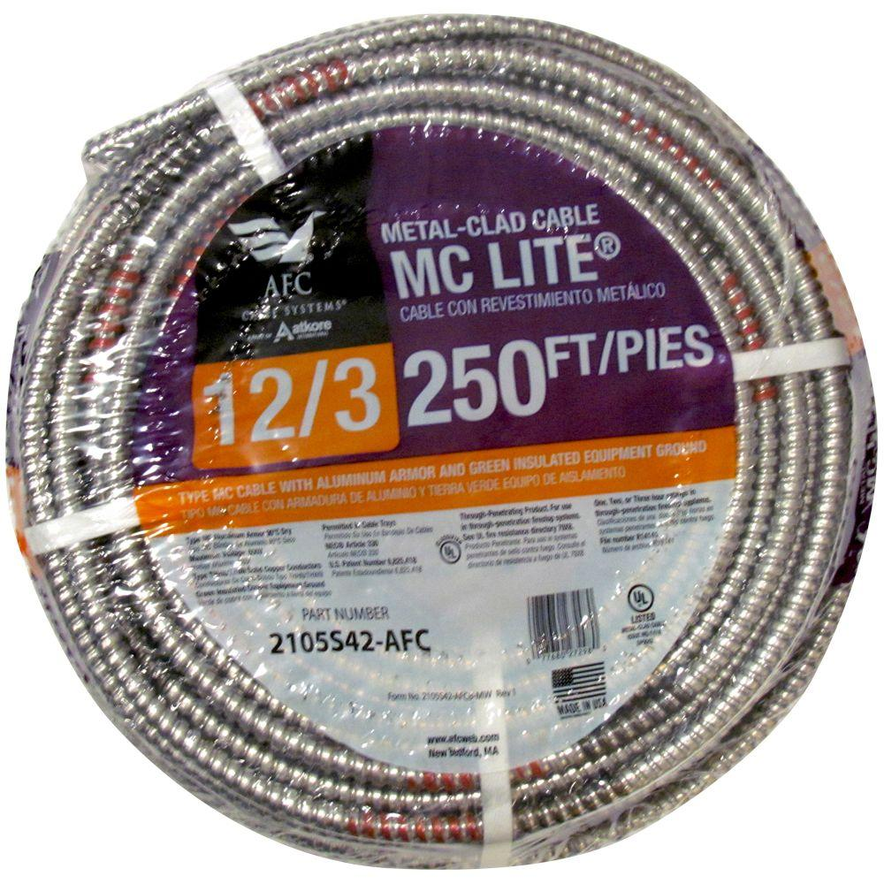
Benefits of Automated Window Shades
Technology Tomorrow:
Integrated “Power over Ethernet” motors
Motors will directly connect to “Structured Cable” systems that provide power and communication without ancillary components
Infrastructure costs will be significantly lowered and the concept will become much more accessible

Slide 19
Benefits of Automation of Window Shades
Considerations on “How” to Specify:
What is the objective – in most cases, the expectation is that the window shade only be lowered and raised, as needed –this can be done in a simple and cost-effective manner but it needs to be spelled out at the beginning
Where is the project located – most buildings only require a simple solution, although buildings in the downtown core may require more thought and therefore a more sophisticated solution, due to shadows and reflected glare –
How is the system to be operated – is it stand alone or integrated – connection and operation via lighting controls is simple, though commonly misunderstood – professionals can assist in the explanation
What is the “Budget” – establish that at the beginning, in order that the appropriate solution can be recommended, rather than “no solution” at all

Slide 20
John Edwards
Window Products Management

Slide 21
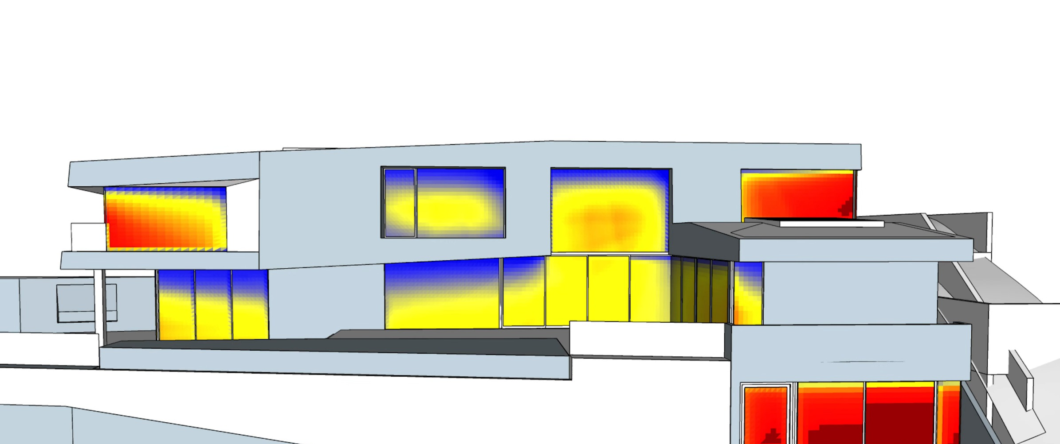
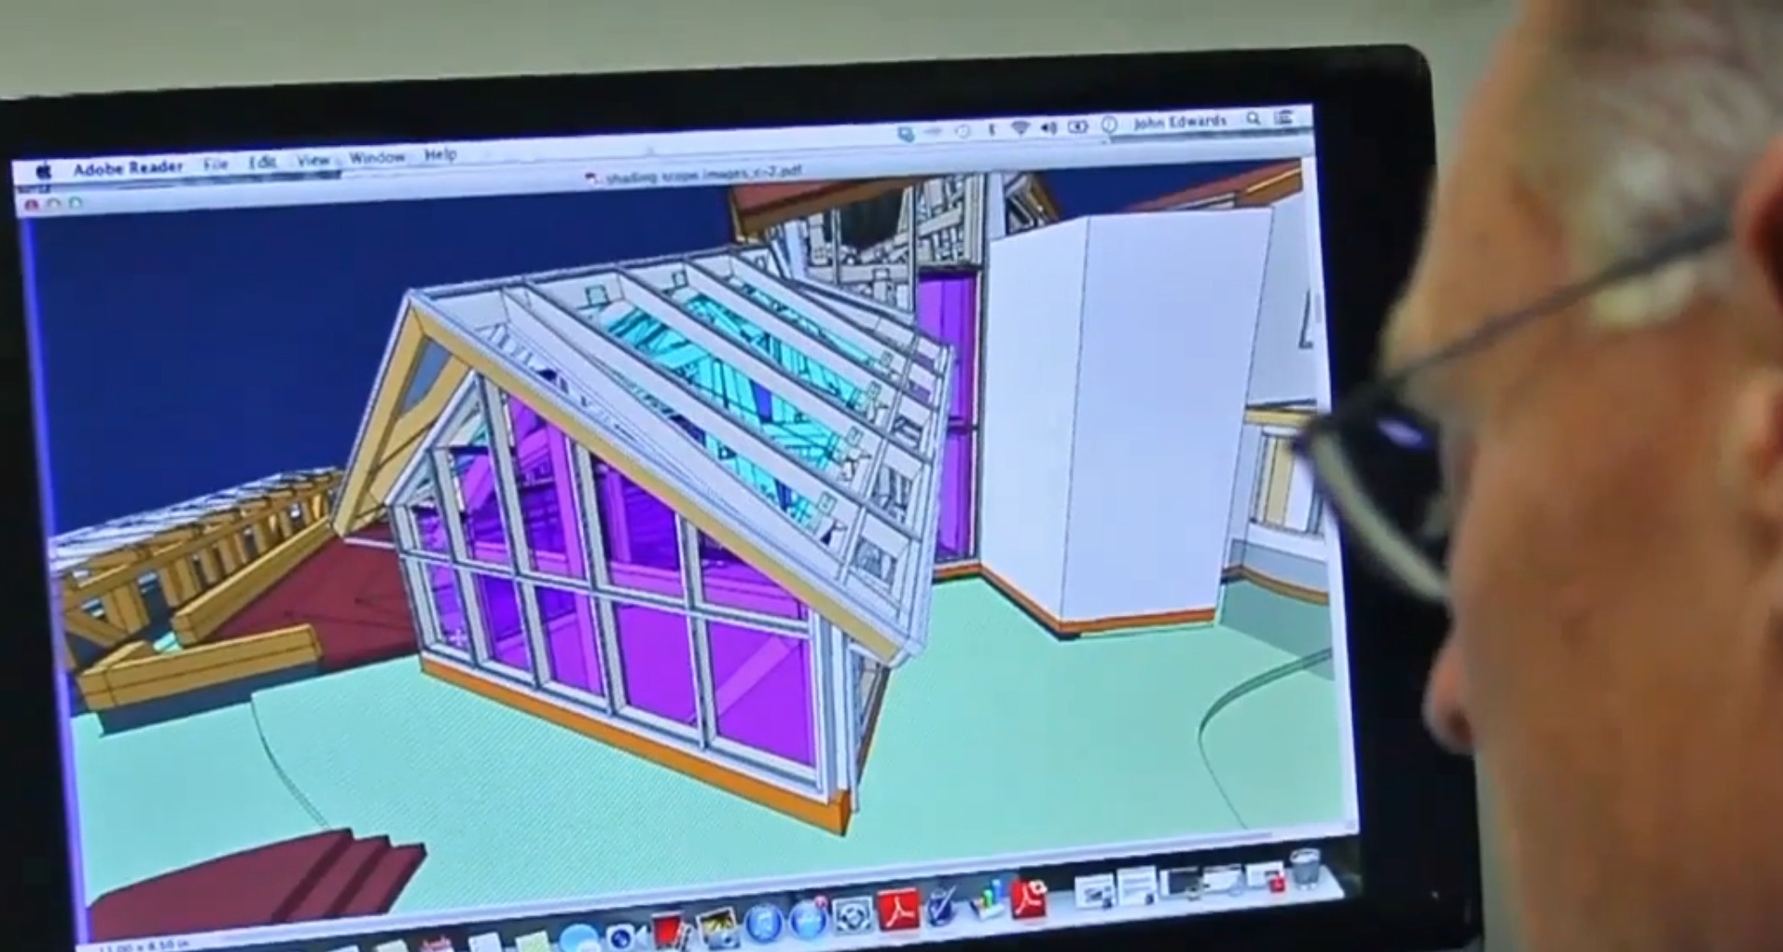
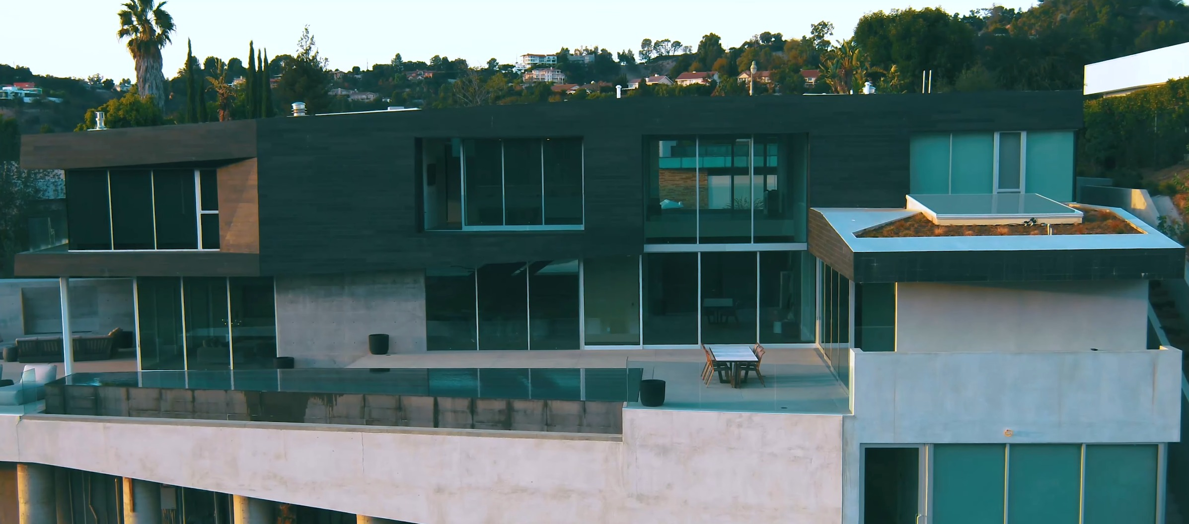
Strategies for improving Windows in Building Design
1. Utilize Computer Simulations
2. Work with People who Understand Glass & Energy
21

Slide 22
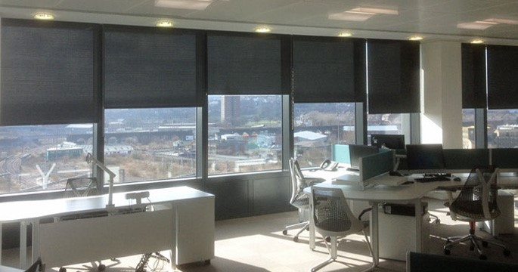
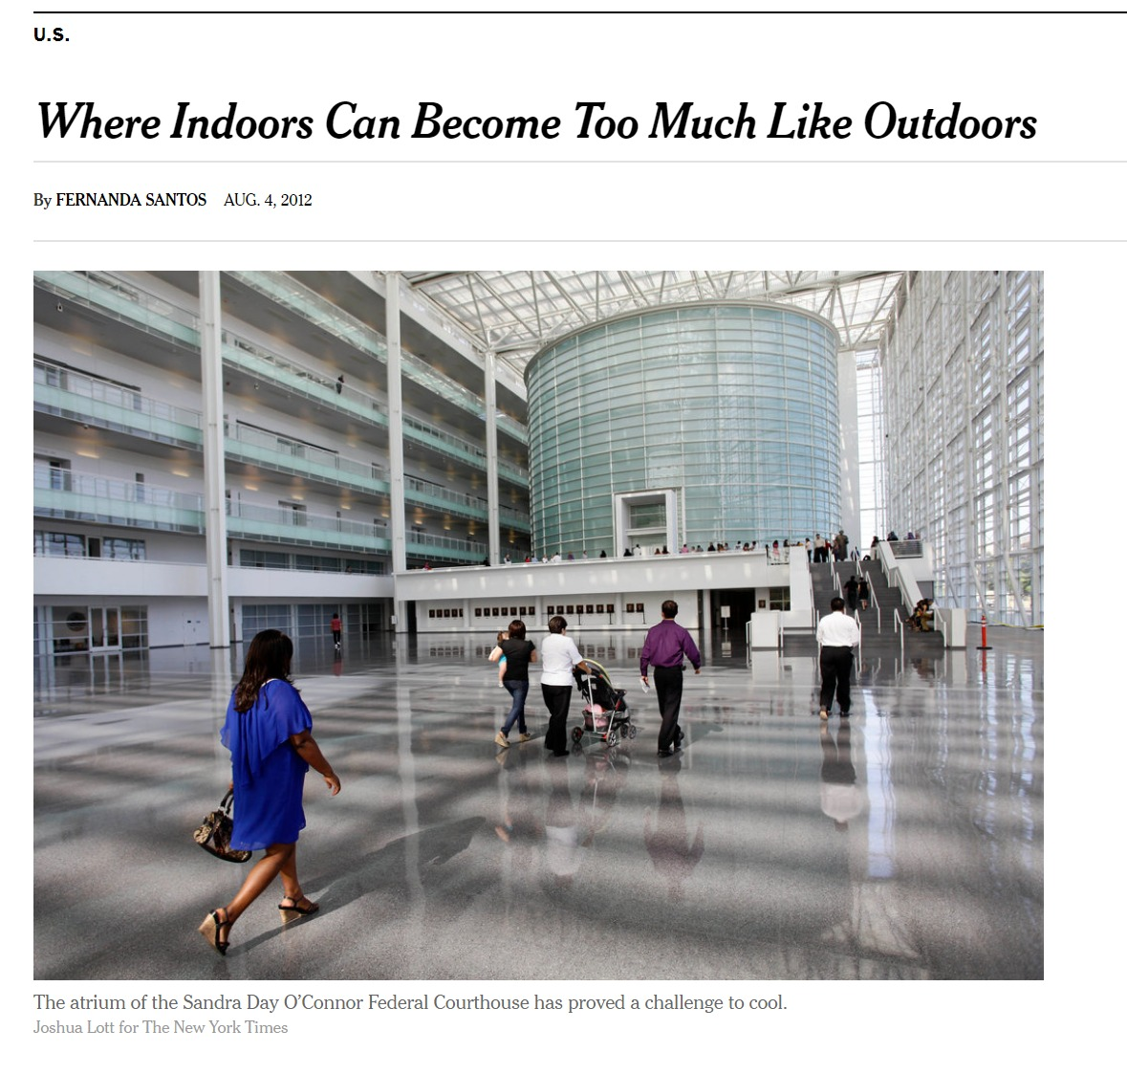
Designers & Builders often create Undesirable Architectural Features on Accident
Black Shade Material behind Window Glass
acts as a Trombe Wall
-
Heating the Building... even when it is not desired
A Green House… In the Desert!
22

Slide 23
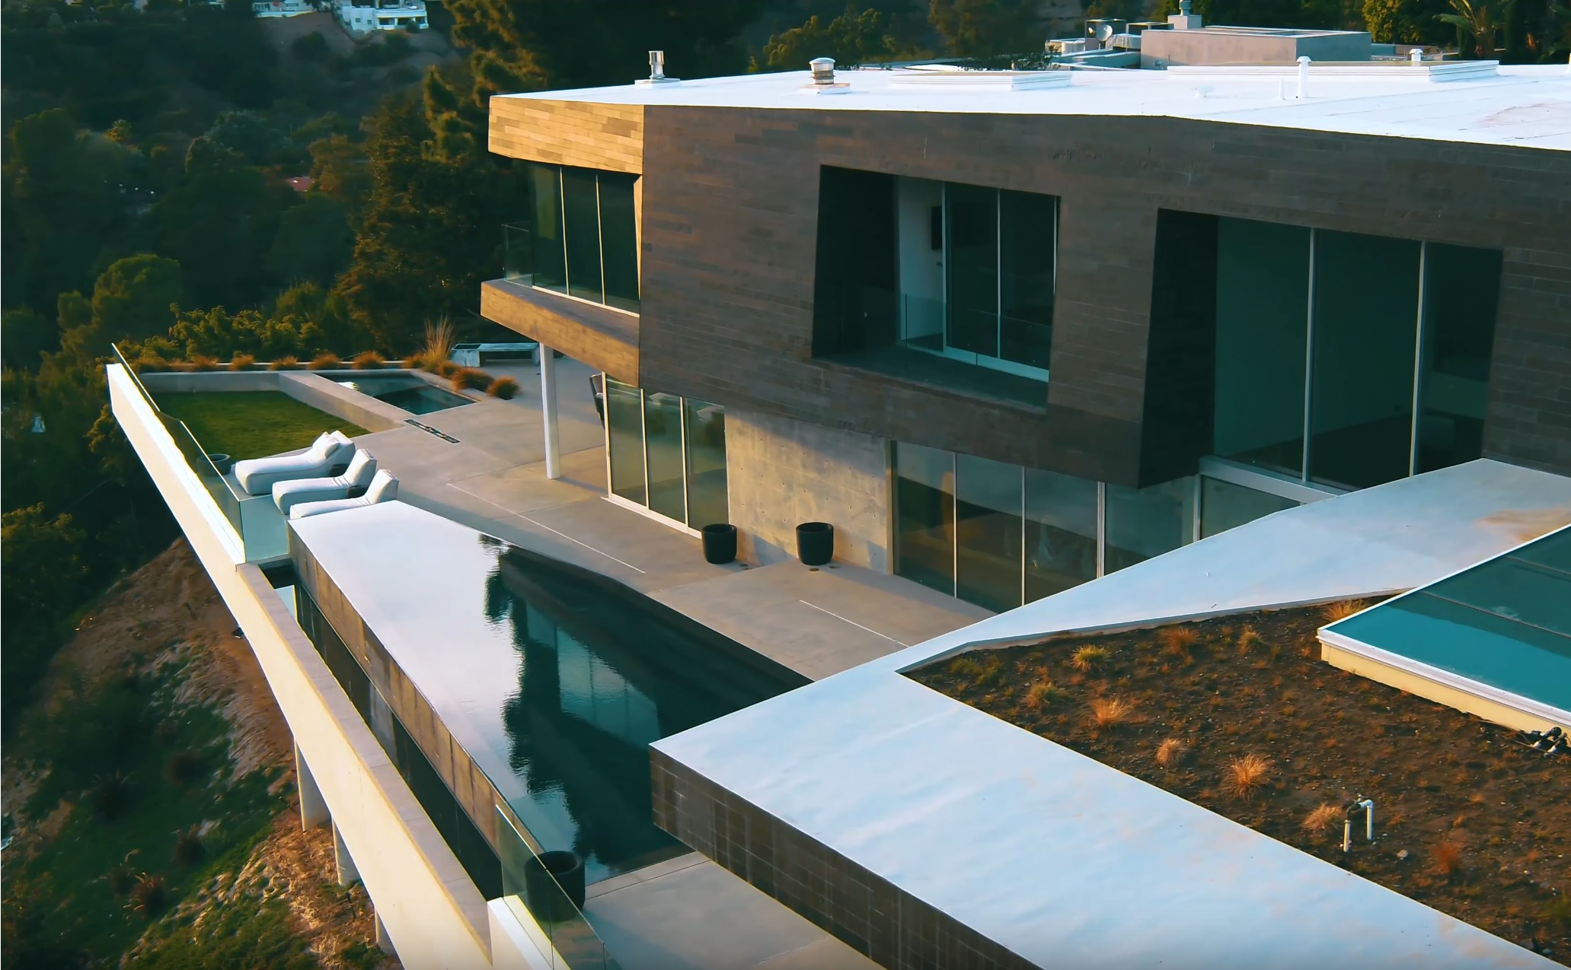
Poorly Guided Efforts can become a Recipe For Disaster
7,000 Sq. Ft. Residence in Beverly Hills, California
Design Team did NOT
Understand Energy as it relates to glass
+
Wrong Glass was Ordered and Installed
+
Inappropriate Shading Material Specified
=
Home was completely
Uninhabitable
23

Slide 24
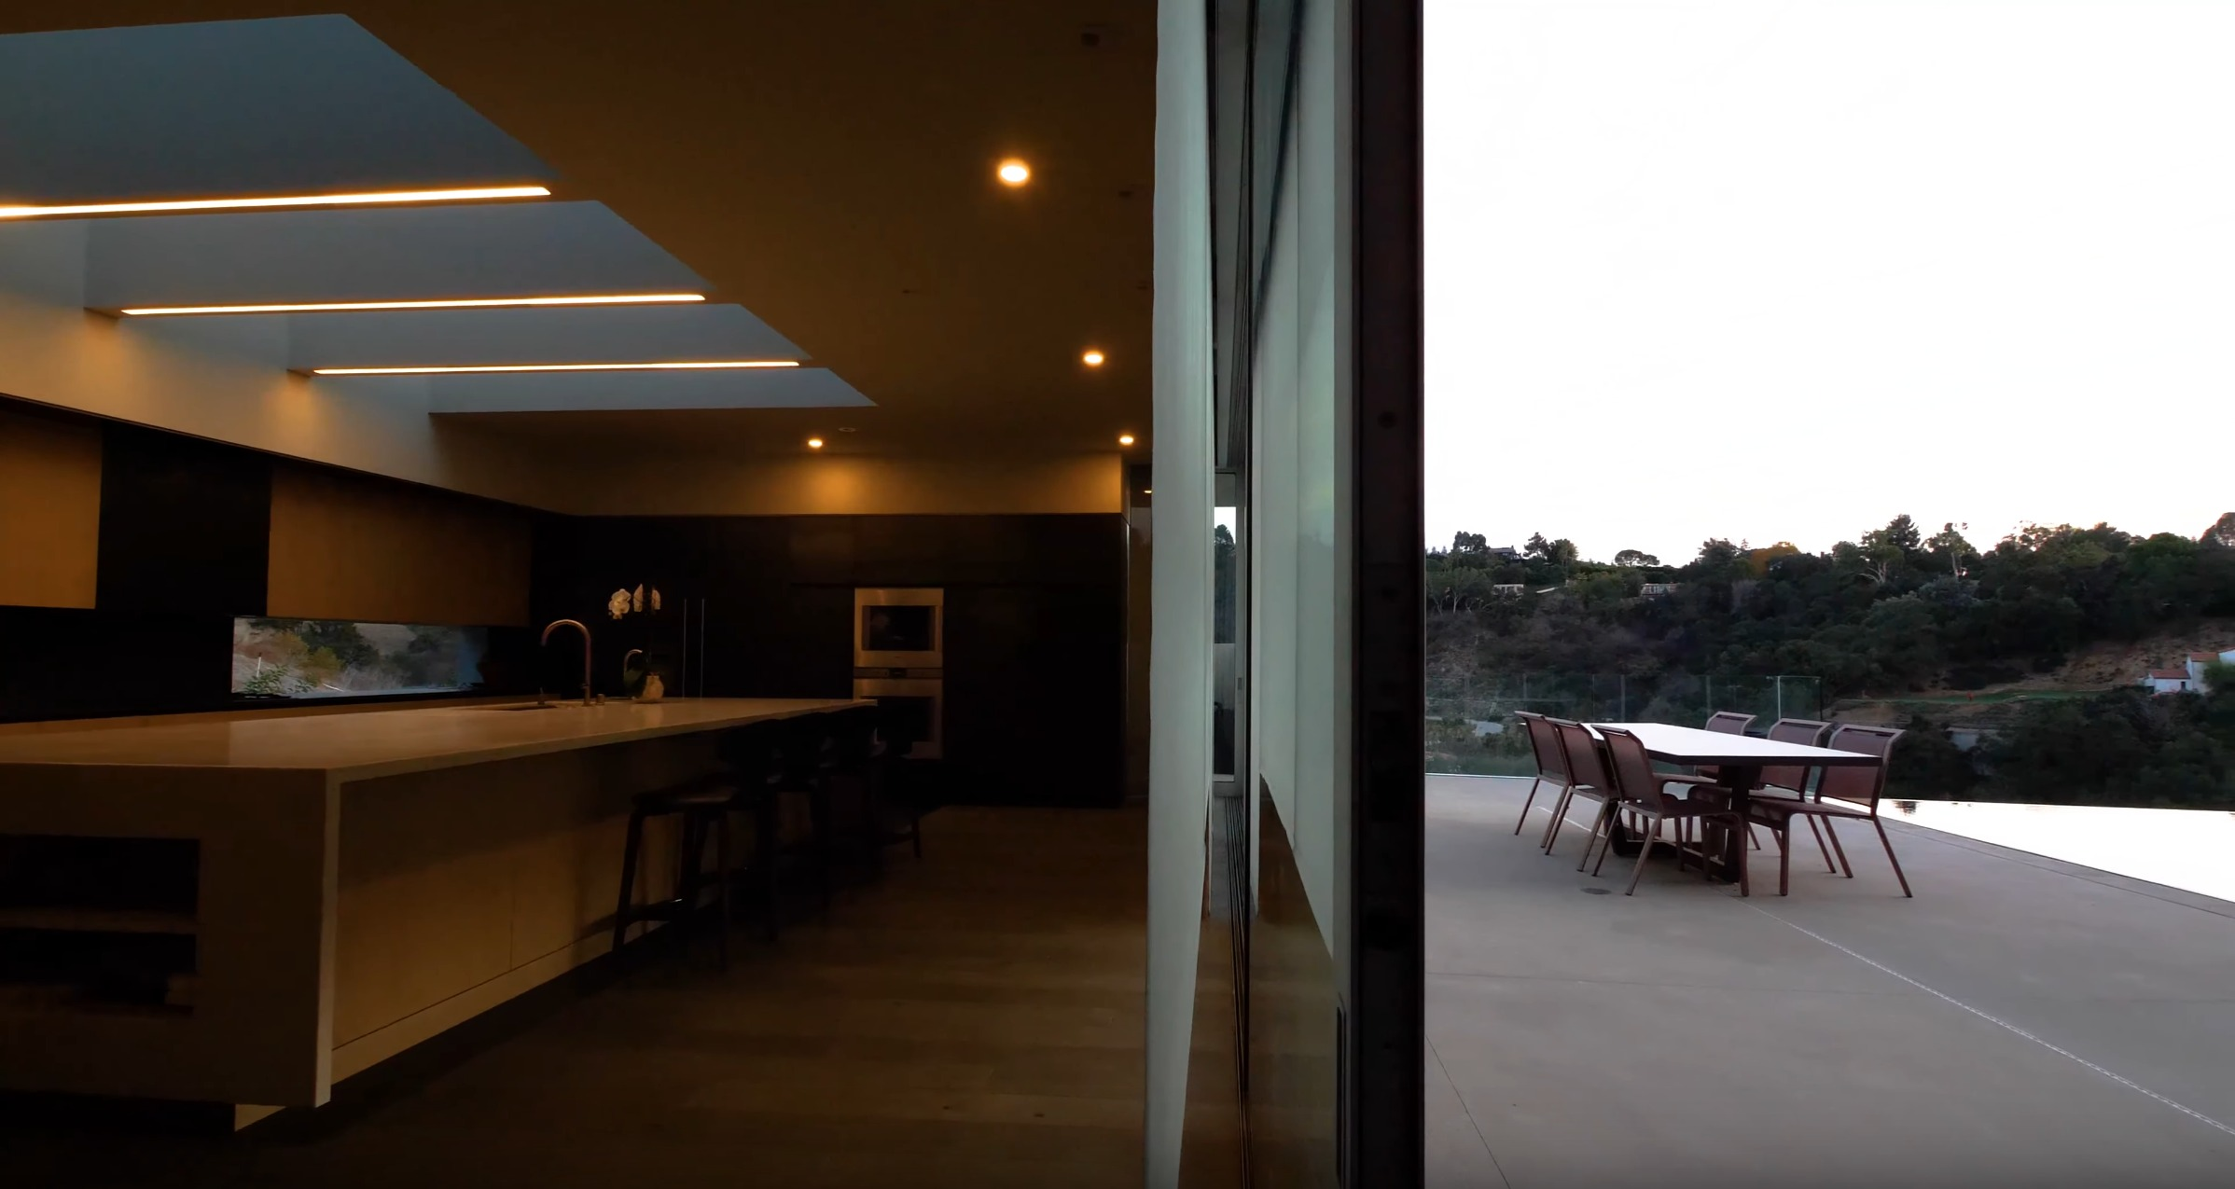
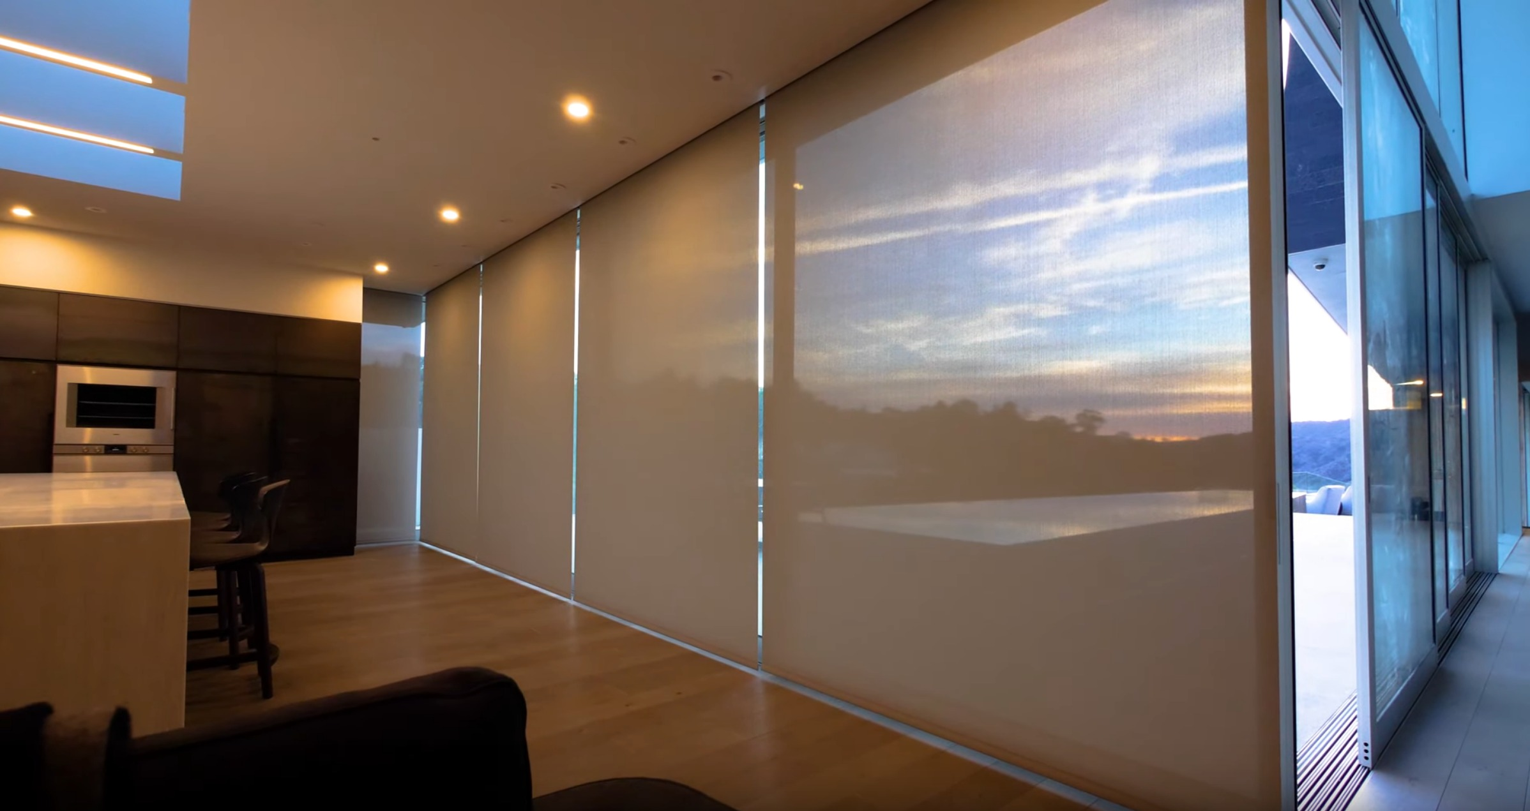
How do we fix a home such as the Beverly Hills Residence?
First… We must understand the principles of Light and Heat through glass
24

Slide 25
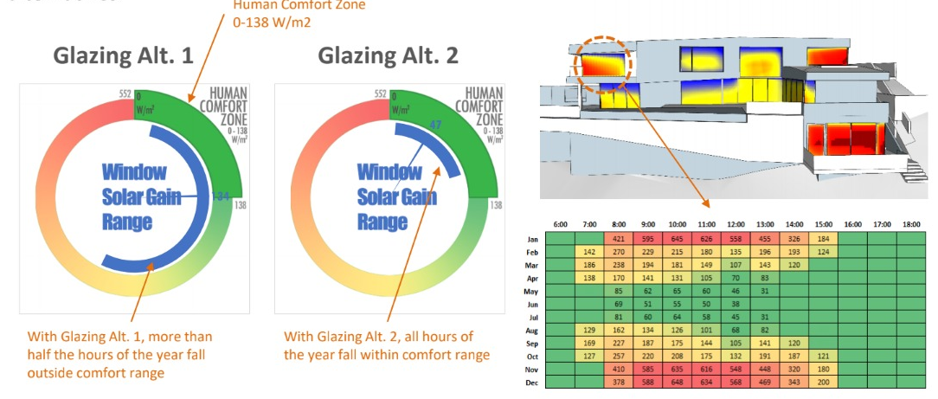
Variables such as Human Comfort are quickly becoming more understood through data
Sometimes… The best option is not the most expensive
25

Slide 26
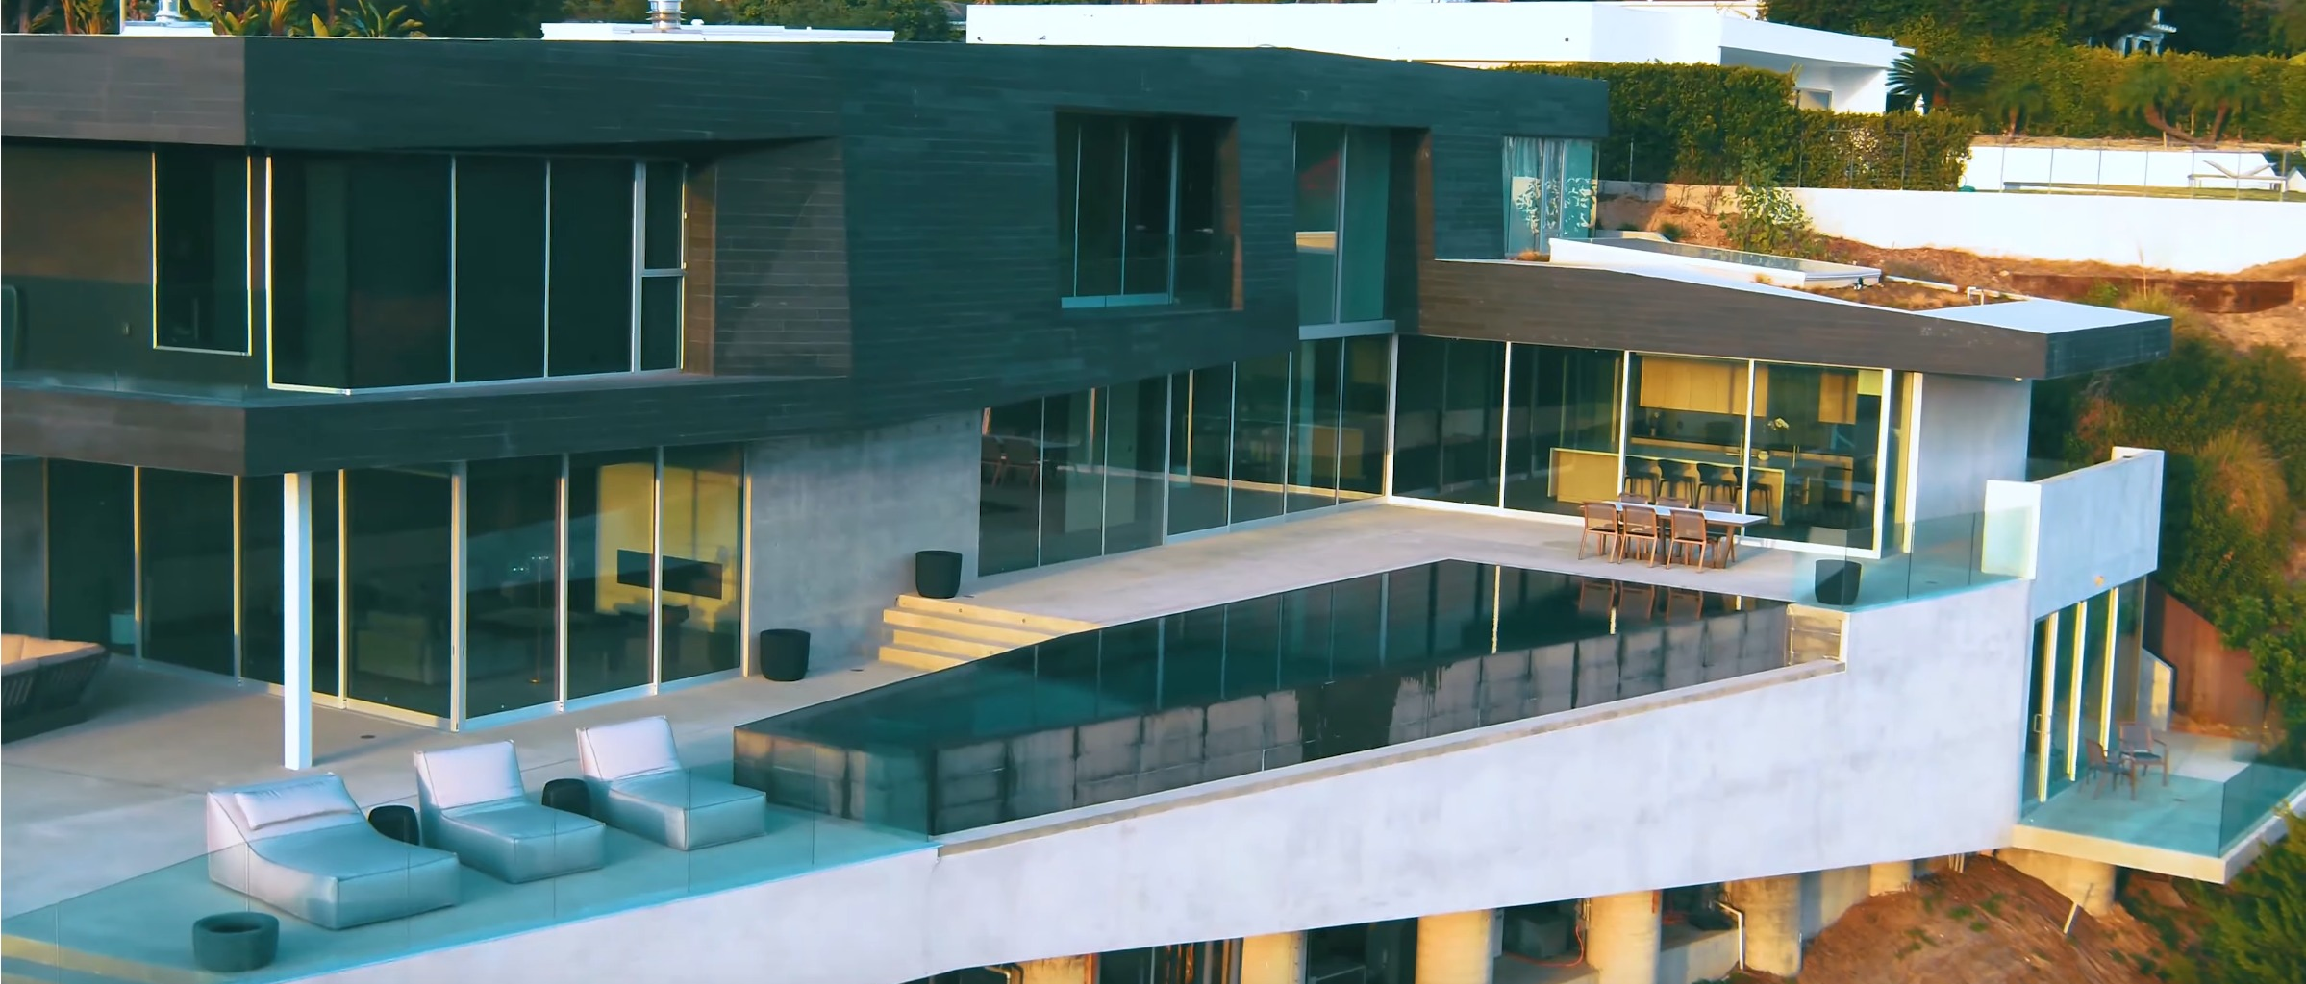
In Summary…
Automated shades are an invaluable tool available to us today
Seek input early in your project to avoid problems later
Heat exchange at the window is a complex problem, but with advanced computer tools we can identify the right solutions with ease
The right shades can fix problems even after buildings are built
So it’s not too late to think about replacing and automating shades in your own building today!
26

Slide 27
4. Keynote - Questions? Harsha Chandrashekar (Honeywell International Inc.)

Slide 28
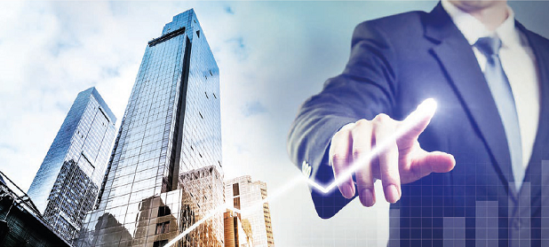
5. Research Update Robert Lane (Robert H. Lane & Associates Inc.)
5.1 “Monetization of Intelligent Buildings” IBC Research
www.caba.org/research

Slide 29
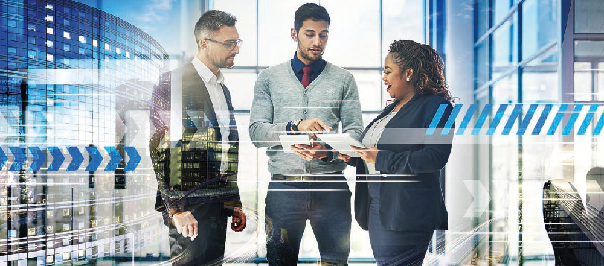
5. Research Update Trevor Nightingale (National Research Council)
5.2 2019 IBC Landmark Research “Improving Organizational Productivity with Building Automation Systems – Phase 2”
www.caba.org/research
Free Download of Phase 1: www.caba.org/productivity

Slide 30
6. White Paper Sub-Committee Update Ken Wacks (Ken Wacks Associates)
6.1 Recently Completed:
“Human Skin Cells: A Potential Source of Building Contaminants”
Environmental Diagnostic Laboratory (EDLab) at Pure Air Control Services, Inc.
www.caba.org/WhitePapers

Slide 31
6. White Paper Sub-Committee Update Ken Wacks (Ken Wacks Associates)
6.2 In Progress:
“Impacts of Automated Shading in Building Projects”
Axis
Ecotay Inc.
HunterDouglas
Ken Wacks Associates
Lawrence Berkeley National Laboratory
Legrand
Lutron
MechoSystems, Inc.
NYSERDA
PLC Multipoint, Inc.
Savant
Screen Innovations
Siemens Industry, Inc.
Somfy
Sustainable Resources Management
TRC Energy Services
Vistar Energy Consulting
Window Products Management
www.caba.org/WhitePapers

Slide 32
6. White Paper Sub-Committee Update Ken Wacks (Ken Wacks Associates)
6.2 In Progress:
“Energy Metering and Power Quality Metering in North America”
ArcoLogix LLC
Asian Institute of Intelligent Buildings
Brainwave Research Corp.
CMG
Convergint Technologies
CopperTree Analytics Inc.
Current, powered by GE
Cyber Power Systems, Inc.
Domotz
Enercare Connections Inc.
EZ Meter Technologies
Honeywell International Inc.
Ken Wacks Associates
Public Works and Government Services Canada
Renesas Electronics America Inc.
Robert H Lane and Associates Inc.
Schneider Electric
Sustainable Resources Management
Triacta Power Solutions
Zinwave
www.caba.org/WhitePapers

Slide 33
6. White Paper Sub-Committee Update Ken Wacks (Ken Wacks Associates)
6.2 In Progress:
“Automated Control Systems for Zero Emission Buildings”
Ecotay Inc.
www.caba.org/WhitePapers

Slide 34
6. White Paper Sub-Committee Update Ken Wacks (Ken Wacks Associates)
6.2 In Progress:
“IOT cyber security guidelines, standards and verification systems”
Agelight Digital Trust Advisory Group
ARC Advisory Group
ArcoLogix LLC
Automation Standards Compliance Institute
BC Hydro
CANASA (Canadian Security Association)
Compass Intelligence, LLC
Consultant
Control4
CopperTree Analytics Inc.
CSA Group
Domotz
eMcRey
EXP
George Brown College
Honeywell International Inc.
Johnson Controls Inc.
Ken Wacks Associates
LonMark International
National Electrical Manufacturers Association (NEMA)
RYCOM Corporation
Sustainable Resources Management Inc.
Syska Hennessy Group
TC9, Inc
The Siemon Company UL LLC
www.caba.org/WhitePapers

Slide 35
6. White Paper Sub-Committee Update Ken Wacks (Ken Wacks Associates)
All proposals and previously completed IBC White Papers can be downloaded at:
www.caba.org/whitepapers

Slide 36
7. New Business Andrew Glennie (CABA)
7.1 Featured CABA Member Benefit
The CABA Information Council identifies and reviews white papers and research for the CABA Information Series, the most authoritative source for technical information in the home and large building automation sectors. CABA Information Series reports are published both in the CABA Public Research Library and the CABA Member Research Library.
www.caba.org/cic

Slide 37
7. New Business Robert Lane (Robert H. Lane & Associates Inc.)
7.2 Other new IBC business?

Slide 38
8. Announcements Ron Zimmer (CABA)
8.1 Past Event Overview:
Greenbuild International Conference & Expo, Nov 14-16, Boston, MA
AHR EXPO HVACR Trade Show, Jan 14 – 16, Chicago, IL
8.2 Upcoming events:
DistribuTECH, Feb 5 – 7, San Antonio, TX
International Wireless Communications Expo (IWCE), Mar 4-8, Las Vegas, NV
ISH, Mar 11-15, Frankfurt, Germany
ISC West - International Security Conference & Exposition, Apr 10-12, Las Vegas, NV
2019 Haystack Connect, May 13-15, San Diego, CA
Internet of Things World, May 13-16, Santa Clara, CA
LIGHTFAIR International 2019, May 21-23, Pennsylvania, PA
CABA Smart Building Summit, Sep 15-17, Ponte Vedra Beach, FL

Slide 39
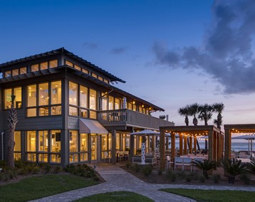
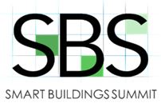
CABA Smart Buildings Summit, produced by AGORA Ron Zimmer (CABA)
CABA
SMART BUILDINGS
SUMMIT
PRODUCED BY:
September 15-17, 2019
Sawgrass Marriott Resort & Spa | Ponte Vedra Beach, FL
39

Slide 40
9. Adjournment Trevor Nightingale (National Research Council)
Next IBC Meeting, April 2019
Continental Automated Buildings Association (CABA) caba@caba.org www.CABA.org
www.caba.org/ibc
Connect to what’s next™

