Slide 1
Intelligent Buildings Council (IBC)
Chair: Trevor Nightingale (National Research Council)
Vice-Chair: Harsha Chandrashekar (Honeywell International Inc)
Vice-Chair: Robert Lane (Robert H. Lane and Associates Inc.)
Vice-Chair: Bob Allan (The Siemon Company)
Vice-Chair: Terrence DeFranco (Iota Communications, Inc.)

Slide 2


1. Agenda
Greg Walker (CABA)
1. Agenda
2. Call to Order, Welcome, Introductions, about IBC
3. Administrative
“Cybersecurity and Intelligent Buildings” (30 minutes)
Larry O’Brien (ARC Advisory Group)
5. Research Update
6. White Paper Sub-Committee Update
7. New Business
8. Announcements
9. Adjournment

Slide 3










2. Call to Order, Welcome, Introductions, About the IBC
Trevor Nightingale (National Research Council)
IBC Chair
Trevor Nightingale
Director General
National Research Council
IBC Vice-Chair
Harsha Chandrashekar
Product Approvals & Regulatory Leader
Honeywell International
Inc
IBC Vice-Chair
Terrence DeFranco
President and Chief Financial Officer
Iota Communications, Inc.
IBC Vice-Chair
Robert Lane
President & Managing Partner
Robert H. Lane and Associates Inc.
IBC Vice-Chair
Bob Allan
Global Business Development Manager, Intelligent Buildings
The Siemon Company
The CABA Intelligent Buildings Council works to strengthen the large building automation industry through innovative technology-driven research projects. The Council was established in 2001 by CABA to specifically review opportunities, take strategic action and monitor initiatives that relate to integrated systems and automation in the large building sector. The Council's projects promote the next generation of intelligent building technologies and incorporates a holistic approach that optimizes building performance and savings.
www.caba.org/ibc

Slide 4

3. Administrative
Trevor Nightingale (National Research Council)
3.1 Motion to approve past IBC Minutes (Nov 25): www.caba.org/ibc

Slide 5

4. Keynote
Harsha Chandrashekar (Honeywell International Inc)
“Cybersecurity and Intelligent Buildings” (30 min)

Slide 6
Intelligent Buildings and Cybersecurity

Slide 7


Speaker
Larry O’Brien
VP of Research – ARC Advisory Group
Member of Cybersecurity and smart Cities Team
Over 25 years of experience

Slide 8
ARC Research on Cybersecurity and Smart Buildings
Quantitative and qualitative research for end users-owner/operators and suppliers
Cybersecurity for OT/ICS environments
Building Automation
Smart Cities (transportation, lighting, smart city platforms, etc.)

Slide 9
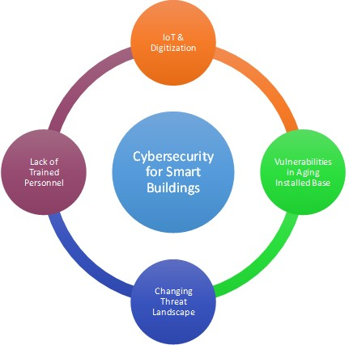
Primary End User Challenges in Cybersecurity for Smart Cities & Buildings
Processes
Technology
People
Cybersecurity for Smart Cities

Slide 10
Economic Impact of Cyber Attacks in Cities and Communities: Recent Ransomware Attacks
Florida – Lakeland City, small town of 12,000 residents, $460K ransom
Atlanta – More than $17 million?
Texas – 22 Mostly rural communities: cost undisclosed
Not just a big city problem, smaller and rural communities are particularly vulnerable.
A ransomware attack may put a major dent in a city’s budget, but it can completely paralyze and bankrupt a small town.
Better funding is needed for municipalities and better coordination at a state level for resources, including training.

Slide 11
IT/OT Convergence: OT Level Cybersecurity Threats
In simple terms, OT is the domain of systems and sensors that control the things that act in the physical world.
In addition to the built environment, smart city OT domains include power distribution networks, microgrids, gas pipelines, water distribution networks, security cameras, and so on.
OT systems have the potential to provide extreme efficiency in the applications they control or to wreak extreme havoc.
The new generation of cyber-attacks, many of which appear to be sponsored by nation states with almost unlimited resources, are sophisticated multistage attacks designed to gain control over OT systems and cause disruption, chaos, and potential loss of human life

Slide 12
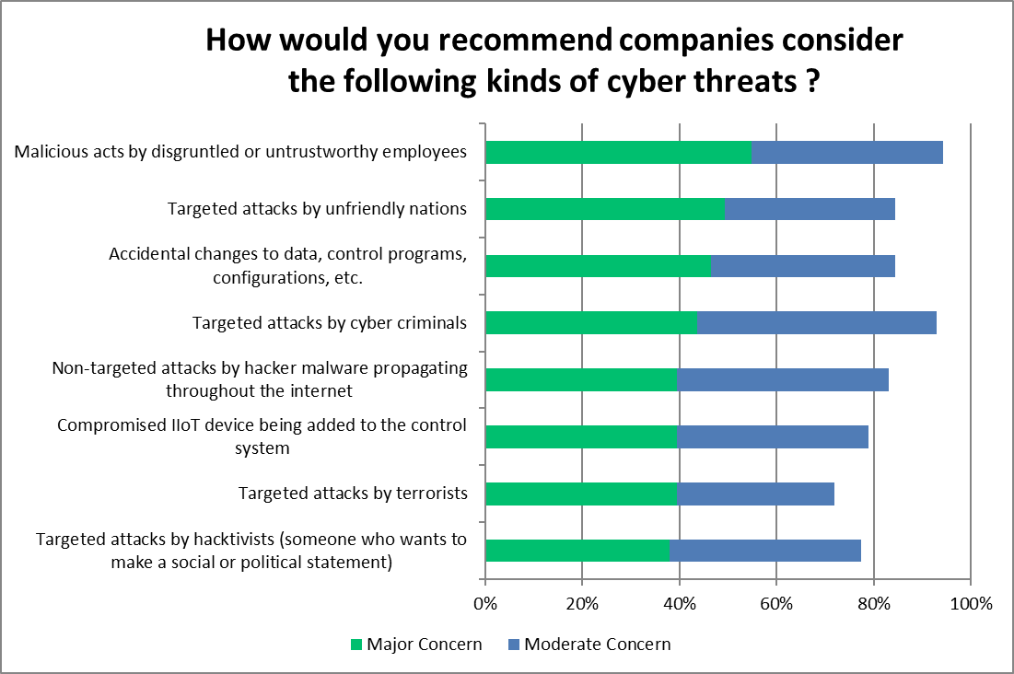
The Evolving Threat Landscape
Ransomware gets headlines and can cripple communities
Threats go beyond simple ransomware
New age of threats focuses specifically on operations and aims to impact equipment in the physical world
Recent ARC Survey Showing End User Concern with Different Kinds of Attacks

Slide 13
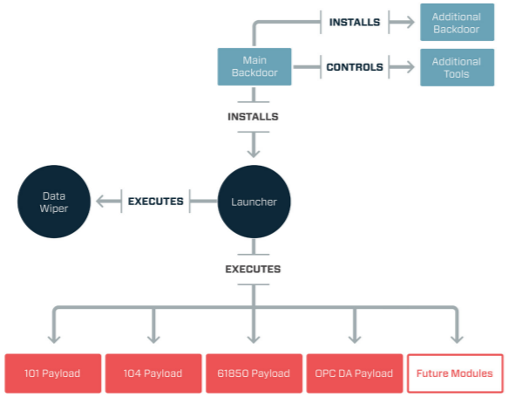
What Future Cyber-attacks on Smart Cities will Look Like
Modular Structure of CRASHOVERRIDE Malware Reveals New Level of Sophistication in Targeted Infrastructure Malware
(Source: Dragos)

Slide 14
Lockheed Martin Cyber Kill Chain Framework Documents the Stages of a Cyber Attack
(Source: Lockheed Martin)
Ransomware is like throwing rocks.
Coordinated OT level attacks are like an organized military operation.
Target hack through HVAC contractor followed similar methodology.

Slide 15
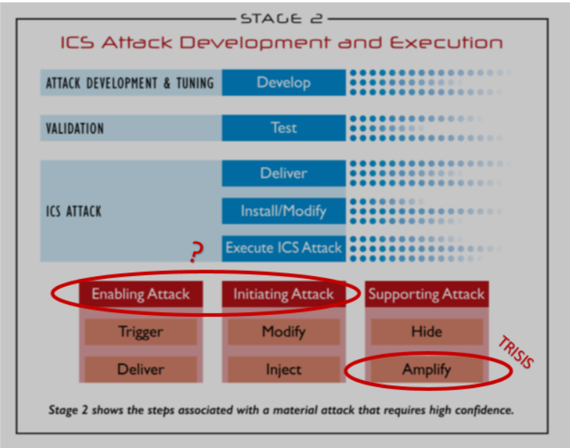
TRITON Changed the Game
Hydrocarbon Processing Plant in the Middle East
Multi-phased, and prolonged cyber-attack that resulted in a safe plant shutdown in August of 2017
Breach was enabled through multiple security lapses
Deny the ability of the plant or process to shut down safely
Within Stage 2 of the ICS Cyber Kill Chain, TRISIS/TRICON Can Be Viewed as a Supporting Attack
(Source: SANS Institute)

Slide 16
Impact of IoT and Edge Technologies on Cybersecurity
IoT is really a catch all term that encompasses a suite of new technologies being adopted by today’s smart cities and buildings.
Cloud computing (which includes multiple definitions), edge and fog computing, analytics, machine learning, AI, networking technologies (MQTT), wireless infrastructure, 5G – all are part of IoT suite of technologies.
These technologies are being driven into many new products at a rapid rate.
Not everyone understands or considers the cybersecurity implications of these technologies and how they find their way into products and applications.
IoT also means connected. Millions of sensors, controllers, and computing devices.
Many large end users and owner/operators are struggling with how to balance the innovation of IoT and the business value that it brings with the associated (and sometimes significant) risk to secure and dependable operations.
Cybersecurity should be part of your selection criteria for products, systems, and applications.

Slide 17
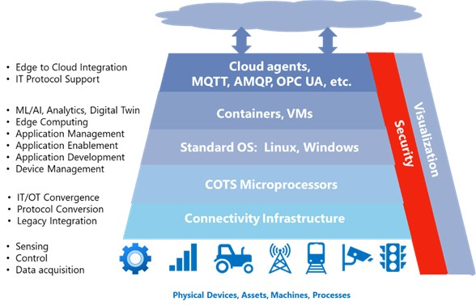
For IoT, the Edge is Where the Rubber Meets the Road

Slide 18
The Business Value of IoT: Building Automation Use Case
Rapid adoption of IoT-based systems with the promise of significantly reduced operational costs is driving rapid growth in the building and facility automation marketplace.
The major objectives of these systems are to improve occupant comfort, reduce energy consumption and total cost of ownership, operate building systems efficiently, and increase the lifecycle of utilities.
Digitizing these systems presents a huge opportunity to reduce energy and operational costs for building or facility owner-operators.
Commercial buildings consume over 70 percent of the electricity produced in the US.
Many buildings are older and incorporate dated legacy technology and could significantly benefit from retrofitting the building control infrastructure to help reduce total cost of ownership and enhance security and safety.

Slide 19
Zero Trust Cybersecurity Schemes and IoT
Security remains one of the leading inhibitors to widespread adoption of Industrial IoT applications.
Zero trust security, where the hardware doesn’t trust the software and vice versa, is emerging as the baseline for edge implementations.
End-to-end secure encrypted network designs are necessary.
The migration toward using Linux and other standard operating systems coincides with a migration away from secure by configuration, which relies on implementation, to a secure by design emphasis that enables more standardized approaches.

Slide 20
IoT, Connectivity, and Managed Services
IoT has created a new wave of remote monitoring, managed service providers, and millions of new remote connections for things like performance monitoring, predictive maintenance, etc.
Exploiting security flaws at trusted third parties is often used as a tactic to gain entry into end user owner/operator sites.
Target hack is an example of this. Remote monitoring of HVAC systems.
TRITON also used this technique, harvesting credentials for control system access from a third party.

Slide 21
Organizations Need Integrated Cybersecurity Strategies
Siloed Programs Can’t Address All of the Issues
Today
Tomorrow
ICS-IT-IIoT
ICS
Systems
Systems
IT
Control Systems
IT Systems
IIoT
IoT
Control Systems
IT
Systems
IIoT
IoT
IIoT Environment & Cloud
IIoT Environment & Cloud
OT
IT
OT
IT
IoT and IIoT
Devices
Devices
Notes:
Now let me summarize all of this by referring to what we have been telling our industrial clients about the changes they need to consider in their cybersecurity programs.
Today, most of these companies are managing their cyber assets with individual, siloed cybersecurity programs
ICS cybersecurity is responsible for the plant and SCADA control systems.
IT cybersecurity is responsible for enterprise systems, cloud interfaces, and IoT devices like cameras, etc.
IIoT cybersecurity is just emerging and is generally defining their responsibilities to be secure devices.
Each of these programs makes their own decisions about strategies and technologies, based upon their limited responsibilities.
But, this will never work for the kinds of situations I just discussed. They require end-to-end security spanning of all of these elements.
Industrial companies are already struggling with ICS attacks through IT systems like email, and the broad connectivity of the IIoT will add to the challenges they face in identifying, isolating and remediating cyber compromises.
Unless they have an integrated strategy, they will never be able to support the new, innovative programs using IIoT.

Slide 22
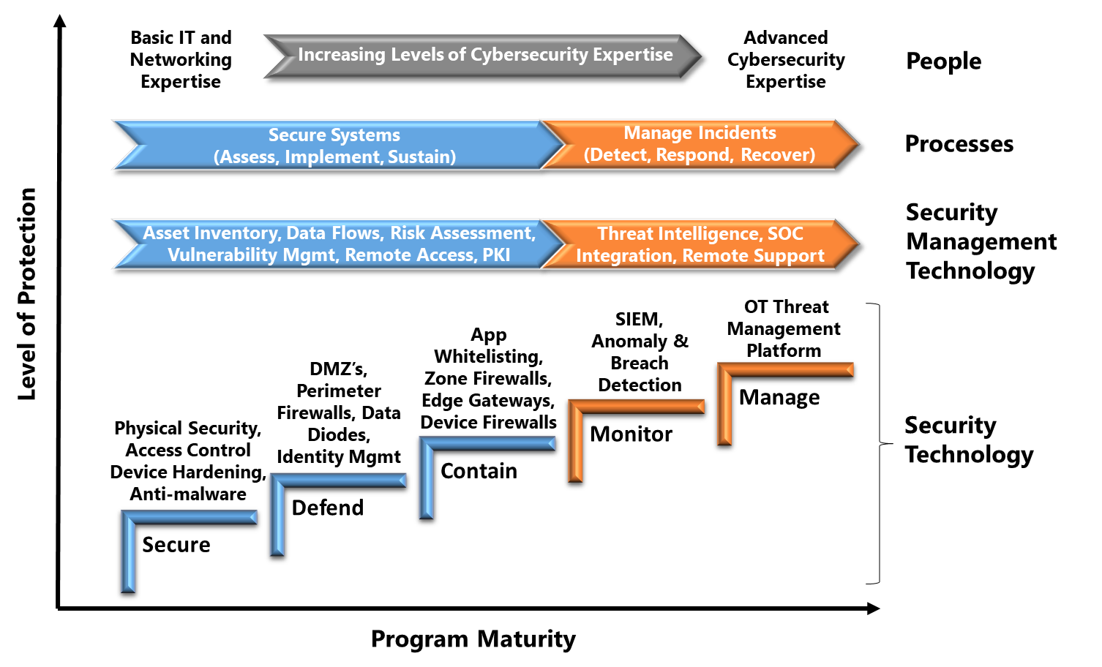
ARC Industrial Cybersecurity Maturity Model

Slide 23
Key Standards and Industry Groups at the OT Level
ISA 62443
NIST Framework
ISO 27000
NERC CIP
DHS

Slide 24
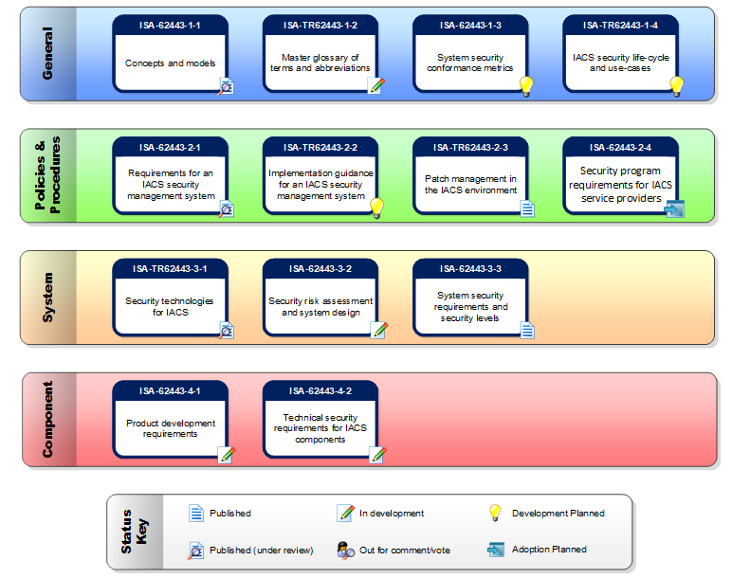
ISA/IEC 62443 Cybersecurity Standard
http://isa99.isa.org/ISA99%20Wiki/Home.aspx

Slide 25
ISA Secure Certification
The ISA Security Compliance Institute (ISCI), a neutral, not-for-profit consortium manages the ISASecure certification process.
ISASecure certifications assess conformance to a subset of the IEC 62443 series.
ISA-Secure certifies commercial-off-the-shelf (COTS) products and product supplier development lifecycle practices, for conformance with applicable parts of the IEC 62443 series.
ISASecure has an initiative with CABA for certifying products for building control system (BCS) applications.

Slide 26
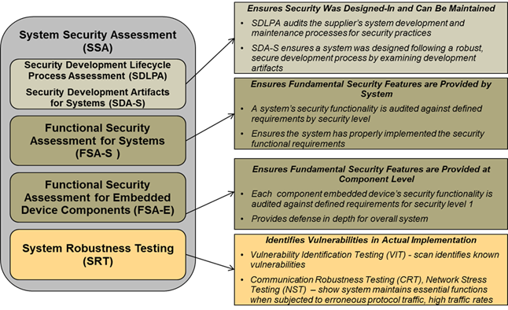
ISA SSA Security Assessment Process

Slide 27
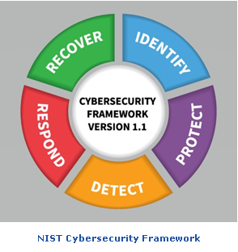
NIST Cybersecurity Framework
The US Commerce Department’s National Institute of Standards and Technology (NIST) has received considerable recognition over the past few years for developing the Cybersecurity Framework (CSF), now widely used as the basis for establishing effective security management systems.

Slide 28

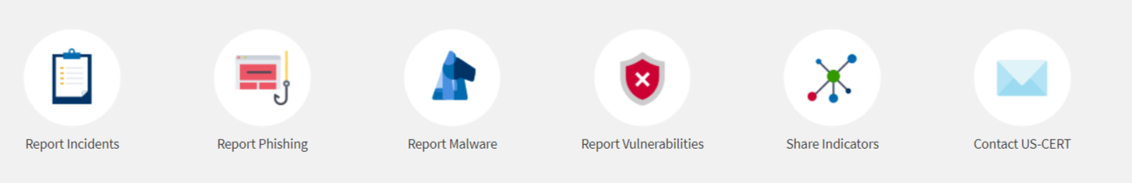
CISA/US-CERT

Slide 29
CSET Tool
The Cyber Security Evaluation Tool (CSET®) provides a systematic, disciplined, and repeatable approach for evaluating an organization’s security posture.
CSET is a desktop software tool that guides asset owners and operators through a step-by-step process to evaluate industrial control system (ICS) and information technology (IT) network security practices.
Users can evaluate their own cybersecurity stance using many recognized government and industry standards and recommendations.

Slide 30
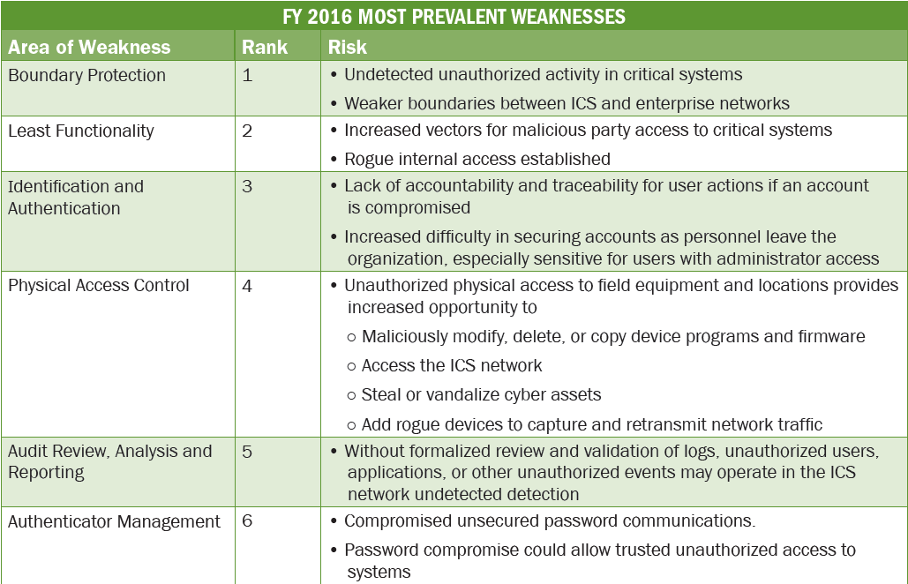
CSIA 2016 Assessment Report

Slide 31
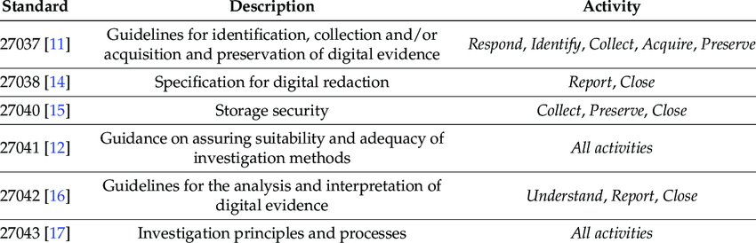
ISO 27000

Slide 32
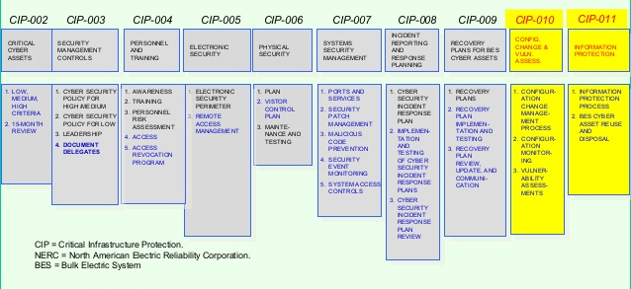
NERC CIP
NERC is committed to protecting the bulk power system against cybersecurity compromises that could lead to misoperation or instability. On November 22, 2013, FERC approved Version 5 of the critical infrastructure protection cybersecurity standards (CIP Version 5), which represent significant progress in mitigating cyber risks to the bulk power system.

Slide 33
UL 2900 Series of Standards

Slide 34
Developing Cybersecurity Policy & Expertise in Your Organization
Cybersecurity does not equal buying and installing products.
Having a good cybersecurity strategy does not have to involve huge investments in technology and training. A sound strategy and standard policies can provide significant benefits.
You Need A Good Response Plan: Ransomware provides a good example of the benefit of having sound cybersecurity policy and the need for a good response plan. Many owner-operators and city governments are completely caught off guard when they face a ransomware attack.
Industrial cybersecurity solutions have become increasingly sophisticated and can require a high level of cybersecurity expertise to configure and maintain. This will increase the importance of additional vendor support and training programs for the end user.
Look to SANS as an excellent source of training and certification for ICS and OT level specific cybersecurity certifications, CISSP, GCIA
ISA, DHS also offer training and resources

Slide 35
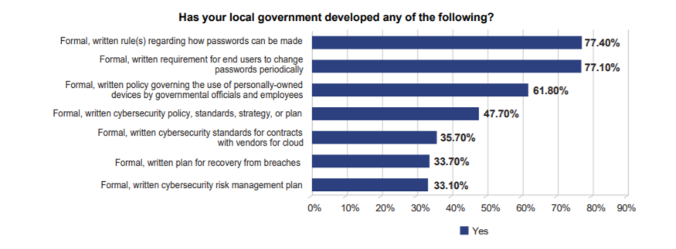
Most Smart City Owner/Operators Don’t Have Formal, Written
Cybersecurity Policies or Standards in Place
(Source: ICMA/UMBC 2016 Survey https://ebiquity.umbc.edu/_file_directory_/papers/881.pdf)

Slide 36
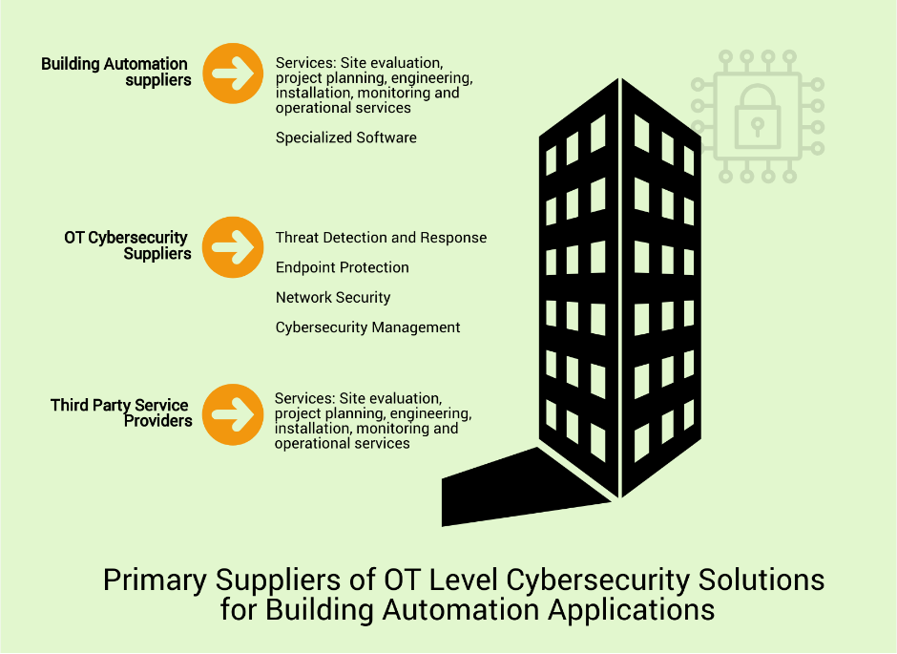
How ARC Defines the ICS/OT Cybersecurity Landscape: Building Automation

Slide 37
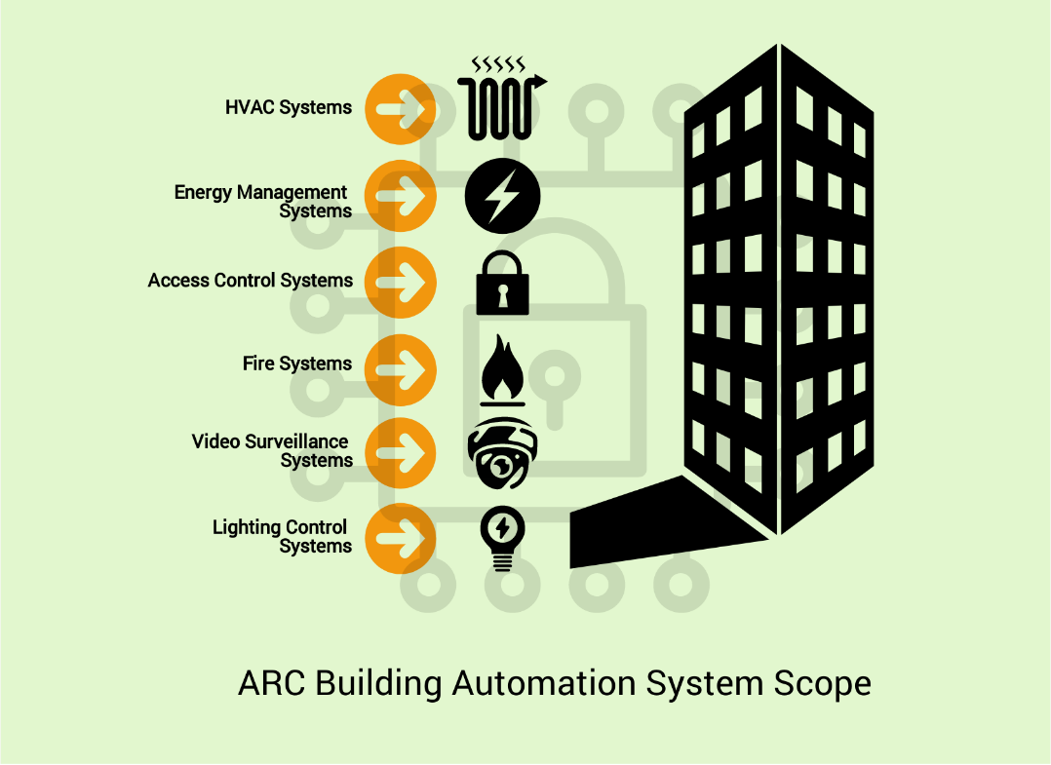
Scope of OT Level Systems in Smart Cities and Buildings is Broad

Slide 38
OT Level Cybersecurity Suppliers
Range of products for monitoring OT networks and endpoint assets. These products enhance system security through detection of latent compromises and attacks that have evaded network security and endpoint defenses
Next-generation firewalls (NGFW), industrial DPI firewalls, and products that provide secure unidirectional communications (unidirectional gateways and data diodes, which ensure secure one-way communication).
Products that actively block compromises to cyber assets within control systems. Technologies in this category include anti-malware software, application whitelisting, access control, and industrial deep packet inspection (DPI) firewalls.
Security information about cyber assets, vulnerability alerts, patches, and firmware/software/hardware updates; launchpad and integration platform for a variety of security maintenance support modules

Slide 39
Cybersecurity Supplier Classification in Building Automation

Slide 40
What to Look for, What to Question
LOTS of suppliers. Many in the startup stages, with relatively small numbers of customers.
Will they be around in five years?
If they get acquired, will they still support you?
Alliances with OT level suppliers.
Do they understand the business?
Product certifications and standards testing.
Secure development processes

Slide 41
Some Thoughts on Cybersecurity and the Selection Process
Many end users don’t have a good handle on the landscape of ICS cybersecurity solutions.
Many end users don’t have the right cybersecurity related criteria embedded into their ICS and OT asset selection process.
“Undocumented” systems and devices currently receive the least amount of attention when it comes to cybersecurity. These obscure systems can include boiler controls, compressor controls, etc.
Different stakeholders in the organization aren’t always involved.

Slide 42
Elements of Success for Supplier Selection
Have a documentable, traceable, and fact-based selection process that proves how and why you made your decision
Bring key stakeholders together to make a consensus based decision
Have a basic understanding of the market and the leading suppliers
Make sure you have the right selection criteria
Prioritize/weight criteria, remember that everything is not of equal importance to everything else
The selection process doesn’t end with the selection. It transitions into a supplier relationship management process.

Slide 43
Summary and Conclusions
If you don’t already have a cybersecurity program or plan in place at your organization, you should take simple steps to start developing one. This presentation should give you information on the key steps needed to get started and resources.
Attacks are only going to become more sophisticated and will increasingly target actions in the physical world through compromising complex control systems and OT infrastructure.
Technology churn is driving a lot of todays cybersecurity challenges. IoT technologies used in an OT level environment need to be carefully vetted for cybersecurity risks, secure by design principles, etc.
The smart city and smart building segment needs to adopt standards. ISA/IEC 62443 should seriously be considered as the standard of reference.
Cybersecurity must be driven into the overall supplier selection process for all OT level systems and products.
Consider development of standard cybersecurity policy and response plans in your organization.

Slide 44
Resources
https://www.arcweb.com/consulting-services/cybersecurity-workshops
https://www.arcweb.com/blog/cybersecurity-viewpoints
https://www.isa.org/training-and-certifications/isa-certification/isa99iec-62443/isa99iec-62443-cybersecurity-certificate-programs/
https://www.nist.gov/topics/cybersecurity
https://www.dhs.gov/cisa/national-cybersecurity-communications-integration-center
https://www.sans.org/netwars/cybercity

Slide 45
Thank You
Questions?
Larry O’Brien
https://www.linkedin.com/in/larry-o-brien-a02685/
lobrien@arcweb.com
@dcsanalyst
@smartcityvwpts

Slide 46

4. Keynote - Questions?
Harsha Chandrashekar (Honeywell International Inc)

Slide 47


5. Research Update
Trevor Nightingale (National Research Council)
5.1 2019 IBC Landmark Research “Evidence for Building Retrofits that Improve Organizational Productivity (Phase 2)” (15 Funders)
Free Download of Phase 1: www.caba.org/productivity
www.caba.org/research

Slide 48

5. Research Update
Terrence DeFranco (Iota Communications, Inc.)
(CABA)
5.2 2020 IBC Landmark Research “Intelligent Building Energy Management Systems”
Topics: Implementation, integration, real-time monitoring, zero net energy, battery storage, grid interactions, renewables, etc.

Slide 49
6. White Paper Sub-Committee Update
Ken Wacks (Ken Wacks Associates)
6.1 Recently Completed: None
www.caba.org/WhitePapers

Slide 50

6. White Paper Sub-Committee Update
Ken Wacks (Ken Wacks Associates)
6.2 In Progress:
“Energy Metering and Power Quality Metering in North America”
ArcoLogix LLC
Asian Institute of Intelligent Buildings
Brainwave Research Corp.
CMG
Convergint Technologies
CopperTree Analytics Inc.
Current, powered by GE
Cyber Power Systems, Inc.
Domotz
Enercare Connections Inc.
EZ Meter Technologies
Honeywell International Inc.
Ken Wacks Associates
Public Works and Government Services Canada
Renesas Electronics America Inc.
Robert H Lane and Associates Inc.
Schneider Electric
Sustainable Resources Management
Triacta Power Solutions
Zinwave
www.caba.org/WhitePapers

Slide 51
6. White Paper Sub-Committee Update
Ken Wacks (Ken Wacks Associates)
6.2 In Progress:
“Multi-MHz Wireless Power Transfer and Its Commercial Applications”
Airfuel Alliance (Chair)
University of Michigan - Shanghai Jiao Tong University Joint Institute
Princeton University
www.caba.org/WhitePapers

Slide 52
6. White Paper Sub-Committee Update
Ken Wacks (Ken Wacks Associates)
6.2 In Progress:
“The Evolution of Integrating LiFi Technology into Smart Lighting and Control Systems for the Intelligent Building”
Wharton County Junior College (Chair)
Acuity Brands, Inc.
ArcoLogix LLC
Control4
National Electrical Manufacturers Association
Telecommunications Industry Association (TIA)
www.caba.org/WhitePapers

Slide 53
6. White Paper Sub-Committee Update
Ken Wacks (Ken Wacks Associates)
6.2 In Progress:
“The Ethics of AI and the IoT Connected Home and Intelligent Buildings”
ArcoLogix LLC
Enbridge Gas Inc.
George Brown College
Hydro One Networks Inc.
Ken Wacks Associates
Site 1001, Inc.
Sustainable Resources Management Inc.
Syska Hennessy Group, Inc.
Telecommunications Industry Association (TIA)
University of Toronto

Slide 54


6. White Paper Sub-Committee Update
Ken Wacks (Ken Wacks Associates)
All proposals and previously completed IBC White Papers can be downloaded at:
www.caba.org/whitepapers

Slide 55

7. New Business
Trevor Nightingale (National Research Council)
7.1 Other new IBC business?

Slide 56

7. New Business
Andre Ristaino (ISA)
7.2 CBRE Building Technology Consultancy – Cyber Roundtable
Andre Ristaino
Managing Director, ISA
Director ISA Global Cybersecurity Alliance

Slide 57



Global Facilities BMS Technology Certification Program
Discussion Document:
Proposal to Develop an Assessment and Conformance Program for Deployed Building Automation and Control Systems
National Electrical Manufacturer’s Association (NEMA)
International Society of Automation (ISA)
US Commercial Real Estate Services (CBRE)

Slide 58

Agenda
(Proposed – Yet to be Finalized)
0830-0900 Introductions & Purpose
0900-1000 Program Overview & Intent
1000-1030 Threat Assessment (DHS /DoD)
1030-1130 Collaborate on Program
1200-1300 Decide Next Steps & Timeline

Slide 59

Building Management System (BMS) Defined
Physical security systems (cameras, entry logs, cipher locks)
Physical movement systems (elevators, escalators)
HVAC
Electrical (power distribution, UPS, backup power, clean power)
Water/Wastewater
Fire Control (life-safety)
Lighting (management, distribution, POE)
BMS control networking (wireless, LiFi, wired)
Proposed Program Excludes Traditional Business & IT Networks and Systems in Initial Phases

Slide 60

Developing Program Expectations
Critical feedback sought to shape this initiative
  Is there a market need?
  Would the real estate market embrace this initiative?
  What are the risks?
  Would this initiative drive positive changes to policyholders and insurers? What other market impacts can be anticipated?
  What Federal, State, Local and Tribal considerations should be included in the standards?
    What is mandated? What is desirable?
  How to avoid the downside of the LEED program
Recommendations for development
  Gaging interest in partnering with your working group
  Establishment of an entity to run the program

Slide 61
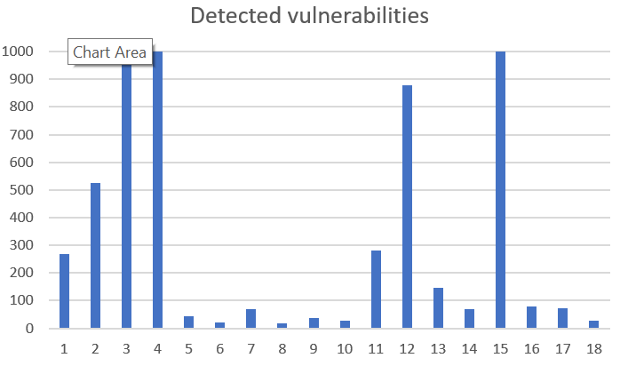
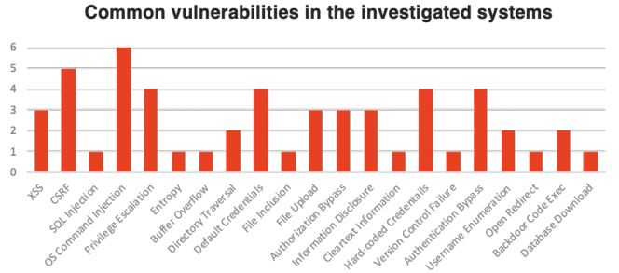
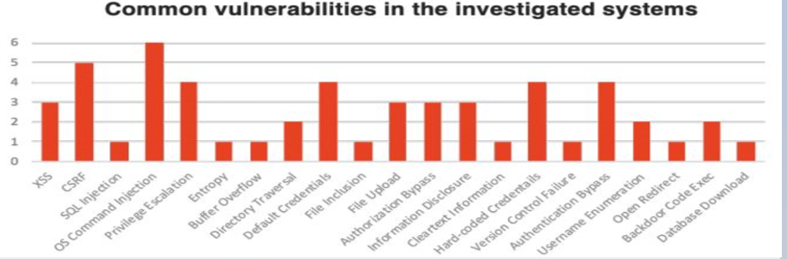
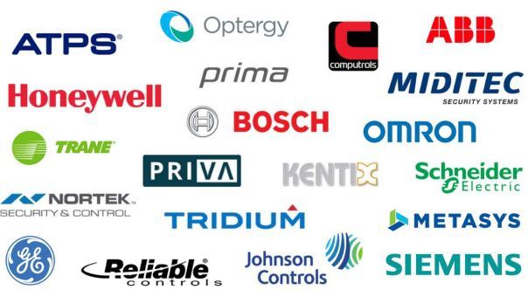
Specific Risk Posed by BMS:
All researched vendors had 12 or greater exposed systems
Some as high as 1000+
Interoperating Building Systems
Multiple Integrators (Vendors)
Open Communi-cations Protocols
Generic Risk Posed by BMS:
Minimal Staffing
Many paths to exploitation
Unchecked spread of malware
Live Pentest Research Finding:
If a third-party software is ‘visible’ as part of a
BMS integration system, it can be exploited
by researchers seeking to penetrate a BMS.
Examples: XSS, root access / Directory Re-writes,
Firmware over-writes, and privilege escalation enabling
researchers to gain full access to corporate IT networks.
Source: I Own Your Building (Management System), Applied Risk, November 2019

Slide 62
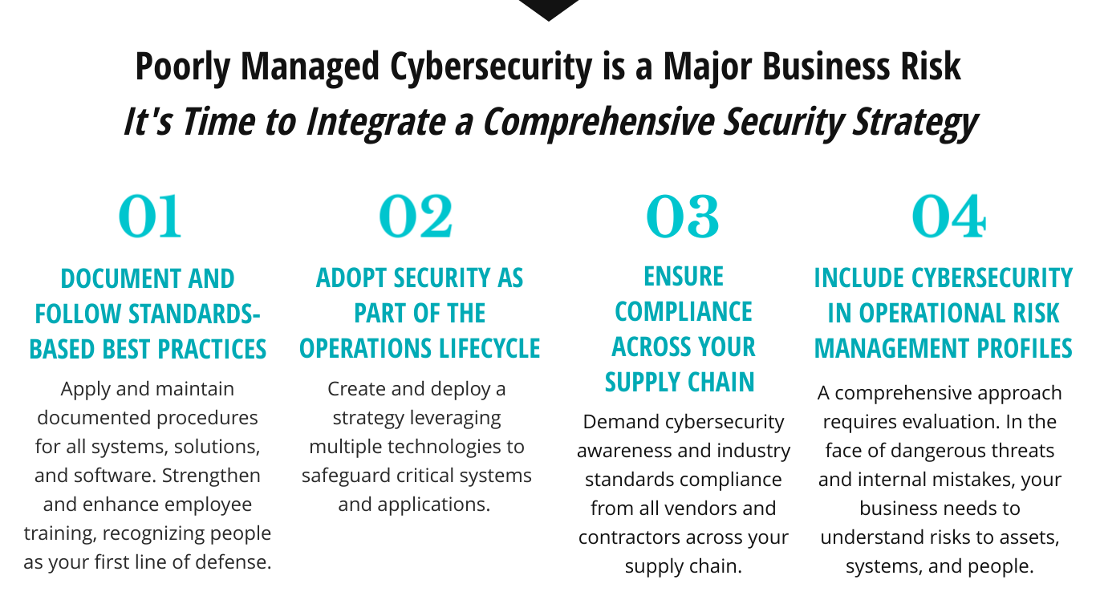

Slide 63







WHAT IS YOUR
CYBER ‘RISK’ SCORE?
This FICO-score-like rating measures an organization’s chance of experiencing a data breach, based on measurements tied to the company’s public-facing assets. Your score ques alerts for cyber or physical threats to supply chains, allowing intelligence to evaluate critical vendors. The lower your score, the higher your risk.
500
650
KEY RISK INDICATORS
720
Health & hygiene of IT systems
Network infrastructure
Software & services
775
300
850
HIGH RISK
LOW RISK
UNCLASSIFIED

Slide 64

Proposed Program Intent
A Standard program for facility owners to confirm the extent of cyber protection designed into BMS
  Possible marketing advantage
  Adaptive to the end user’s requirements
  Raise awareness for all facility occupants
Enhance the value of investments in BMS cyber protections
  Rewarded with a competitive advantage over less secure facilities
  Positive response from facility insurers
  Utilizes widely-accepted industry Standards
Accelerate the improvement of BMS cyber security for occupant safety
Guide a growing industry of third-party cyber protection firms
Start with commercial office buildings, follow on frameworks for healthcare, industrial, hospitality, academic, and residential facilities

Slide 65
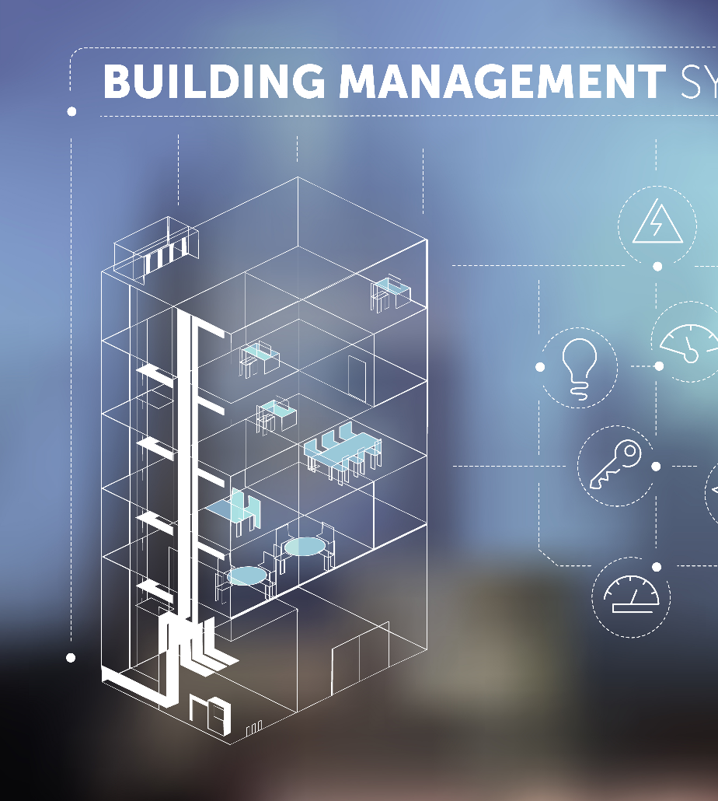
Scope of Proposed Program
An application specifically for BMS to enhance cybersecurity for operational technology and physical control systems – does not include IT currently
Addresses the entire value chain of building automation and control systems
Reviews and integrates multiple, existing international standards with industry best practices-promoting the use of a tiered security posture for the BMS selected by the end user based on the risk to a facility or operation
Confirmed via regular 3rd party control system enterprise and process evaluations
Program Addresses People, Processes & Technology

Slide 66
BMS Cybersecurity
Lifecycles
Value-Added to
Lifecycles
1. Product Supplier
2. System Integrator
3. Asset Owner
Product Supplier
  Discovers and mitigates risk
  Adheres to Federal regulations
  Evolves systems and/or components with risk landscape
System Integrator Service Provider
  Discovers and escalates risk for removal
  Adheres to Federal regulations and other compliance schema
  Provides more-secure automation
Asset Owner (Facility Owner)
  Deploys securely – confident!
  Cyber security management system awareness of risk landscape
  Operation and Maintenance
    Service provider partnership in CS management system
Product Supplier
  Secure by design
  Security development lifecycle
  Provides systems and/or components
System Integrator Service Provider
  Secure in development
  Risk-based system and component
  integration
  Provides an automation solution
Asset Owner (Facility Owner)
  Secure in deployment
  Cyber security management system
  Operation and maintenance
    Maintenance may be done
    by a service provider

Slide 67

Program Targets
Incentivize the protection of BMS systems to reduce risk to/from:
Life, safety, health – protection of employees (physical and virtual)
Employee actions
Adheres to Federal, State, and Local laws and ordinances on landlord/tenant rights and individual rights to privacy, as-applicable.
Protection of data (IP, financial)
Outsider attacks (e.g. ransomware)
Business interruption / degradation
Compliance with Federal and Defense regulations on Federal real estate assets, as-applicable.
Protection of brand value
Promote Concept & Obtain Commitment Decisions NLT March 2020

Slide 68
Assess and Issue a Cyber Performance Rating for Facility’s BMS
Based on consolidation of standards already in public domain
Dynamic – the threat is always evolving
Dynamic- the program for the response is always evolving
  Incentivizes sustainment of good cyber practices over life cycle
  Dynamic- rating requires periodic recertification to sustain these good cyber practices
Assessment addresses protections for technology, processes, and people
Rating public or private to tenants – Owner discretion
Good Better Best
Bronze
Silver
Gold
Platinum
Least
Secure
Most
Secure

Slide 69
Performance Model Comparison
Proposed For BMS Certification
DoD Cybersecurity Maturity Model Certification (CMMC)
DoE Cybersecurity Capability Maturity Model (C2M2)
ISA/IEC 62443
Basic Cyber Hygiene
Intermediate Cyber Hygiene
Good Cyber Hygiene
Proactive Cyber Hygiene
Advanced / Progressive / State of the Art
Maturity Indicator Level 0
Maturity Indicator Level 1
Maturity Indicator Level 2
Maturity Indicator Level 3
BRONZE
SILVER
GOLD
PLATINUM
Maturity Level 1
Maturity Level 2
Maturity Level 3
Maturity Level 4

Slide 70
Bronze Level Proposed
CMMC Int Capabilities* # of Practices
Cybersecurity Requirements Definition
Operations Maturity Level | ISA/IEC 62443-2-1 – Maturity Level 1
Maintenance Maturity Level | ISA/IEC 62443-2-4 – Maturity Level 1
Automation Security Zone | ISA/IEC 62443-3-3 – Security Level 1
Critical Security Zone | ISA/IEC 62443-3-3 – Security Level 2
Access Control
Asset Management
Audit & Accountability
Awareness & Training
Configuration Management
ID & Authorization
Incident Response
Maintenance
Media Protection
Personnel Security
Physical Protection
Recovery
Risk Management
Security Assessment
Situational Awareness
System & Comm. Protection
System & Info. Integrity
4
-
-
-
-
2
-
-
1
-
4
-
-
-
-
2
4
Security Level 1 Requirements - High Level Summary
Identification and Authentication Control | User identification and authentication
Use Control | User authorization enforcement
System Integrity | Communications integrity, Malware protection
Data Confidentiality | Information confidentiality at rest
Restricted Data Flow | Network segmentation
Timely Response to Events | Audit log accessibility
Resource Availability | Denial of Service protection, Backup
*NIST, ISO, RMM KIM-SG4, CIS, etc
Practices defined as of CMMC v.6 11/19.

Slide 71
Silver Level Proposed
CMMC Good Capabilities* Add’l Practices
Cybersecurity Requirements Definition
Operations Maturity Level | ISA/IEC 62443-2-1 – Maturity Level 2
Maintenance Maturity Level | ISA/IEC 62443-2-4 – Maturity Level 2
Automation Security Zone | ISA/IEC 62443-3-3 – Security Level 2
Critical Security Zone | ISA/IEC 62443-3-3 – Security Level 3
Access Control
Asset Management
Audit & Accountability
Awareness & Training
Configuration Management
ID & Authorization
Incident Response
Maintenance
Media Protection
Personnel Security
Physical Protection
Recovery
Risk Management
Security Assessment
Situational Awareness
System & Comm. Protection
System & Info. Integrity
12
--
4
2
6
5
5
4
3
2
1
2
3
3
1
3
2
Security Level 2 Requirements - High Level Summary
Identification and Authentication Control | Unique user identification and authentication
Use Control | Enforcement + Role Based Access Control
System Integrity | Communications integrity, Entry/Exit malware protection
Data Confidentiality | Information confidentiality at rest or in transit
Restricted Data Flow | Physical network segmentation
Timely Response to Events | Audit log accessibility, Continuous monitoring
Resource Availability | DoS protection, Backup verification, Inventory
*NIST, ISO, RMM KIM-SG4, CIS, etc
Practices defined as of CMMC v.6 11/19.

Slide 72
Gold Level Proposed
CMMC Pro Control Capabilities* Add’lPractices
Cybersecurity Requirements Definition
Operations Maturity Level | ISA/IEC 62443-2-1 – Maturity Level 3
Maintenance Maturity Level | ISA/IEC 62443-2-4 – Maturity Level 3
Automation Security Zone | ISA/IEC 62443-3-3 – Security Level 3
Critical Security Zone | ISA/IEC 62443-3-3 – Security Level 4
Access Control
Asset Management
Audit & Accountability
Awareness & Training
Configuration Management
ID & Authorization
Incident Response
Maintenance
Media Protection
Personnel Security
Physical Protection
Recovery
Risk Management
Security Assessment
Situational Awareness
System & Comm. Protection
System & Info. Integrity
5
2
7
1
3
4
2
2
4
-
1
1
3
2
1
14
3
Security Level 3 Requirements - High Level Summary
Identification and Authentication Control | Multifactor user identification and authentication
Use Control | Enforcement + RBAC + Supervisor Override
System Integrity | Cryptographic integrity, Centralized malware protection
Data Confidentiality | Information confidentiality at rest or in transit
Restricted Data Flow | Independence from non-control networks
Timely Response to Events | Audit log accessibility, Continuous monitoring
Resource Availability | DoS protection, Backup automation, Inventory
*NIST, ISO, RMM KIM-SG4, CIS, etc
Practices defined as of CMMC v.6 11/19.

Slide 73
Platinum Level Proposed
CMMC Adv Control Family* Add’lPractices
Cybersecurity Requirements Definition
Operations Maturity Level | ISA/IEC 62443-2-1 – Maturity Level 4
Maintenance Maturity Level | ISA/IEC 62443-2-4 – Maturity Level 4
Automation Security Zone | ISA/IEC 62443-3-3 – Security Level 4
Critical Security Zone | ISA/IEC 62443-3-3 – Security Level 4
Access Control
Asset Management
Audit & Accountability
Awareness & Training
Configuration Management
ID & Authorization
Incident Response
Maintenance
Media Protection
Personnel Security
Physical Protection
Recovery
Risk Management
Security Assessment
Situational Awareness
System & Comm. Protection
System & Info. Integrity
Not Yet Defined
“
“
“
“
“
“
“
“
“
“
“
“
“
“
“
“
Security Level 4 Requirements - High Level Summary
Identification and Authentication Control | Multifactor user identification and authentication
Use Control | Enforcement + RBAC + Override + Dual approval
System Integrity | Cryptographic integrity, Centralized malware protection
Data Confidentiality | Information confidentiality across zones
Restricted Data Flow | Logical and physical isolation of critical networks
Timely Response to Events | Audit log accessibility, Continuous monitoring
Resource Availability | DoS protection, Backup automation, Inventory
*NIST, ISO, RMM KIM-SG4, CIS, etc
Practices defined as of CMMC v.6 11/19.

Slide 74
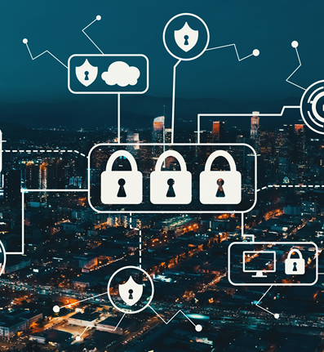
Our Assessment of Value
Meet global and U.S. security requirements using a single, unified certification
Simplifies procurement specification process (establish corporate standards) for technology and cyber protection services
All stakeholders (including insurers) can easily understand standards-based cybersecurity capabilities
Capabilities independently validated by external entity
Confidence that protections will be upgraded over time based on evolving risk
Easily adopted into public policy

Slide 75
Next Steps
Next Steps
Establishment of an entity to serve as the keeper of the program and certification agency
Invite stakeholders to develop certification program for commercial properties
Continued development of Program for other facility types
Strategic Communication on the growing threat and proposed response
Potential adoption of program for “smart” products (cars, media, homes, appliances)

Slide 76
Action Timeline
Jan ‘20
Asset Owner Meeting
Feb ‘20
Certification body designated
Funding documents drafted
Apr ‘20
Update to ICS JWG
Initiate body

Slide 77

8. Announcements
Ron Zimmer (CABA)
8.1 Past Event Overview:
CoRETECH 2109, Nov 13-15, San Jose, CA
Greenbuild International Conference and Expo 2019, Nov 19-22, Atlanta, GA
CABA AGM, Dec 5, 11am ET via Webinar
AHR Expo, Feb 3-5, Orlando, FL
DISTRIBUTECH International 2020, Feb 9-11, San Diego, CA

Slide 78
8. Announcements
Ron Zimmer (CABA)
8.2 Upcoming events:
Light+building, Mar 8-13, Frankfurt, Germany
Internet of Things World, Apr 6-9, San Jose, CA
Niagara Summit: Connecting the World, Apr 19-21, San Diego, CA
BuildingsNY, Apr 28-29, New York, NY

Slide 79
9. Adjournment
Trevor Nightingale (National Research Council)
Next IBC Meeting, April 2020
Continental Automated Buildings Association (CABA)
caba@caba.org
www.CABA.org
www.caba.org/ibc
Connect to what’s next™

