Slide 1
Connected Home Council (CHC) Webinar
Tuesday, November 26, 2019, 12 NOON – 1:30 PM (ET)
Chair: Roy Perry (Alarm.com, Inc.)
Vice-Chair: Obiorah Ike (ABB, Inc.)
Vice-Chair: Danny Sran (TELUS)

Slide 2


1. Agenda
Greg Walker (CABA)
1. Agenda
2. Call to Order, Welcome, Introductions, about the CHC
3. Administrative
“Holistic Sustainability and Energy Management: Through the Lens of the Honda Smart Home” (30 min)
    - Michael Koenig (American Honda Motor Co., Inc)
5. Research Update
6. White Paper Sub-Committee Update
7. New Business
8. Announcements
9. Adjournment

Slide 3
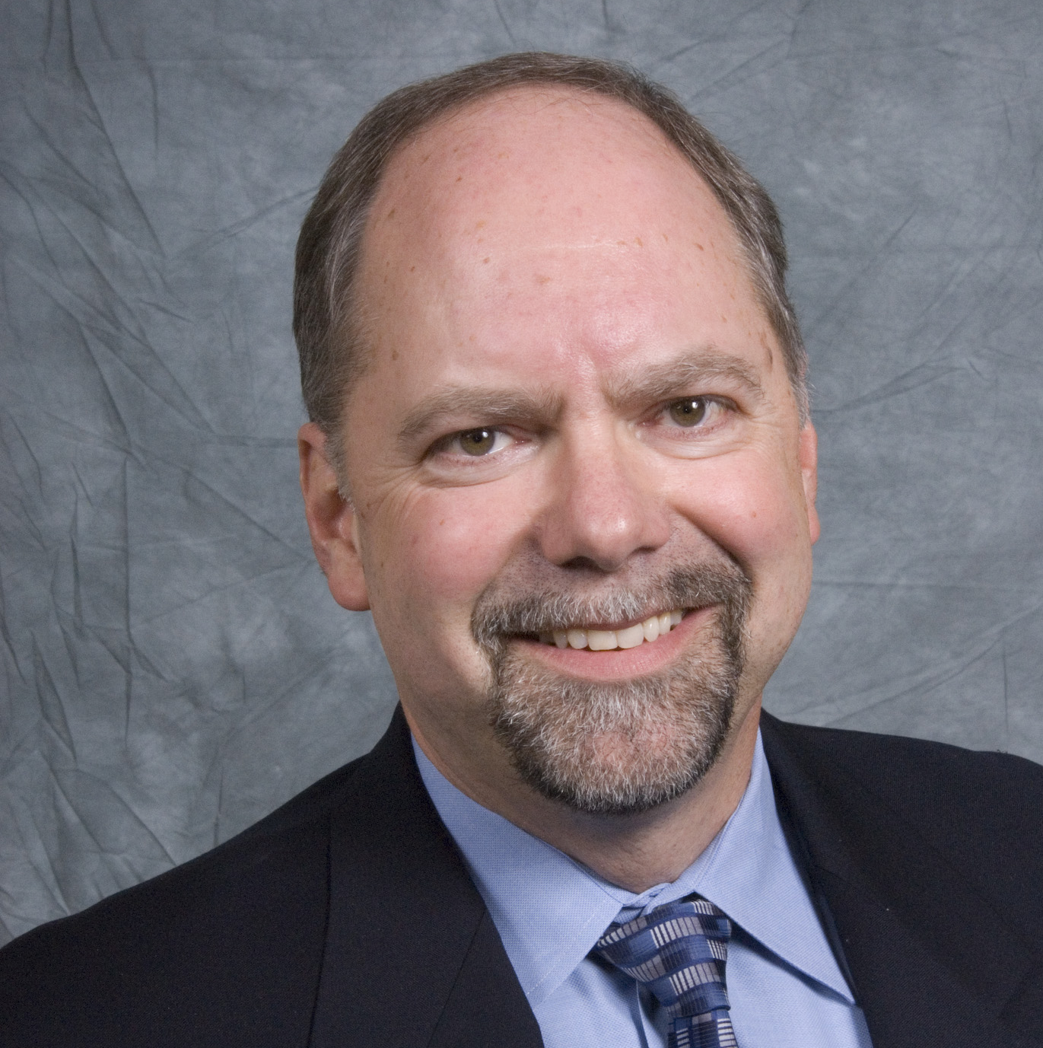

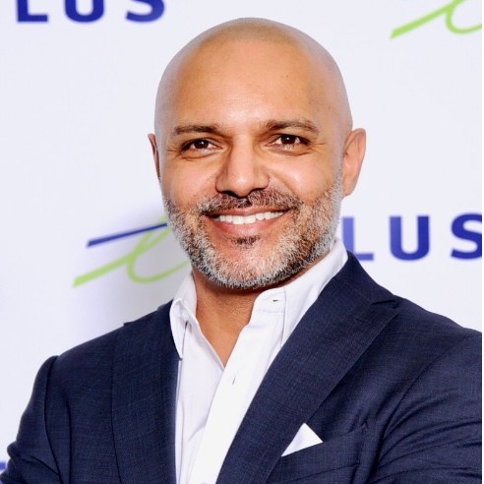
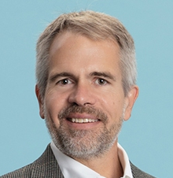




2. Call to Order, Welcome, Introductions, About the CHC
Roy Perry (Alarm.com, Inc.)
CHC Chair
Roy Perry
VP Ecosystem Alliances
Alarm.com
CHC Vice-Chair
Obiorah Ike
Product Marketing Manager
ABB Inc.
CHC Vice-Chair
Danny Sran
Mgr. Construction - New Growth Markets TELUS
Past CHC Chair
Jay McLellan
VP, Energy Management, Controls and Automation Leviton Manufacturing Co., Inc.
Established in 2004, the CABA Connected Home Council initiates and reviews projects that relate to connected home and multiple dwelling unit technologies and applications. The Council also examines industry opportunities that can accelerate the adoption of new technologies, consumer electronics and broadband services within the burgeoning connected home market.
www.caba.org/chc

Slide 4

3. Administrative
Roy Perry (Alarm.com, Inc.)
3.1 Motion to approve past CHC Minutes:
September 26, 2019
www.caba.org/chc

Slide 5
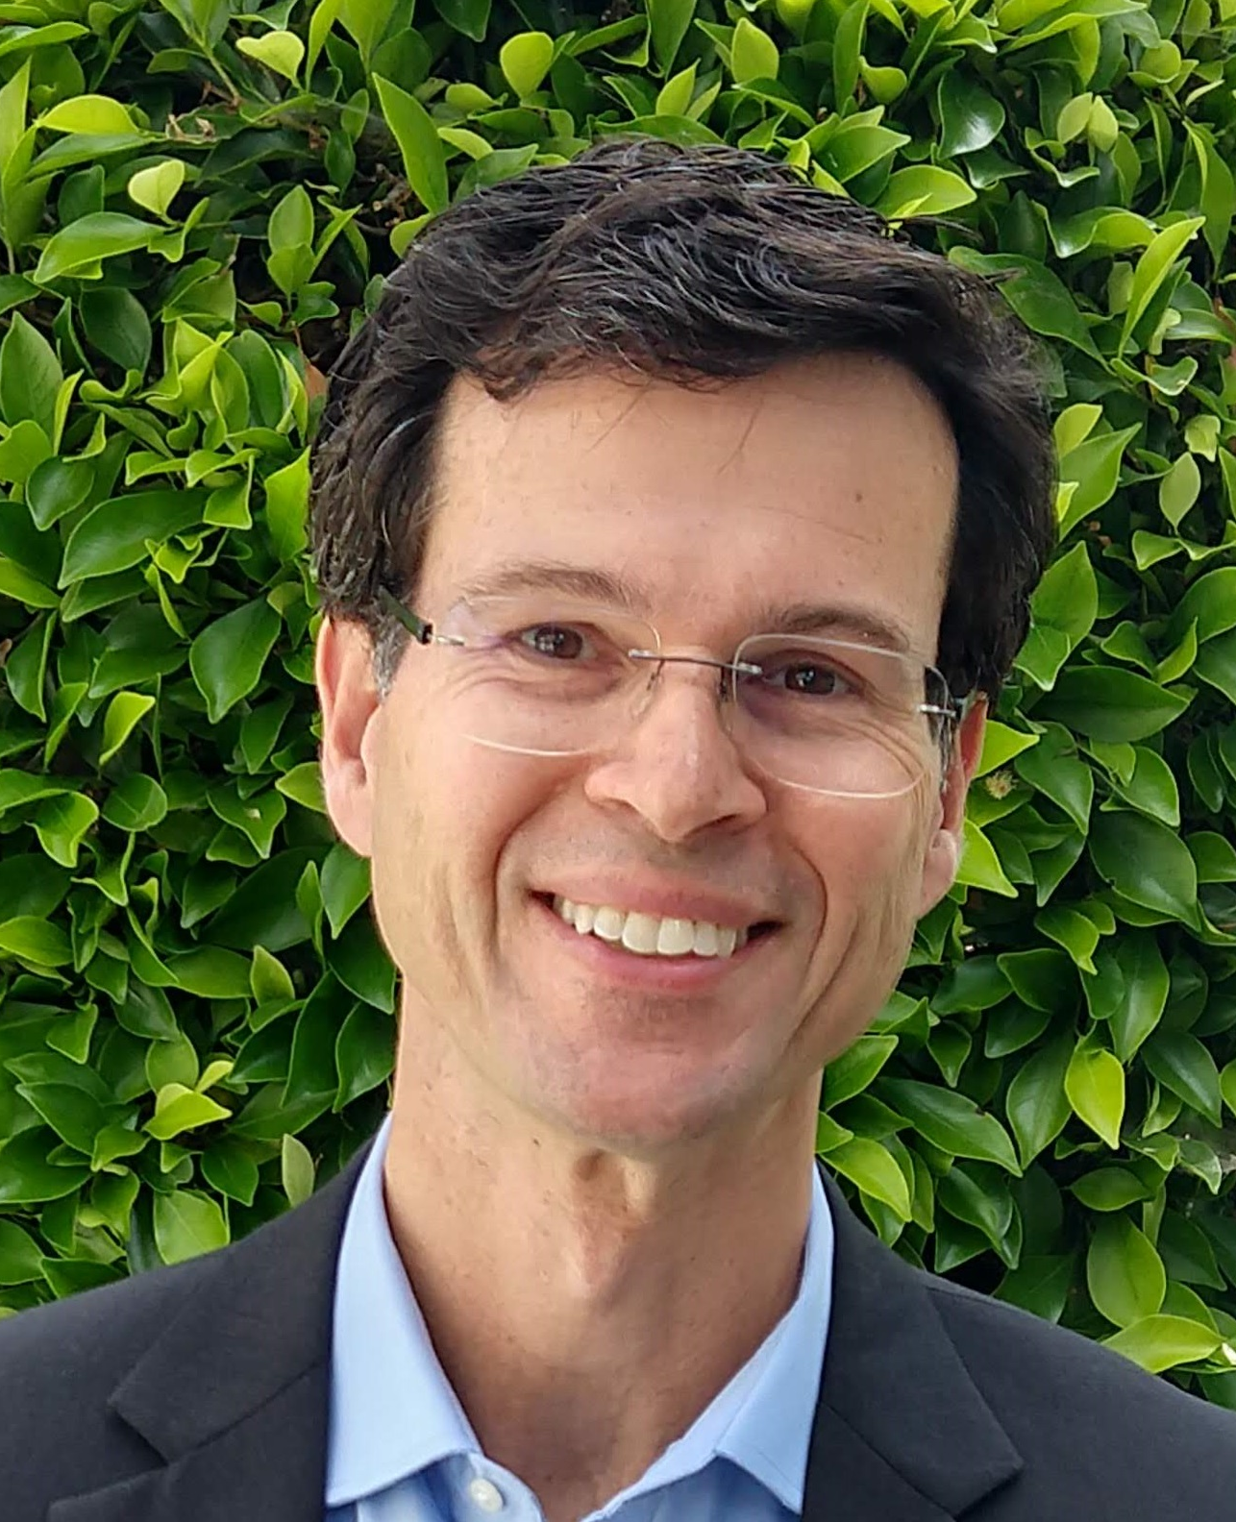

4. “Holistic Sustainability and Energy Management”
Greg Walker (CABA)
Holistic Sustainability and Energy Management: Through the Lens of the Honda Smart Home
Michael Koenig
American Honda Motor Co., Inc
Project Leader, Honda Smart Home U.S.

Slide 6


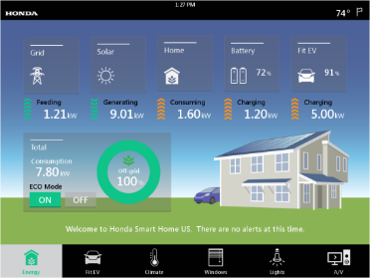
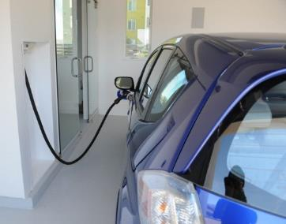
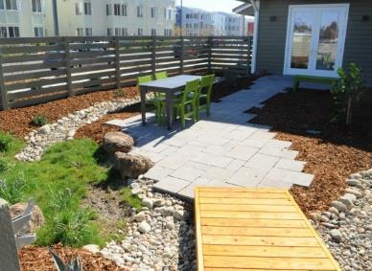
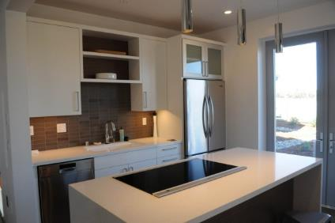
Holistic Sustainability and Energy Management
Through the Lens of the Honda Smart Home
Michael Koenig
American Honda Motor Co., Inc
Project Leader, Honda Smart Home U.S.

Slide 7
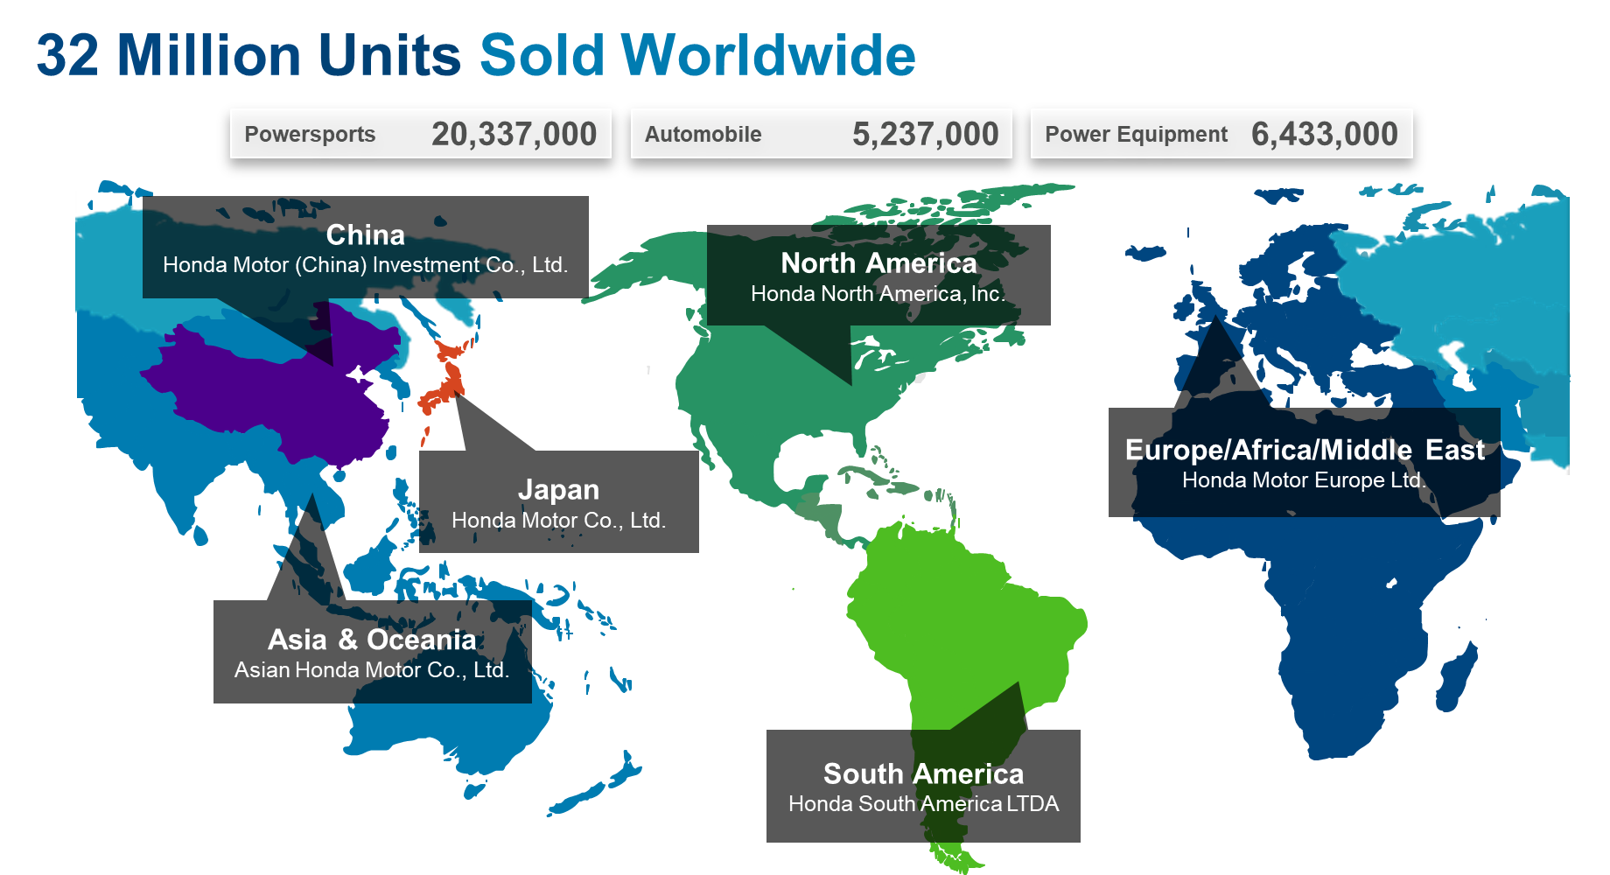
Honda? The Car Company?

Slide 8


Striving to be a Company That Society Wants to Exist
“Honda puts climate change and energy at the top of the list of global environmental issues that it needs to address.”
- 2013 Honda Annual Environmental Report

Slide 9
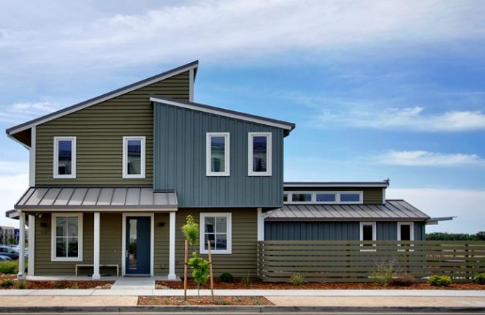

Honda Smart Home US Vision
Q: How can we make zero-net-energy homes with EVs actually play nicely with the electric grid? AND do it while respecting all facets of sustainability?
Some Background:
California set a 2020 goal for all new residential construction to be Zero Net Energy
The Basics…
1944 square feet single family home (181m²)
Occupant uses the Home and Fit EV vehicle
HSHus is a living laboratory to demonstrate a vision for zero-carbon living and mobility
Zero Net Energy including transportation

Slide 10





Facets of Sustainable Construction
Health
Water
Materials
Holistic
Sustainability
Waste
Energy

Slide 11
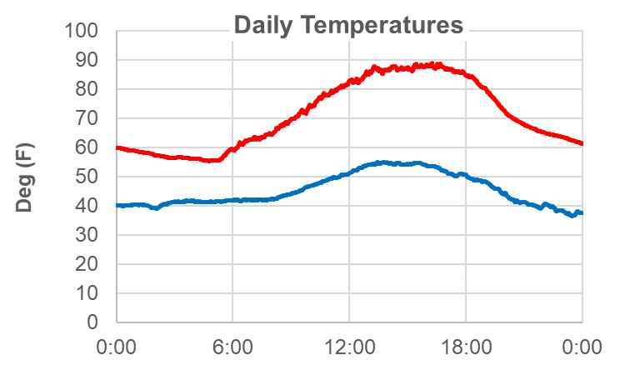
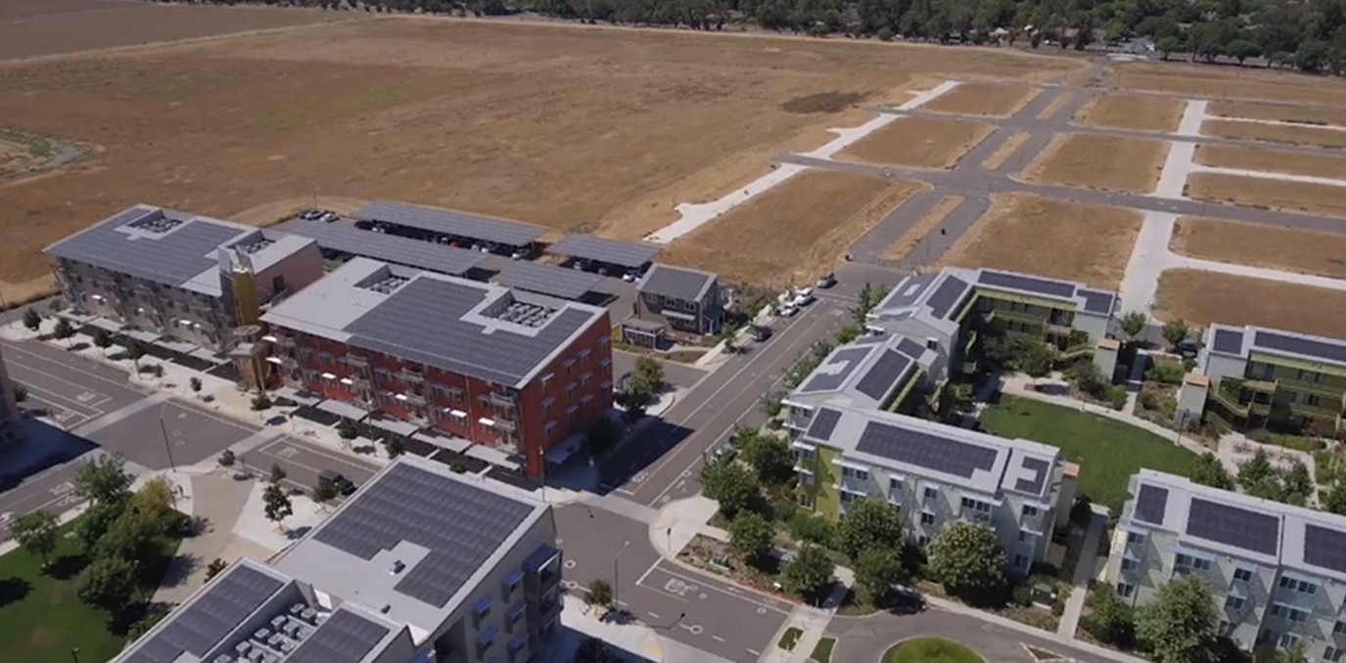
Where
UC Davis “West Village” community… Zero Net Energy target for the entire village (apartments and future homes)
July 1: Summer - Hot, desert climate
January 1: Winter - 30’s ~ 50’s, sometimes rainy

Slide 12
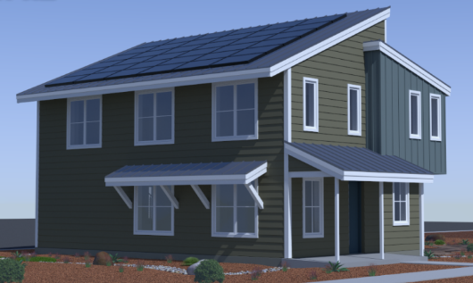
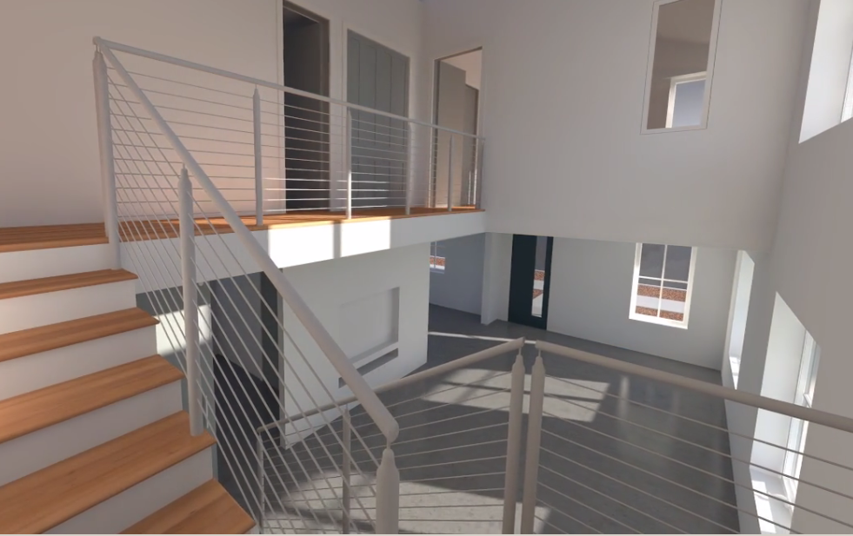
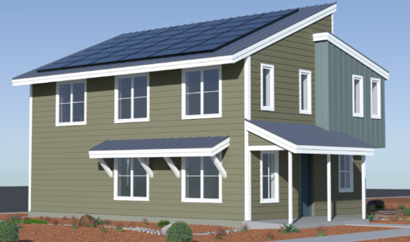
Start With The Basics of Orientation and Envelope…
  9.25” Walls + Triple Pane Windows
  Tight envelope
  Optimized Orientation and Overhangs
Summer
Winter
Winter

Slide 13
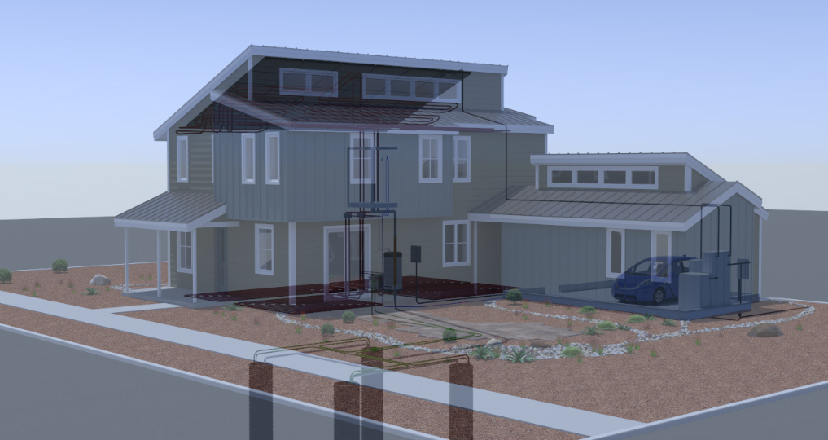
Integrated System: Heating, Cooling, Hot Water, Ventilation

Slide 14
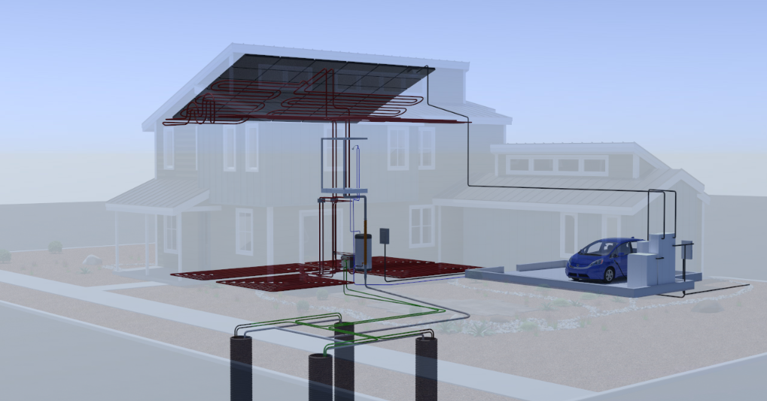
Integrated System: Heating, Cooling, Hot Water, Ventilation
Radiant Heating and Cooling
Single Heat Pump provides Heating, Cooling, and Hot Water
Large diameter boreholes for heat exhangers

Slide 15
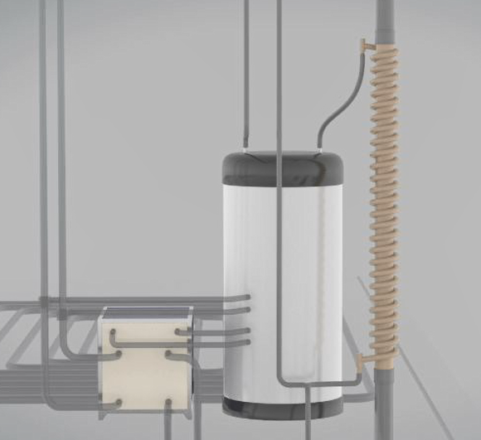
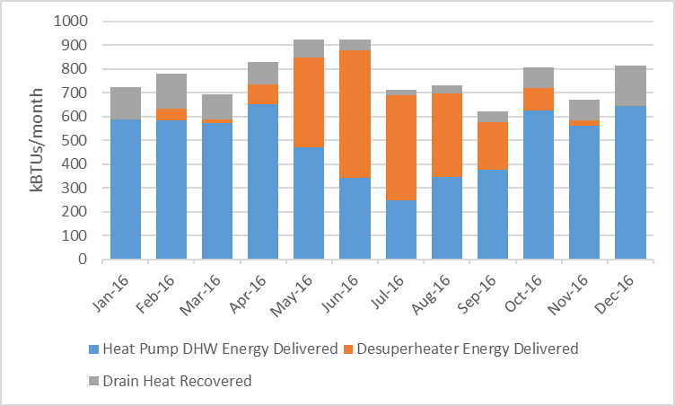
Integrated System: Heating, Cooling, Hot Water, Ventilation
Where Did the Hot Water Come From (2016)
Figure credit:
Frontier Energy
Desuperheater (free hot water… 15 year payback) 23% of hot-water energy
Drain Heat Recovery (free warm water… 40 year payback) 11% of hot-water energy

Slide 16
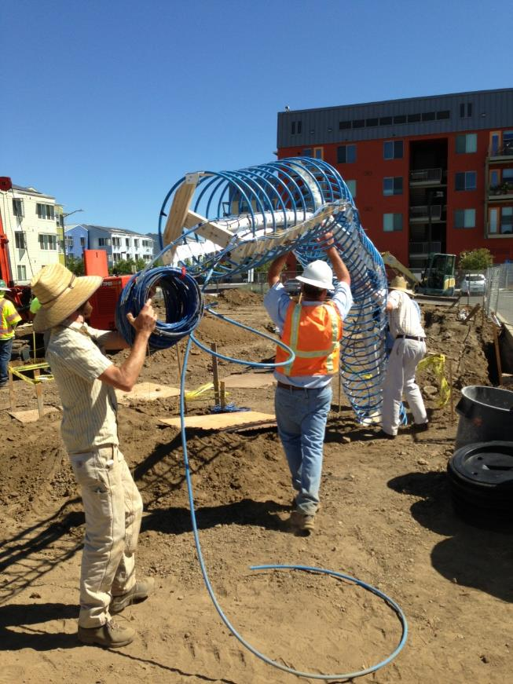

Large Diameter Borehole Experiment (2’ x 20’)
Drilling is fast and cheap, but how effective are the heat exchangers?

Slide 17
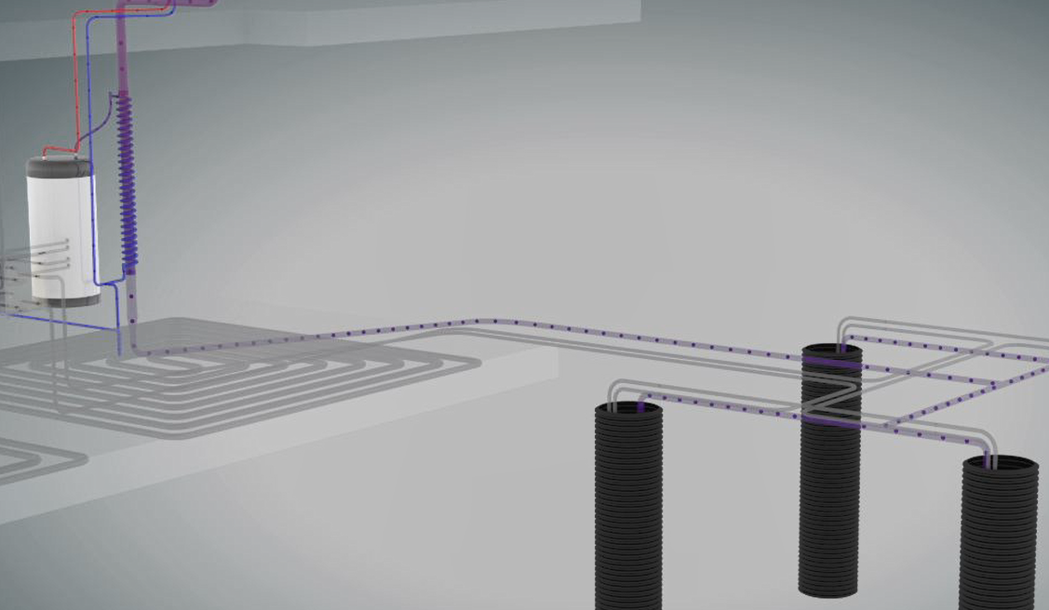
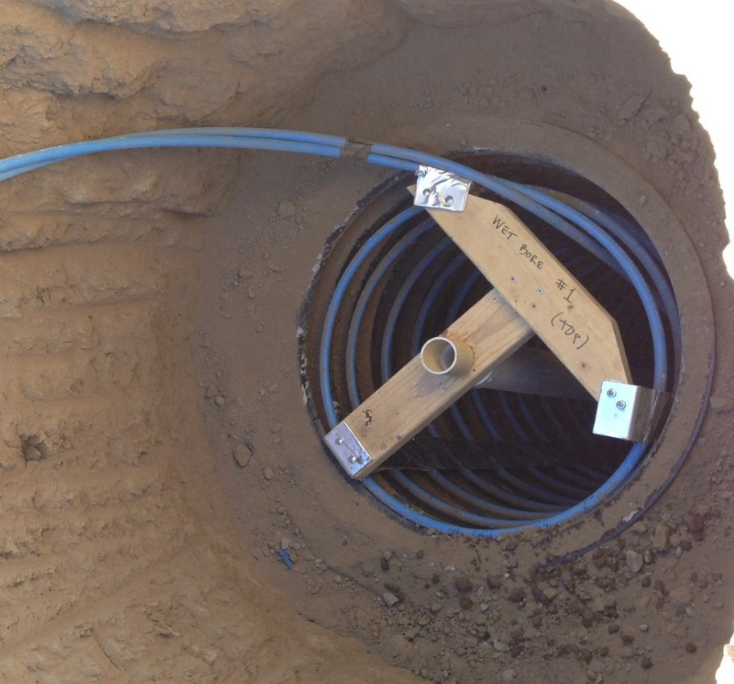
Large Diameter Borehole Experiment (2’ x 20’)
Answer:
Dry: About 0.20 tons each
Wet: About 0.25 tons each
Total = 8 Boreholes:
  4 - Wetted by Graywater
  4 - Dry Soil

Slide 18
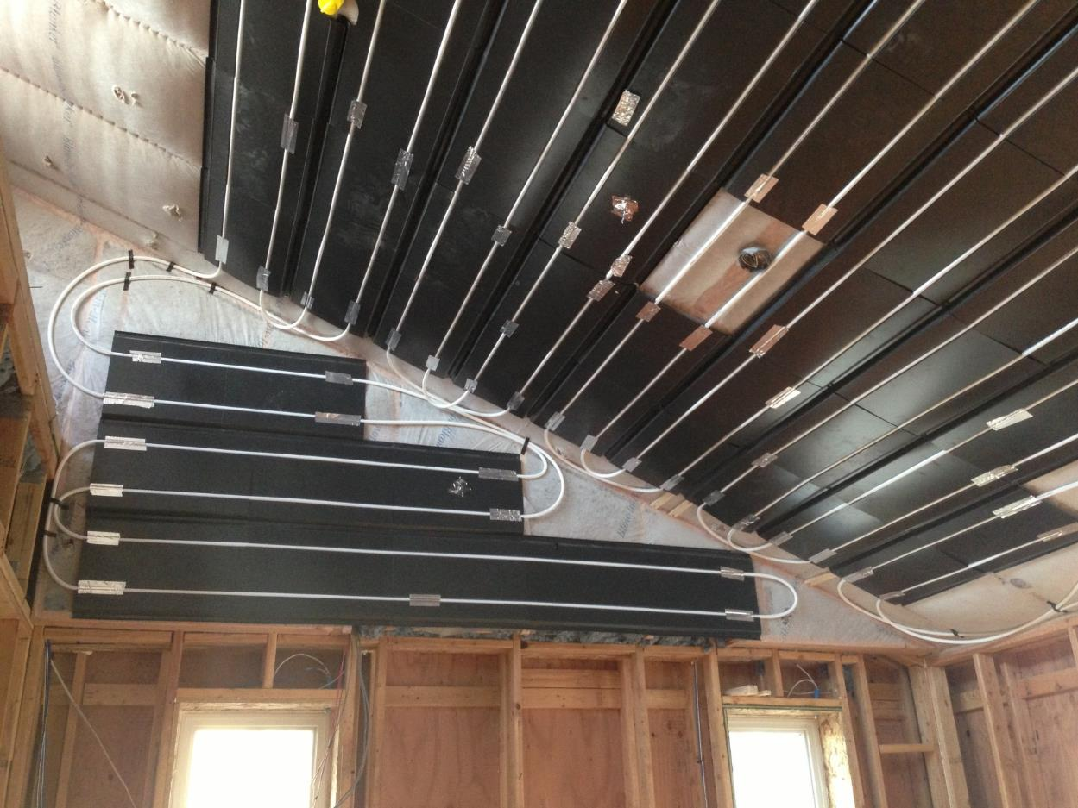
Radiant Panels Over Insulation (Mstr Bdrm)

Slide 19
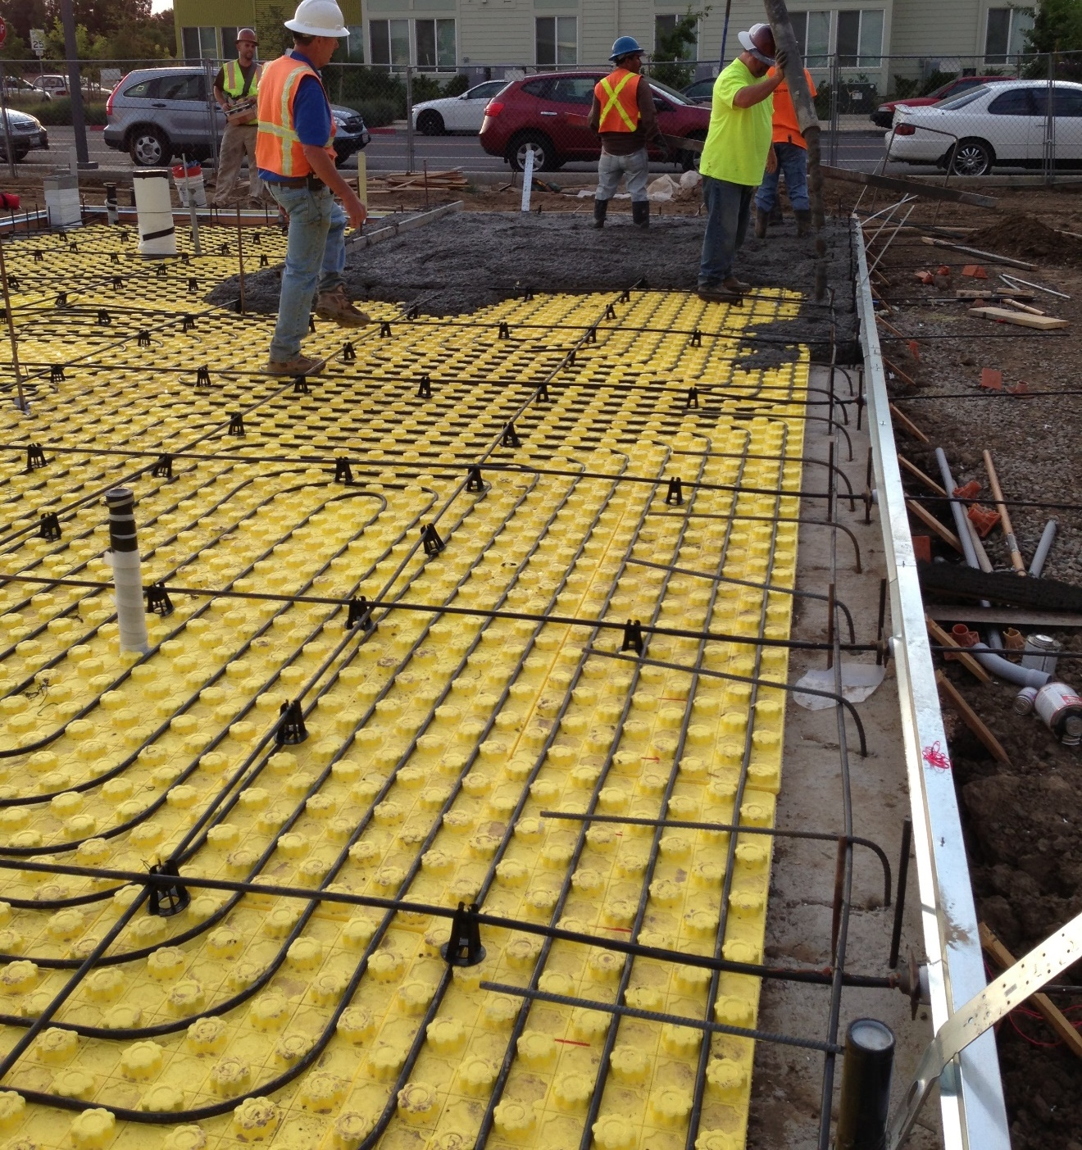
Radiant Cooling
+ Higher Set Points yet equal comfort
+ Low pumping energy
- Long time delays
- Cold floors in summer
- Dew Point Control can be challenging
Post-Tensioning Tendon
Hydronic Tubing
Insulation Mat

Slide 20
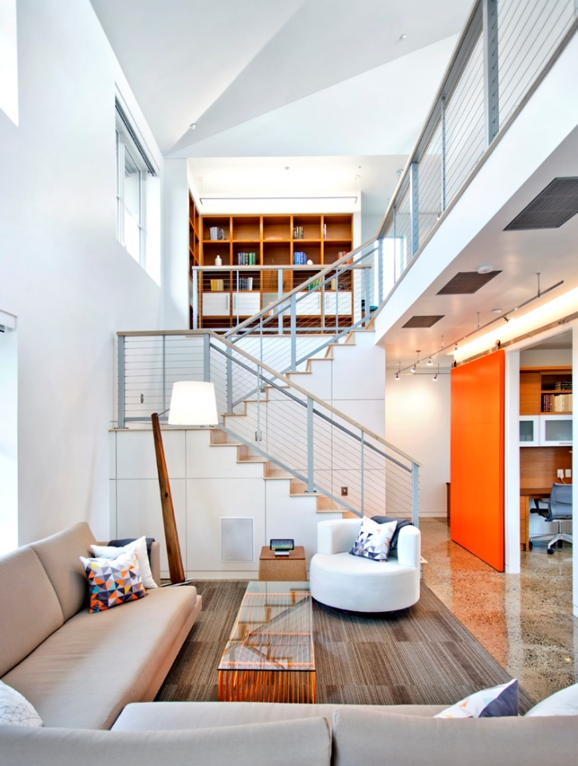
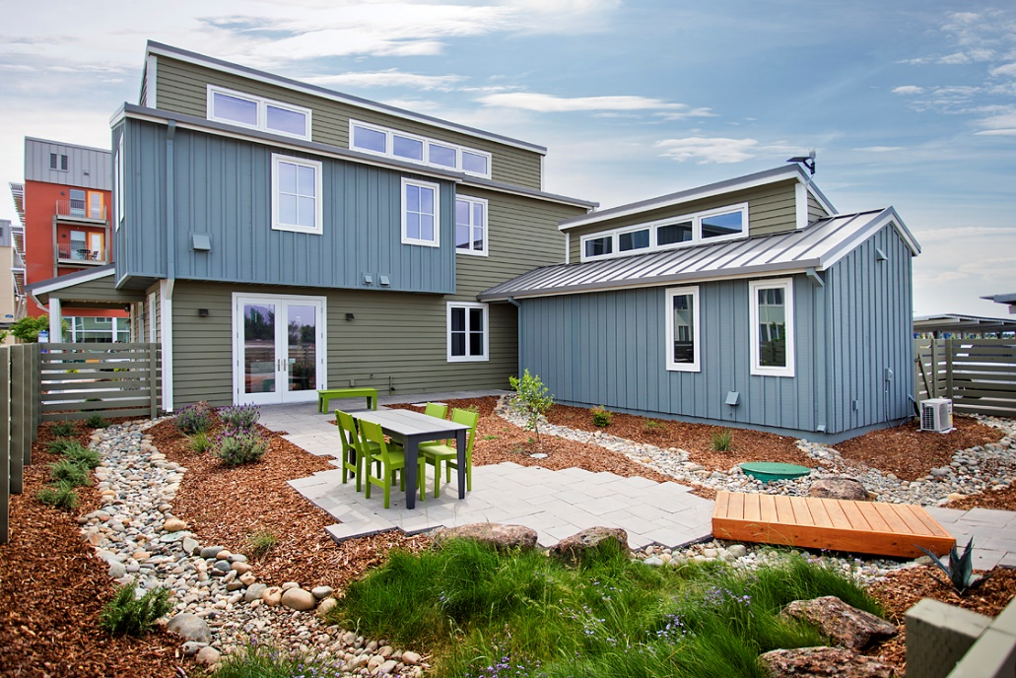
Vent Cooling… Try 1: Open Clerestories and Pressurize

Slide 21

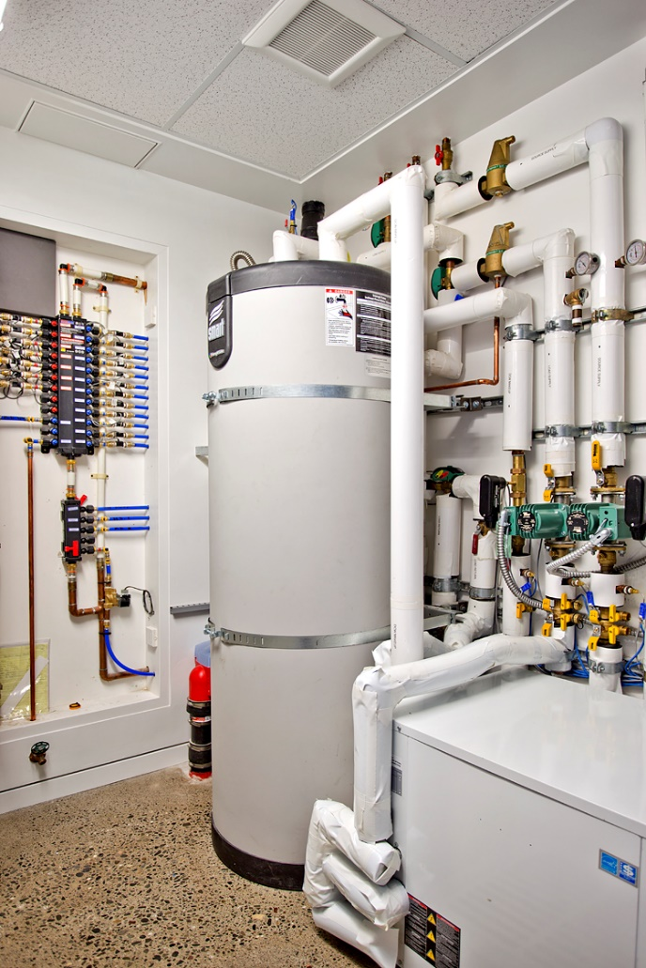
Vent Cooling… Try 2: Depressurize with n=5 Bath Fans

Slide 22
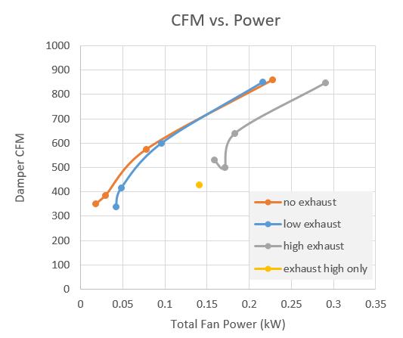
Vent Cooling… Try 3: Start Over With Data
Optimize Energy, Pressure, Noise:
  Whole House Fan
  Exhaust Fans
AND integrated with 62.2 Ventilation
Figure Credit: Frontier Energy

Slide 23
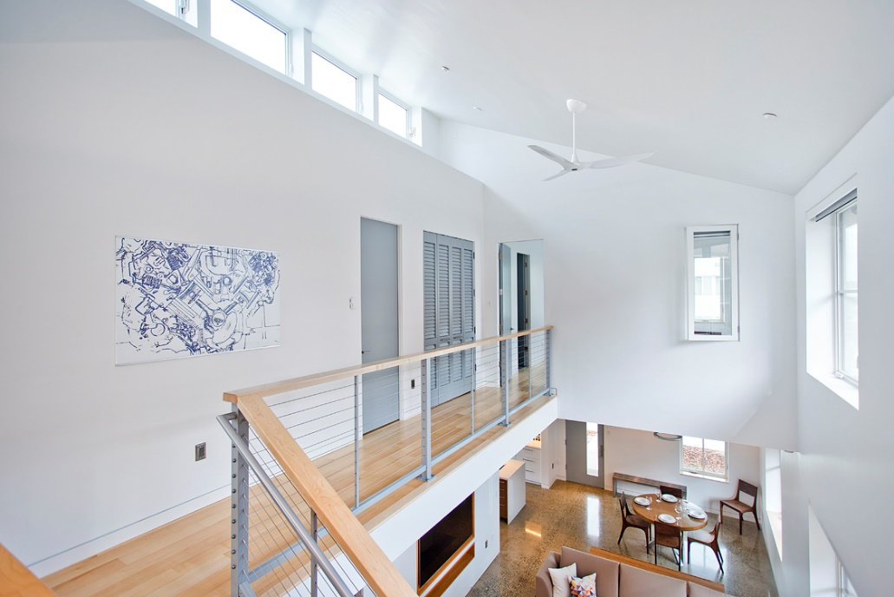
LED Lighting: Man Max, Machine Min
Lighting Goals:
  Daylighting First
  Comfortable, High Quality
  Energy Efficient
  Healthy

Slide 24
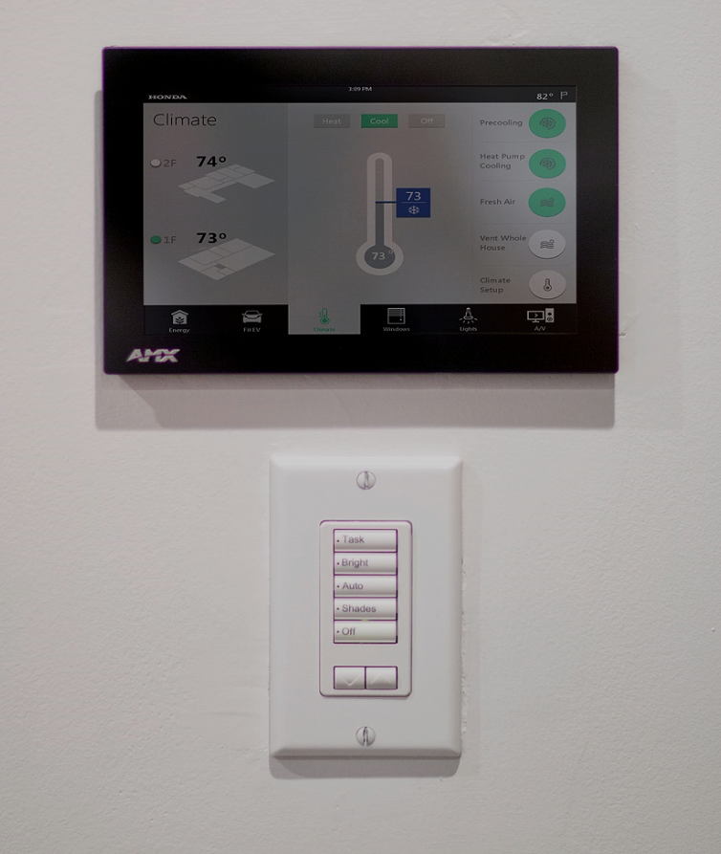
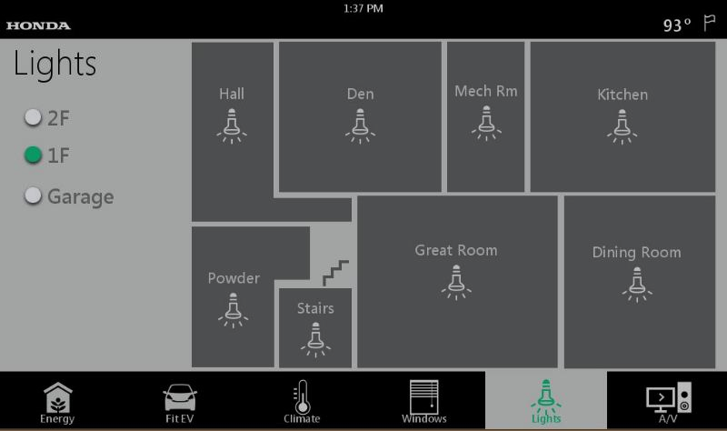
LED Lighting: Man Max, Machine Min
3
Because fiddling with a control pad is a hassle
1
Everything should just work automatically in the background…
2
But over-riding is easy with a keypad in every room…
But what about when you go to bed?? How does it know when to ignore motion?
Ans: We added a “Sleep” button

Slide 25
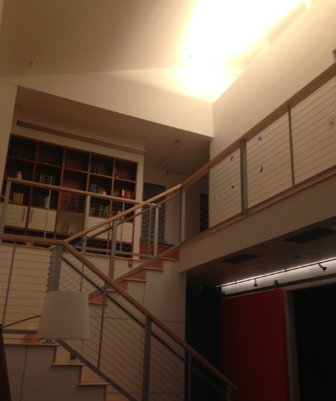
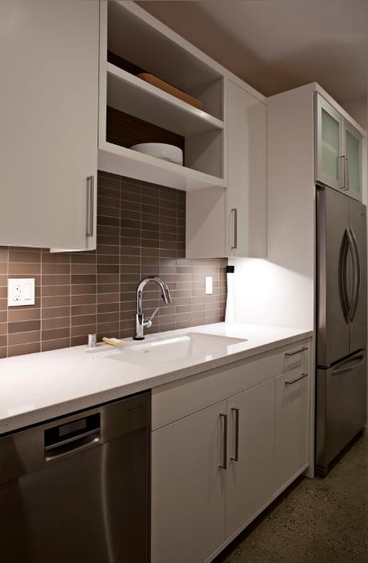
LED Lighting, Circadian Design:
Main Array
= Adjustable
Most Fixtures
= 2700K

Slide 26
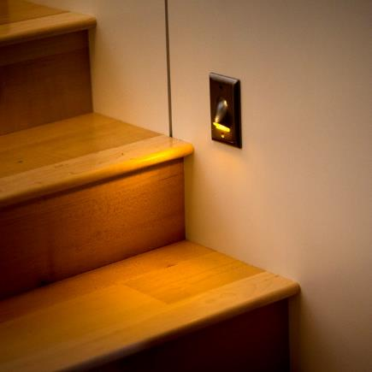
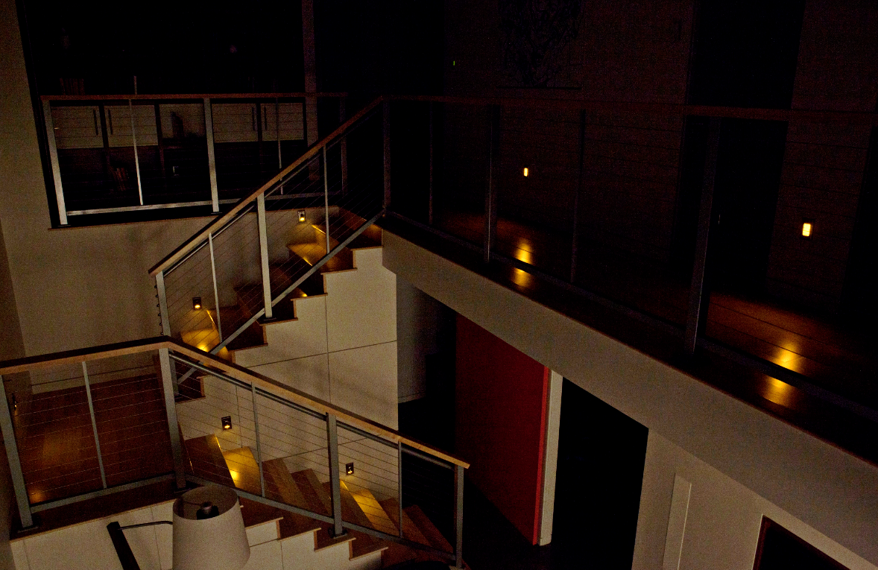
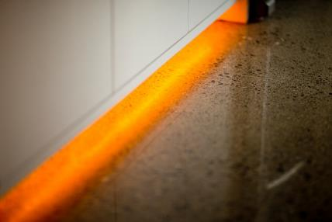
Amber Night Lights
Hall and Stairs
Kitchen and Bath

Slide 27
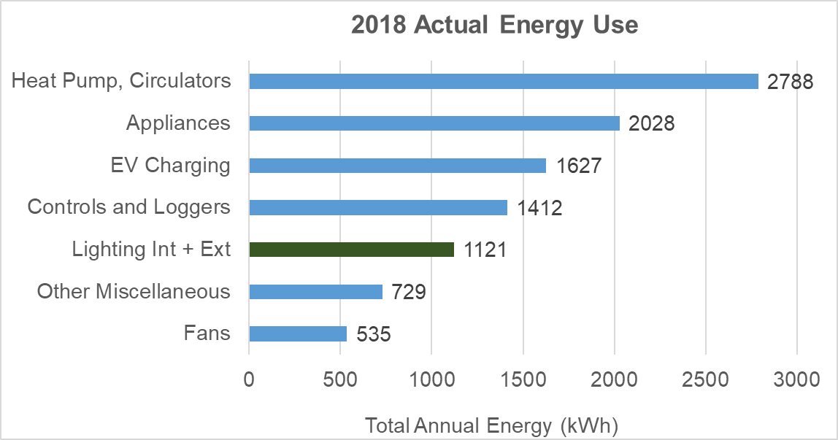
Mind the Standby Loads
44% Less Than Average New Construction*
* But controls in general is a killer with 2013 tech.

Slide 28
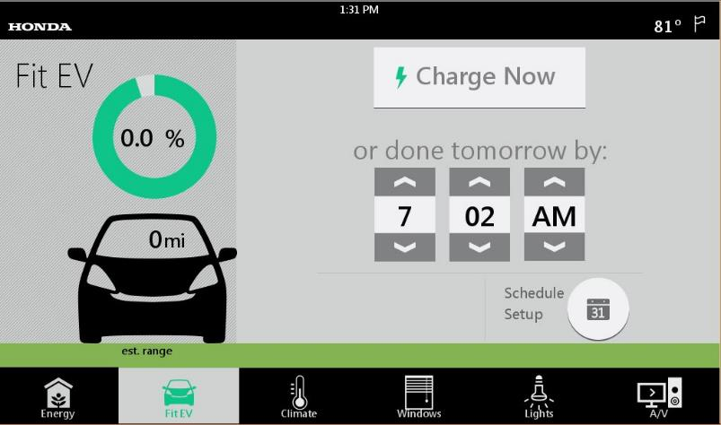
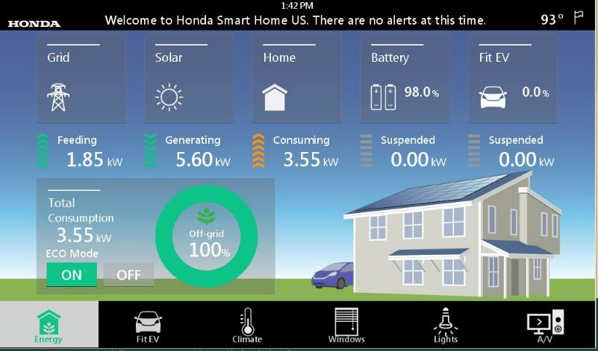
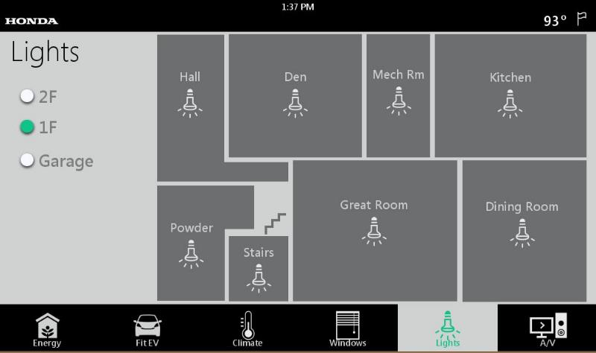
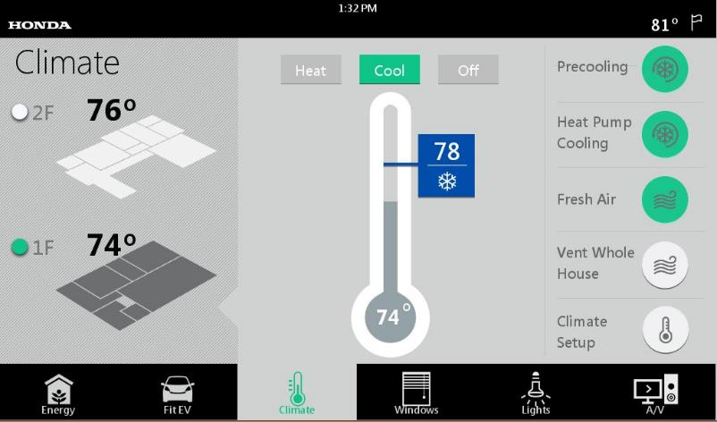
Home Control using the Smart Home App

Slide 29
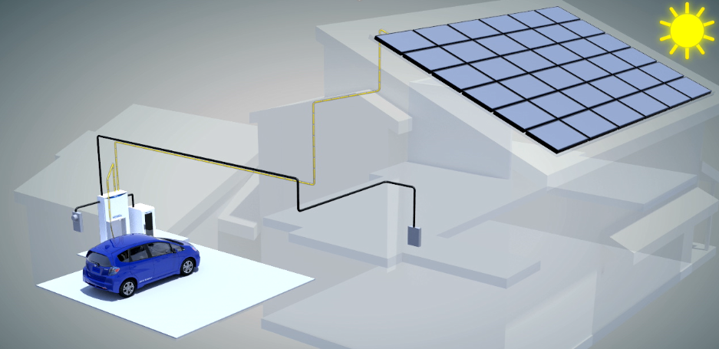
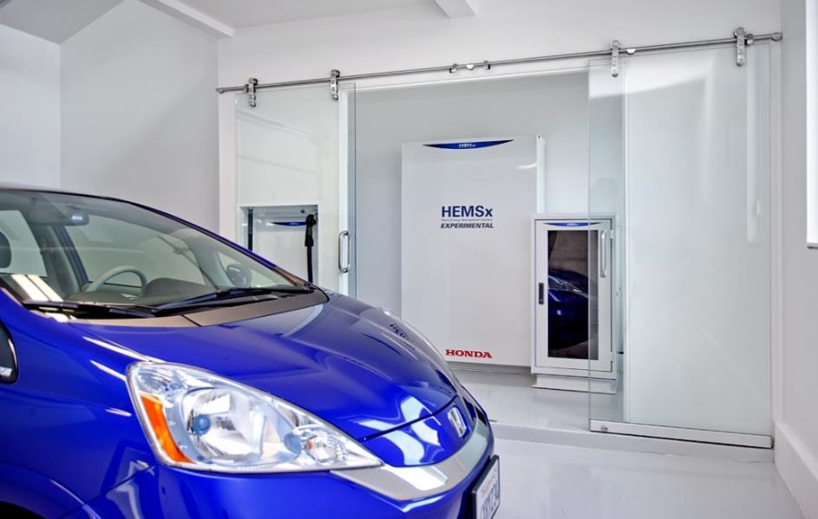
Energy Management System Details
Hardware:
9.5 kW Solar PV array
10 kW bi-directional inverter
10 kW bi-directional DC charger
10 kWh* Lithium battery
DC Microgrid

Slide 30
Energy Management System Details
Hardware:
9.5 kW Solar PV array
10 kW bi-directional inverter
10 kW bi-directional DC charger
10 kWh* Lithium battery
Response Examples:
If total house current > 100A
→ Discharge battery
To a Demand Response Request
→ Discharge car (to net zero P)
In case of solar power fluctuation
→ Smooth output using battery
In case of grid voltage fluctuation
→ Charge/Discharge battery
→ Make hot water (if available)
DC Microgrid
Note: We will publish a report on how to better predict times of low-carbon grid electricity in CA

Slide 31
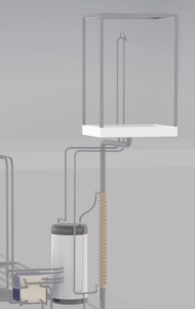
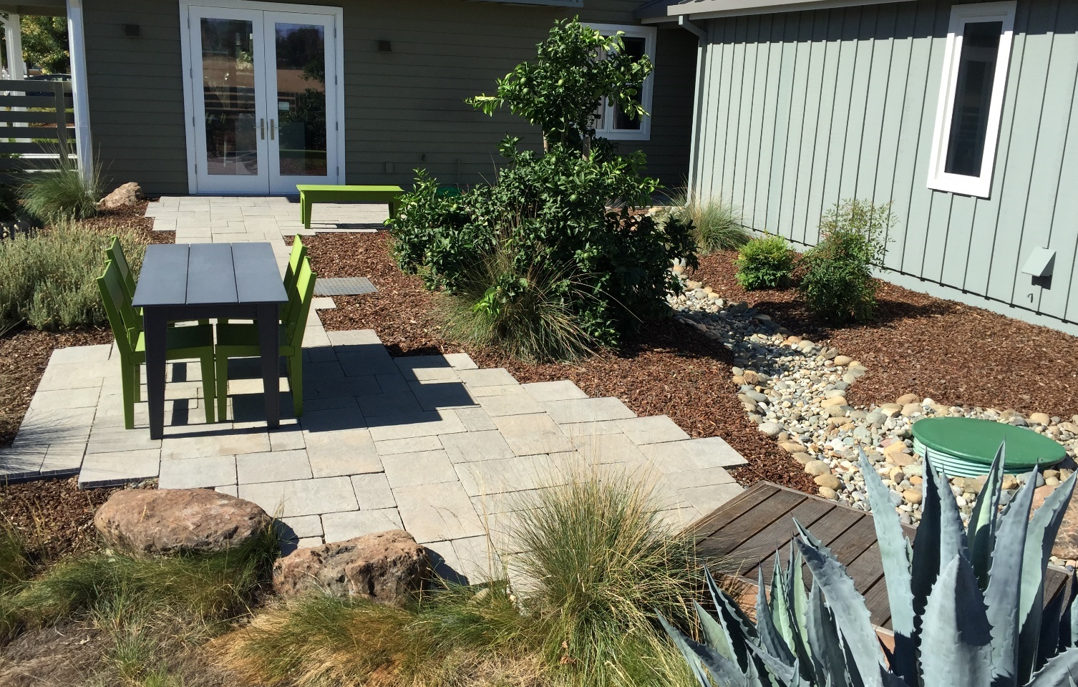
Water Savings
Compact Plumbing Design
→ Very short hot water runs
Low flow fixtures and dual-flush toilets
Xeriscaped landscape with graywater irrigation

Slide 32

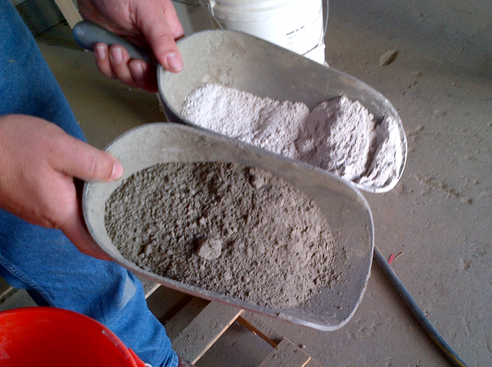
Sustainable Raw Materials
HSHus used 50% natural ash material
Post-Tensioning reduces concrete volume
Exposed Concrete = No Additional Flooring material
Every pound of cement releases about one pound of carbon dioxide during its manufacture !
Factoid

Slide 33
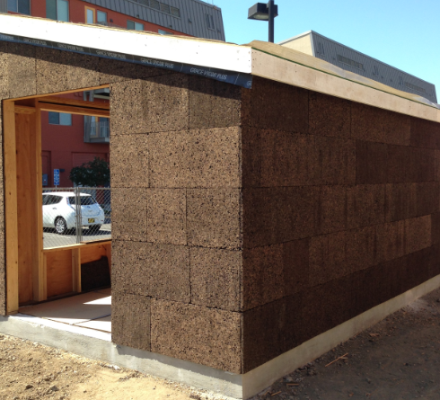
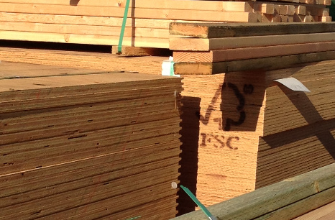
Sustainable Raw Materials
All lumber, trim AND furniture is third-party certified for sustainable forestry
Cork, Denim, Cellulose Insulation

Slide 34


Sustainable Furniture (examples)
Made in USA
FSC certified
No Formaldehyde
No Chemical Fire Retardants

Slide 35
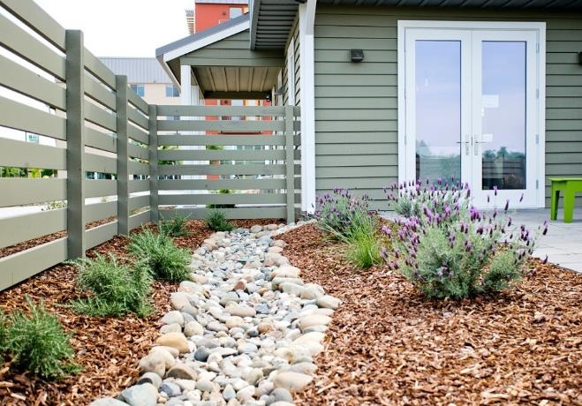
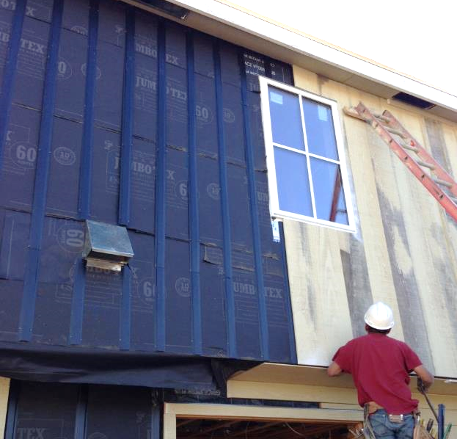
Indoor Air Quality: Keep The House Dry First…
Proper grading with swales to direct rainwater to the rain garden
Rainscreen (air gap) behind siding

Slide 36


Fresh Air
We track the airflow out of the house:
  Bath fans, Central vac, Range hood
→ Then run fans if more air is required
Automatic humidity sensing
Plus a manual fan control

Slide 37
Hopefully Some of That Was Interesting.
Now Let’s Move the Ball Down the Field.

Slide 38

All of Our Drawings and Specs are on the Website…

Slide 39


Data Monitoring…
239 Channels Published @ 1-min resolution
Individual water flows
Temperatures, Power, …
Data Loggers

Slide 40


Data Examples
Solar Irradiance (max available solar power)
Actual DC solar power decreases as temperature rises
Fan stages for night cooling
Refrigerator cycles

Slide 41

Ours is Public Because It’s A Hassle To Do It Yourself!

Slide 42


www.HondaSmartHome.com
Michael_Koenig@ahm.honda.com

Slide 43

4. “Holistic Sustainability and Energy Management”
Greg Walker (CABA)
Questions?
Michael Koenig
American Honda Motor Co., Inc
Project Leader, Honda Smart Home U.S.

Slide 44


5. Research Update
Obiorah Ike (ABB, Inc)
5.1 “Smart Home as a Service” 2019 CHC Landmark Research
www.caba.org/research

Slide 45


5. Research Update
Greg Walker (CABA)
5.2 2020 CHC Landmark Research Topic?

Slide 46
6. White Paper Sub-Committee Update
Ken Wacks (Ken Wacks Associates)
6.1 Recently Completed: None

Slide 47

6. White Paper Sub-Committee Update
Ken Wacks (Ken Wacks Associates)
6.2 In Progress:
“Power over Ethernet (PoE) & Digital Electricity (DE) in Commercial and Multiple Dwelling Residential Buildings”
Somfy Systems, Inc. (Chair)
Contemporary Controls Systems, Inc.
LumenCache, Inc.
National Electrical Manufacturers Association (NEMA)
Public Services and Procurement Canada
Renesas Electronics America Inc.
Southwire Company, LLC
UL LLC

Slide 48
6. White Paper Sub-Committee Update
Ken Wacks (Ken Wacks Associates)
6.2 In Progress:
“The Ethics of AI and the IoT Connected Home”
ArcoLogix LLC (Chair)
Enbridge Gas Inc.
George Brown College
Hydro One Networks Inc.
Site 1001, Inc.
Sustainable Resources Management Inc.
Syska Hennessy Group, Inc.
Telecommunications Industry Association (TIA)

Slide 49
6. White Paper Sub-Committee Update
Ken Wacks (Ken Wacks Associates)
6.2 In Progress:
“Human Centric Lighting: Non-Energy Benefits of Lighting and its Smart Controls”
Human Centric Lighting Society (Chair)
ArcoLogix LLC
Control4
National Electrical Manufacturers Association
Syska Hennessy
UL LLC

Slide 50
6. White Paper Sub-Committee Update
Ken Wacks (Ken Wacks Associates)
6.2 In Progress:
“The Evolution of Integrating LiFi Technology into Smart Lighting and Control Systems for the Intelligent Building”
Wharton County Junior College (Chair)
Acuity Brands, Inc.
ArcoLogix LLC
Control4
National Electrical Manufacturers Association
Telecommunications Industry Association (TIA)

Slide 51
6. White Paper Sub-Committee Update
Ken Wacks (Ken Wacks Associates)
All proposals and previously completed CHC White Papers can be downloaded at:
www.caba.org/whitepapers

Slide 52

7. New Business
Roy Perry (Alarm.com)
7.1 Other new CHC business?

Slide 53

8. Announcements
Greg Walker (CABA)
8.1 Past Event Overview:
CEDIA Expo, Sept 10-14, Denver, CO
Greenbuild, Nov 19-20, Atlanta, GA
Smart Home Summit, Nov 19-20, San Francisco, CA
8.2 Upcoming events:
CABA AGM, Dec 5, via Webinar
CES International 2020, Jan 7-10, Las Vegas, NV
The NAHB International Builders' Show (IBS), Jan 21-23, Las Vegas, NV
The Kitchen & Bath Industry Show (KBIS), Jan 21-23, Las Vegas, NV

Slide 54
9. Adjournment
Roy Perry (Alarm.com)
Next CHC Meeting: Late Jan / Early Feb 2019
Continental Automated Buildings Association (CABA)
caba@caba.org
www.CABA.org
www.caba.org/chc
Connect to what’s next™

