Slide 1
Connected Home Council (CHC) Webinar Tuesday, May 28, 2019, 12 NOON – 1:30 PM (ET)
Chair: Roy Perry (Alarm.com, Inc.)
Vice-Chair: Obiorah Ike (ABB, Inc.)
Vice-Chair: Danny Sran (TELUS)

Slide 2
1. Agenda Greg Walker (CABA)
1. Agenda
2. Call to Order, Welcome, Introductions, about the CHC
3. Administrative
“RF Power Enables Smart home IoT Sensors to Go Mainstream” (30 min) - Sanjay Gupta (AirFuel Alliance)
5. Research Update
6. White Paper Sub-Committee Update
7. New Business
8. Announcements
9. Adjournment

Slide 3
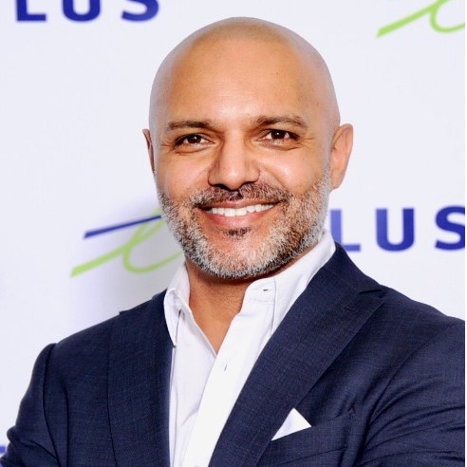
2. Call to Order, Welcome, Introductions, About the CHC Roy Perry (Alarm.com, Inc.)
CHC Chair
Roy Perry
VP Ecosystem Alliances
Alarm.com
CHC Vice-Chair
Obiorah Ike
Product Marketing Manager
ABB Inc.
CHC Vice-Chair
Danny Sran
Mgr. Construction - New Growth Markets TELUS
Past CHC Chair
Jay McLellan
VP, Energy Management, Controls and Automation Leviton Manufacturing Co., Inc.
Established in 2004, the CABA Connected Home Council initiates and reviews projects that relate to connected home and multiple dwelling unit technologies and applications. The Council also examines industry opportunities that can accelerate the adoption of new technologies, consumer electronics and broadband services within the burgeoning connected home market.
www.caba.org/chc

Slide 4
3. Administrative Roy Perry (Alarm.com, Inc.)
3.1 Motion to approve past CHC Minutes:
www.caba.org/chc

Slide 5
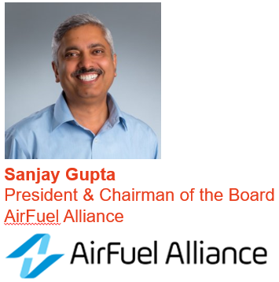
4. “RF Power Enables Smart home IoT Sensors to Go Mainstream” Roy Perry (Alarm.com, Inc.)

Slide 6
Wireless Power Essential for Smarthomes
May 28, 2019
Sanjay Gupta

Slide 7
AirFuel Alliance & CABA
AirFuel Alliance and CABA are working together to accelerate adoption of next generation technologies that offer better consumer and infrastructure solutions.

Slide 8
The Wireless Power Universe
500 million devices last year
40% increase this year
SIZE
2 billion receivers &
transmitters by 2022
$12B USD by end of 2022
AR/VR
Automotive
Industrial
Robotics
Healthcare
IoT
Aerospace/
Defense
SCOPE
Notes:
The global wireless charging market is expected to reach $24B by the end of 2023 with 32.56% CAGR during the forecast period of 2017-2023 according to Market Research Future.
The use cases for wireless power extend far beyond smartphones and tablets. Wireless powering technologies are revolutionizing the capabilities of major industries including commercial, industrial, medical, IoT and more.

Slide 9
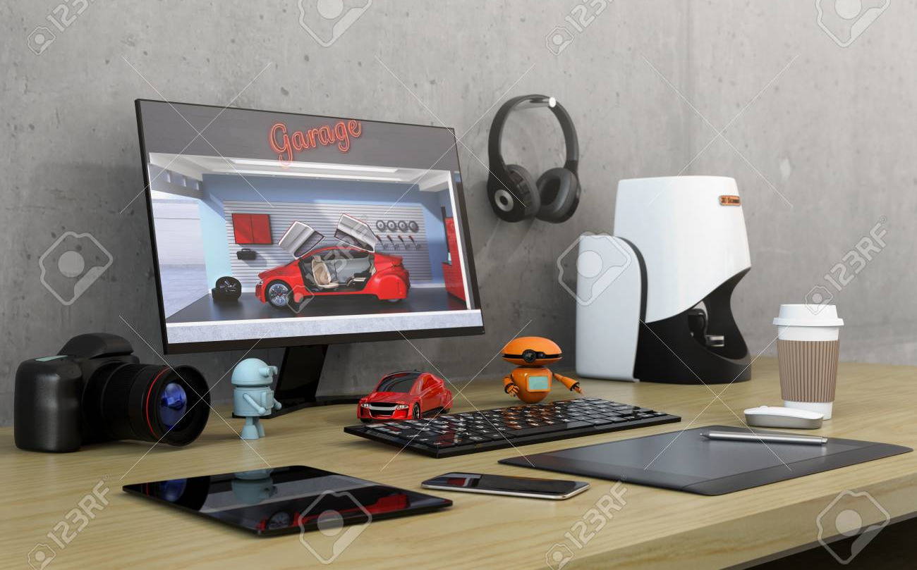
What Consumers Want
Interoperability
Versatility
Fast
Notes:
AFA’s network specifications help members create and deploy solutions that are interoperable, versatile, fast and secure – giving diverse markets the ability to wirelessly power up in public and private places.
Through thick surfaces – no drilling, no mess
Multiple Devices, All Power Levels
Industrial Design
Thin and Flexible
Non-Planar

Slide 10
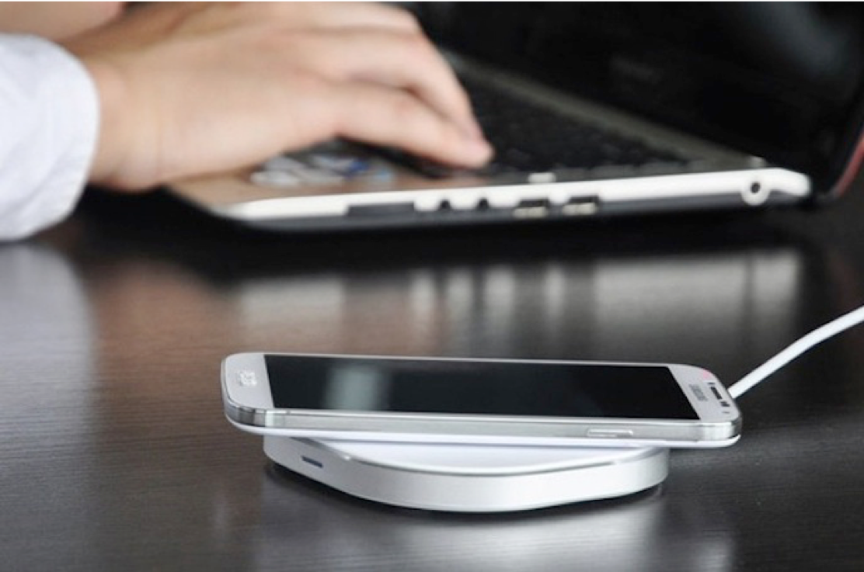
We Need A Technology Evolution
WP1.0
WP2.0
Inductive
100-300KHz
Magnetic
Resonance
6.78MHz
RF
900MHz and higher
Notes:
There is not a “one size fits all” solution for wireless power. AFA supports the spectrum of technologies available, recognizing that different uses demand varying solutions.
AFA is currently focused on Magnetic Resonance & RF solutions because these technologies are ready for deployment, offer the most varied applications, and address key market demands including increased spatial freedom, flexibility and device compatibility.

Slide 11
The AirFuel Alliance – Who We Are
Global coalition of innovative companies committed to a world where we can power up without plugging in
Standards development for leading edge wireless power technologies and acceleration of their deployment.
Diverse membership representing the full spectrum of the wireless power value chain
Notes:
AFA provides technical requirements, specifications and guidelines that members can use to ensure wireless charging products interoperate with one another and that wireless power technology is high quality, safe and reliable.

Slide 12
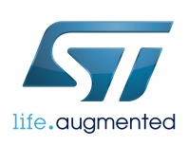
Ecosystem
semiconductors
components
Engineering support
Test
Reference designs
Resonators/ materials
Production
Notes:
AirFuel members represent the full value chain – from semiconductor and device manufacturers to automotive and infrastructure solutions providers – including a mix of large, mid-size and start-up organizations.

Slide 13
So, what is a Smart Home?

Slide 14
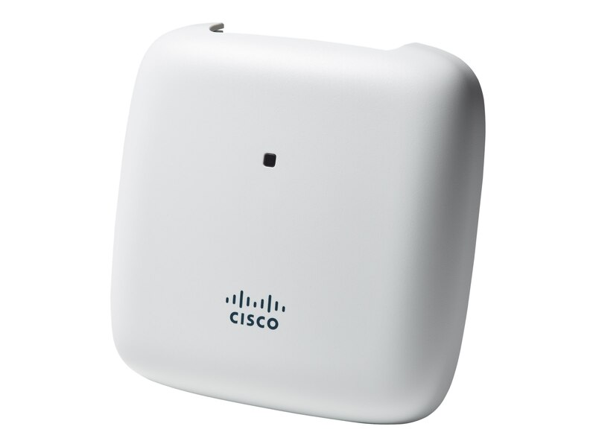
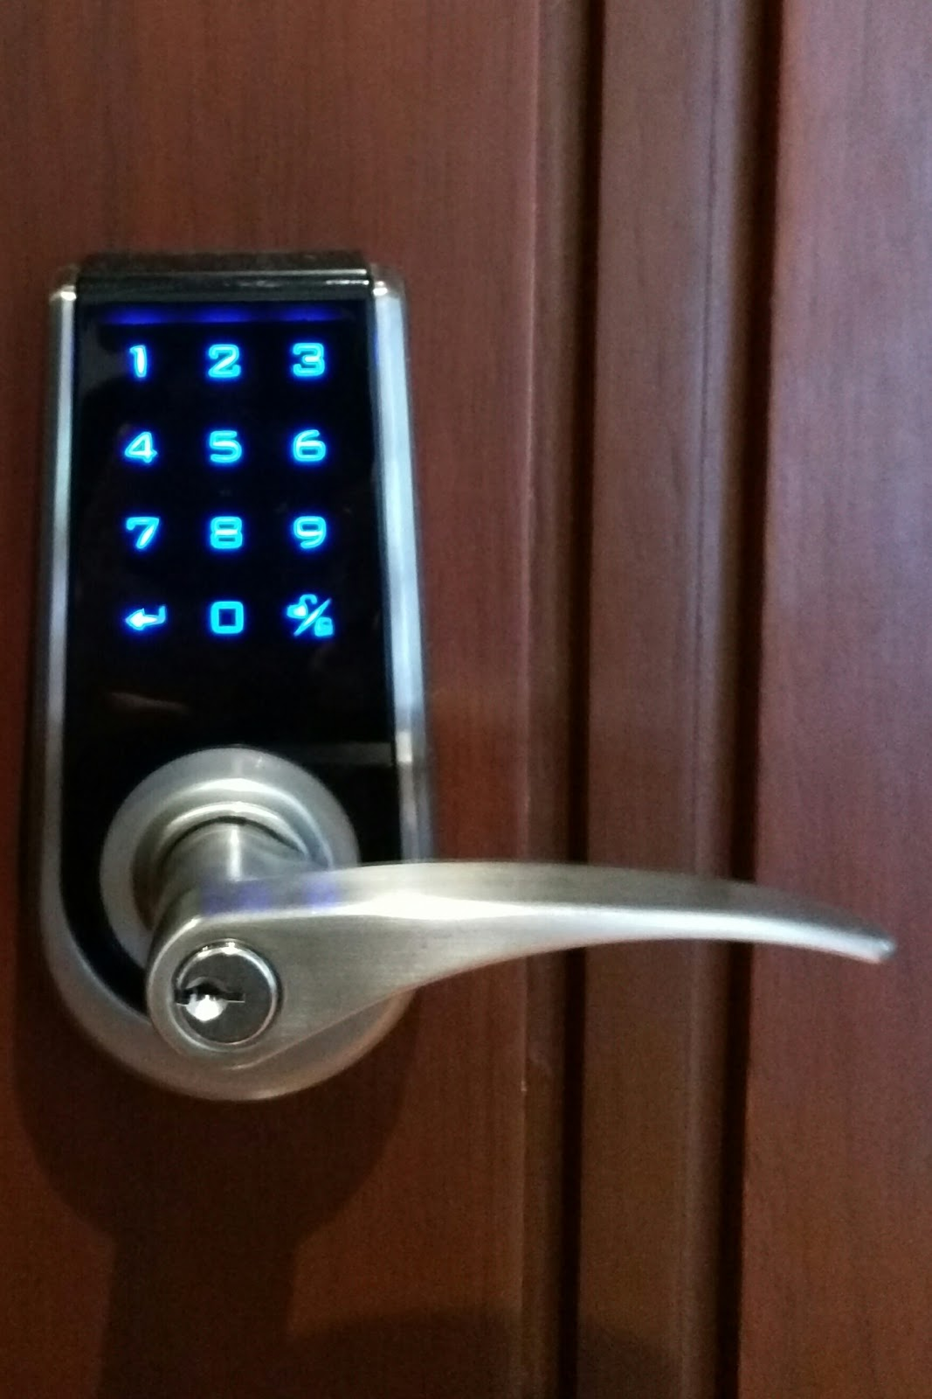
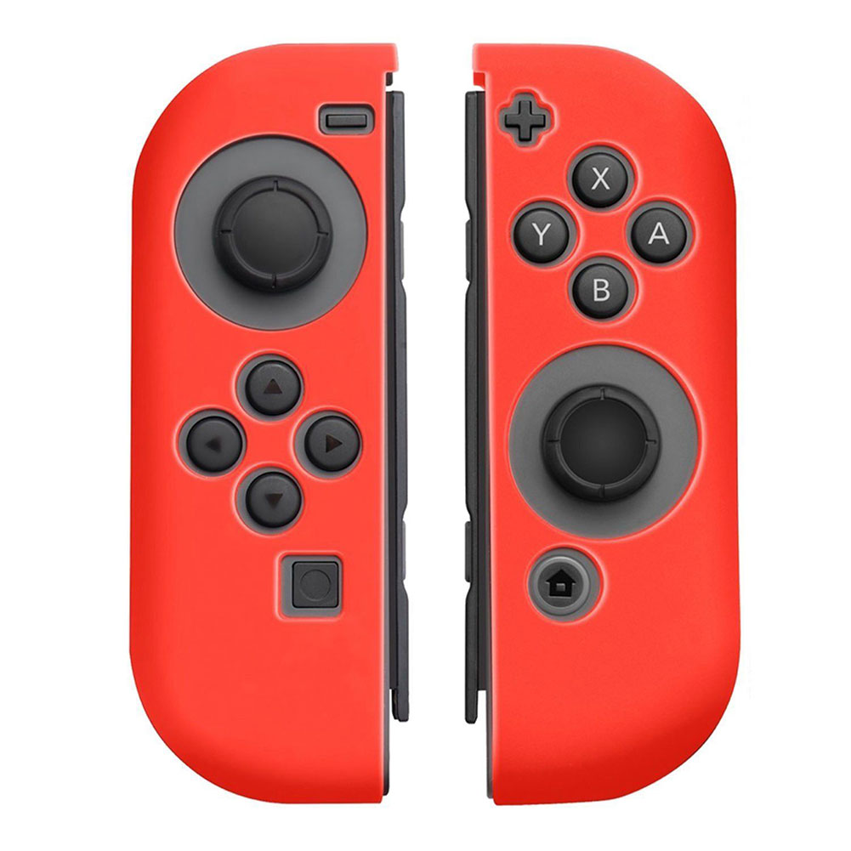
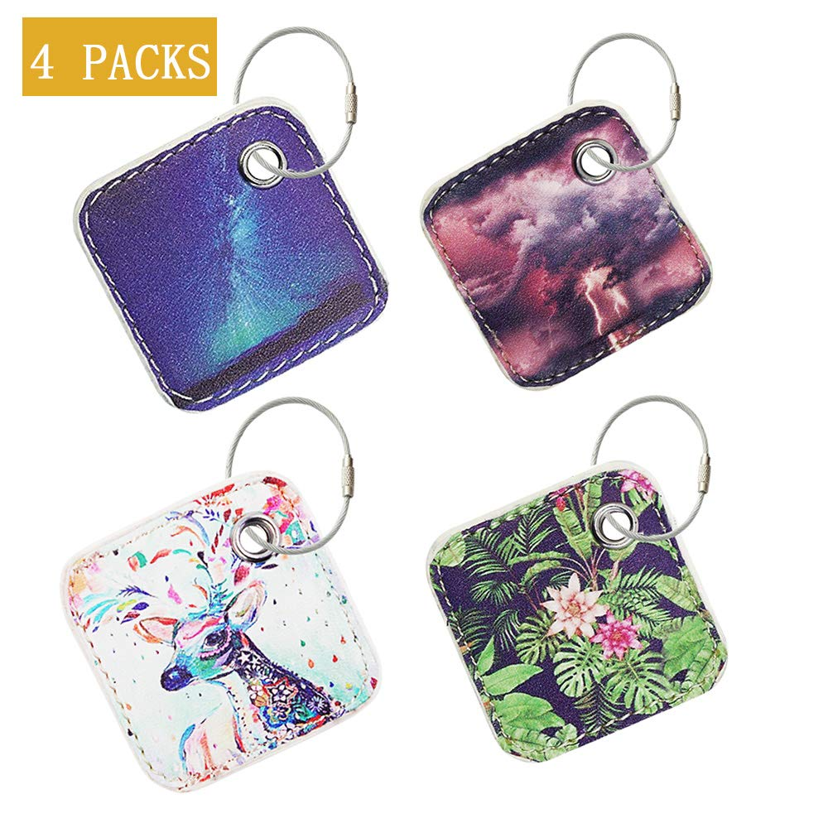
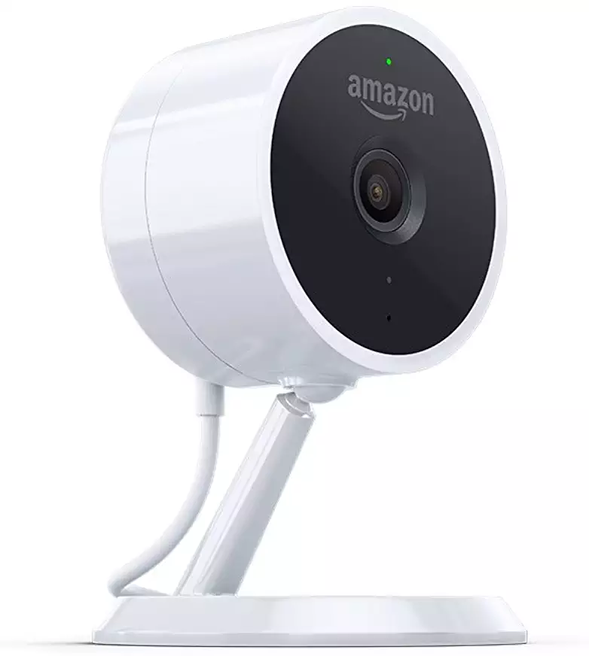
Smart Home needs Smart Sensors

Slide 15
Making Spaces Smart
Smart Buildings
Smart Logistics
Sensors
Sensor
IOT
Smart Offices
Big Data
Cloud Platform
IOT
Device
Smart Home
AI
Services
Connectivity

Slide 16
Benefits of Battery-Free Smart Sensors
1
Long Product Life
2
Environmentally Friendly
3
Thin , Flexible, and Light
4
Low Cost
5
Safe

Slide 17
Smart Sensor Power Requirements
Distance ~5M
One to Many charging
Communication (nice to have)
One chip with high power & high transmission speed solution

Slide 18
AirFuel Uncoupled/RF
Power delivery during normal use
Spatial freedom in all dimensions
Low cost & eco friendly
Technology | Radio Frequency
Max Power Delivered | few watts
Spatial Freedom | 3D, Far Field
Simultaneous Receivers | Multiple
Communication | Out of band (BT4.0/BLE)
Frequency | 900MHz and higher
Notes:
RF works particularly well for wearables, medical devices and other devices that need the broadest spatial freedom.
RF uses a radio frequency transmitter and a receiver embedded within a device (not a coil) to pick up RF energy and convert it to power.
RF provides low power at distances ranging from a few centimeters to a meter, delivering true spatial freedom.

Slide 19
AirFuel Resonant
Spatial freedom in all dimensions
Efficient
High power charging
Low cost, eco friendly infrastructure deployment
Technology | Magnetic Resonance
Max Power Delivered | 100’s of Watts
Simultaneous Receivers | Multiple, max 8
Spatial Freedom | Charging Surfaces
Metal Housings | Supported
Communication | Out of band (BT4.0/BLE)
Frequency | 6.78MHz
Notes:
RF works particularly well for wearables, medical devices and other devices that need the broadest spatial freedom.
RF uses a radio frequency transmitter and a receiver embedded within a device (not a coil) to pick up RF energy and convert it to power.
RF provides low power at distances ranging from a few centimeters to a meter, delivering true spatial freedom.

Slide 20
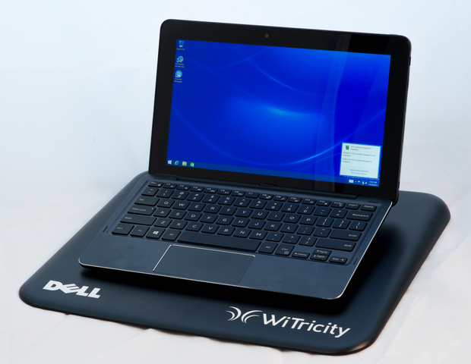
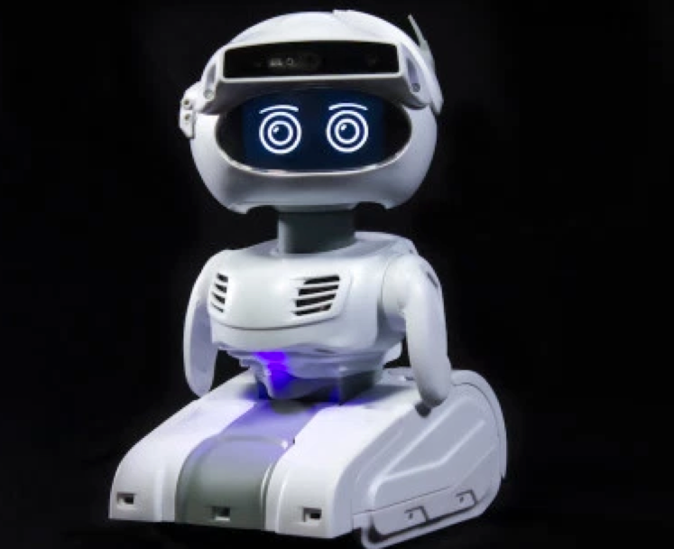
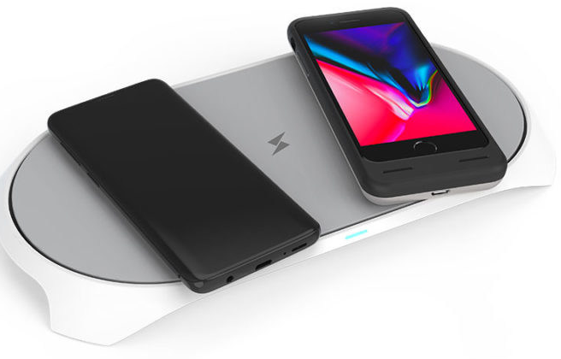
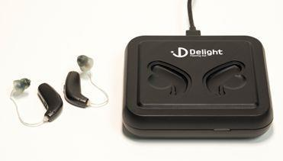
AirFuel Resonant and AirFuel RF in Action
Notes:
We’ve only just begun to discover what’s possible with wireless technologies and how new innovations will advance industries beyond our imagination.
The AirFuel Alliance is proud to help lead the charge.

Slide 21
The Future of Wireless Power is Here.
Join Us...

Slide 22
4. “RF Power Enables Smart home IoT Sensors to Go Mainstream” Roy Perry (Alarm.com, Inc.)
Questions?

Slide 23
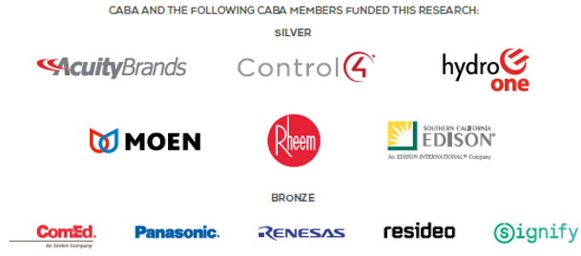
5. Research Update Obiorah Ike (ABB, Inc)
5.1 “Connected Home Roadmap” CHC Research
www.caba.org/research

Slide 24
5. Research Update Greg Walker (CABA)
5.2 2019 CHC Landmark Research “Smart Home as a Service”
www.caba.org/research

Slide 25
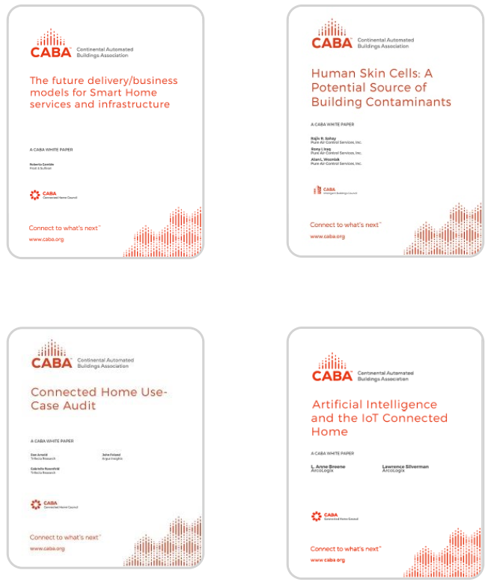
6. White Paper Sub-Committee Update Ken Wacks (Ken Wacks Associates)
6.1 Recently Completed:
www.caba.org/whitepapers

Slide 26
6. White Paper Sub-Committee Update Ken Wacks (Ken Wacks Associates)
6.2 In Progress: “IOT cyber security guidelines, standards and verification systems”
BC Hydro (Working Group Chair)
AgeLight LLC
ARC Advisory Group
ArcoLogix LLC
BC Hydro
CANASA (Canadian Security Association)
CEDIA
Cimetrics, Inc.
Compass Intelligence, LLC
Consultant
Control4
CopperTree Analytics Inc.
CSA Group
Current, powered by GE
Domotz
eMcRey
exp US Services, Inc.
George Brown College
Honeywell International Inc.
Internet Society
Johnson Controls Inc.
Ken Wacks Associates
LonMark International
National Electrical Manufacturers Association (NEMA)
RYCOM Inc.
SPARQ Global
Sustainable Resources Management Inc.
Syska Hennessy Group, Inc.
TC9, Inc
The International Society of Automation
The Siemon Company
TrustCentral
TwelveDot Inc.
UL LLC

Slide 27
6. White Paper Sub-Committee Update Ken Wacks (Ken Wacks Associates)
6.2 In Progress: “Power over Ethernet (PoE) & Digital Electricity (DE) in Commercial and Multiple Dwelling Residential Buildings”
Somfy Systems, Inc. (Working Group Chair)
Contemporary Controls Systems, Inc.
LumenCache, Inc.
National Electrical Manufacturers Association (NEMA)
Public Services and Procurement Canada
Renesas Electronics America Inc.
Southwire Company, LLC
UL LLC

Slide 28
6. White Paper Sub-Committee Update Ken Wacks (Ken Wacks Associates)
6.2 In Progress:
“The Ethics of AI and the IoT Connected Home”
ArcoLogix LLC (Working Group Chair)
George Brown College
Hydro One Networks Inc.
Sustainable Resources Management Inc.BC Hydro
“Human Centric Lighting: Non-Energy Benefits of Lighting and its Smart Controls”
Human Centric Lighting Society (Working Group Chair)

Slide 29
6. White Paper Sub-Committee Update Ken Wacks (Ken Wacks Associates)
All proposals and previously completed CHC White Papers can be downloaded at:
www.caba.org/whitepapers

Slide 30
7. New Business Ken Wacks (Ken Wacks Associates), Andrew Glennie (CABA)
7.1 Featured CABA Member Benefit – CABA White Papers
The Continental Automated Buildings Association publishes its own white paper series focused on both connected homes and intelligent buildings. The reports serve as authoritative guides to assist industry stakeholders make decisions about particular products, services and technologies.
www.caba.org/whitepaper

Slide 31
7. New Business Greg Walker (CABA)
7.2. “Lighting & Homes for Tomorrow” competition
The Lighting for Tomorrow competition provides manufacturers the opportunity to push the industry forward by introducing high quality and innovative designs, contribute to the greater energy efficiency movement, and gain exposure for their brands and products among industry leaders and consumers alike. In particular, the exceptional products identified by the judging panel are heavily promoted by Lighting for Tomorrow for a full calendar year.
The competition is typically launched at the International Lighting Market in Dallas. The 2015-2017 competitions sought LED and OLED fixtures, LED replacement lamps, LED retrofit kits, and lighting control devices.
Lighting for Tomorrow is organized by the American Lighting Association (ALA), the Consortium for Energy Efficiency (CEE) and UL. The annual Lighting for Tomorrow competition was created in 2002 to recognize the best decorative, energy efficient lighting fixtures in the market. Since its inception, Lighting for Tomorrow has encouraged manufacturers to develop well designed, energy efficient lighting products with a specific goal of increasing the availability and market adoption of ENERGY STAR® certified residential lighting products.

Slide 32
7. New Business Roy Perry (Alarm.com)
7.3 Other new CHC business?

Slide 33
8. Announcements Ron Zimmer (CABA)
8.1 Past Event Overview:
Internet of Things World, May 13-16, Santa Clara, CA
CONNECTIONS, May 21-23, San Francisco, CA
8.2 Upcoming events:
CEDIA Expo, Sept 10-14, Denver, CO

Slide 34
9. Adjournment Roy Perry (Alarm.com)
Next CHC Meeting: August 2019
Continental Automated Buildings Association (CABA) caba@caba.org www.CABA.org
www.caba.org/chc
Connect to what’s next™

