Slide 1
Connected Home Council (CHC) Webinar Tuesday, February 12, 2019, 12 NOON – 1:30 PM (ET)
Chair: Roy Perry (Alarm.com, Inc.)
Vice-Chair: Obiorah Ike (ABB, Inc.)
Vice-Chair: Danny Sran (TELUS)

Slide 2
1. Agenda Greg Walker (CABA)
1. Agenda
2. Call to Order, Welcome, Introductions, about CHC
3. Administrative
“The Connected Home - A Perspective from the Field” (30 min)
Zouheir Mansourati (TELUS)
5. Research Update
6. White Paper Sub-Committee Update
7. New Business
8. Announcements
9. Adjournment

Slide 3
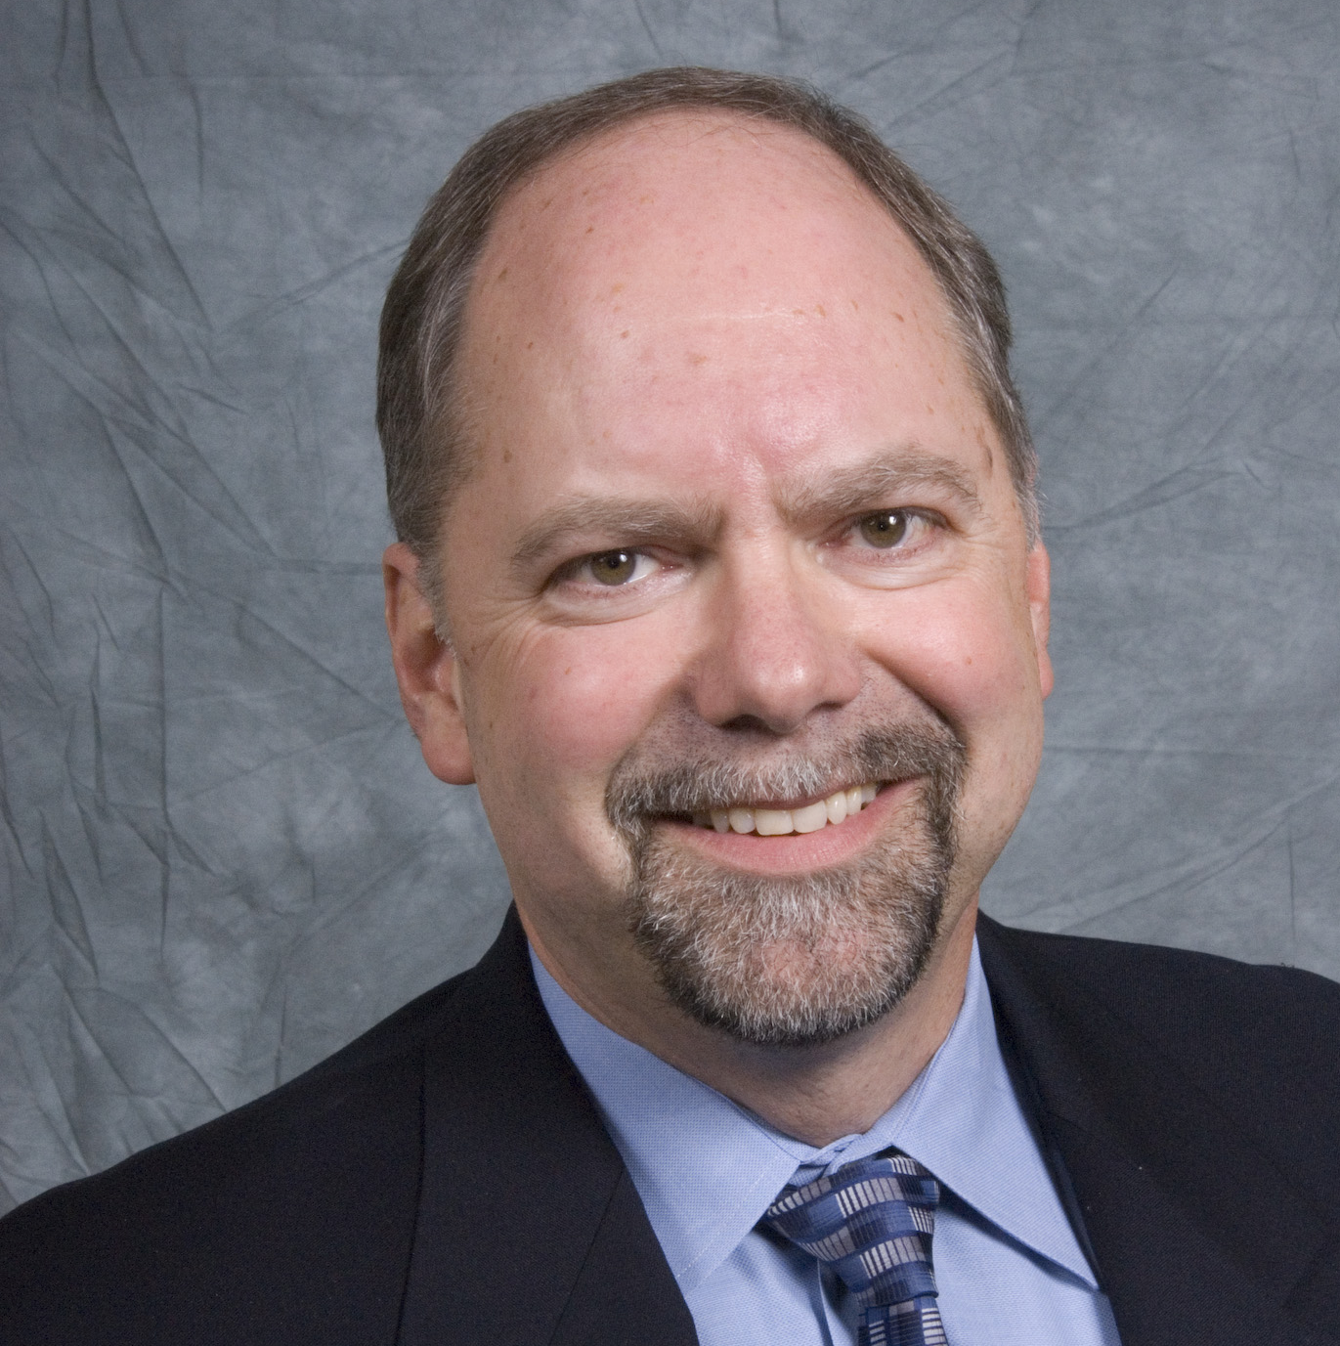
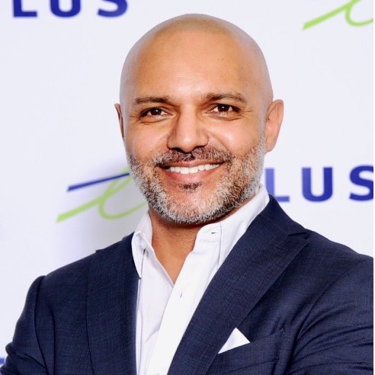
2. Call to Order, Welcome, Introductions, About the CHC Roy Perry (Alarm.com, Inc.)
CHC Chair
Roy Perry
VP Ecosystem Alliances
Alarm.com
CHC Vice-Chair
Obiorah Ike
Product Marketing Manager
ABB Inc.
CHC Vice-Chair
Danny Sran
Mgr. Construction - New Growth Markets TELUS
Past CHC Chair
Jay McLellan
VP, Energy Management, Controls and Automation Leviton Manufacturing Co., Inc.
Established in 2004, the CABA Connected Home Council initiates and reviews projects that relate to connected home and multiple dwelling unit technologies and applications. The Council also examines industry opportunities that can accelerate the adoption of new technologies, consumer electronics and broadband services within the burgeoning connected home market.
www.caba.org/chc

Slide 4
3. Administrative Roy Perry (Alarm.com, Inc.)
3.1 Announcement of the new CHC Chair and CHC Vice-Chair:
“Thanks to all for your support during my tenure as Chair of the CHC. It is my honor to pass the Chairmanship into the capable hands of Mr. Roy Perry of Alarm.com.”
Past CHC Chair, Jay McLellan, VP, Leviton Manufacturing Co., Inc.
CHC Chair
Roy Perry
VP Ecosystem Alliances
Alarm.com
CHC Vice-Chair
Danny Sran
Mgr. Construction - New Growth Markets TELUS

Slide 5
3. Administrative Roy Perry (Alarm.com, Inc.)
3.2 Motion to approve past CHC Minutes:
www.caba.org/chc

Slide 6
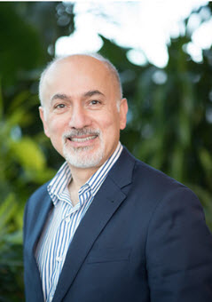
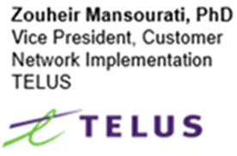
4. “The Connected Home - A Perspective from the Field” Roy Perry (Alarm.com, Inc.)

Slide 7
The Connected Home – A Perspective from the Field
Zouheir Mansourati, Ph.D.
VP, Customer Network Implementation
TELUS
CABA Connected Home Council (CHC) Webinar
Tuesday, February 12, 2019, 12 NOON – 1:30 PM (ET)

Slide 8
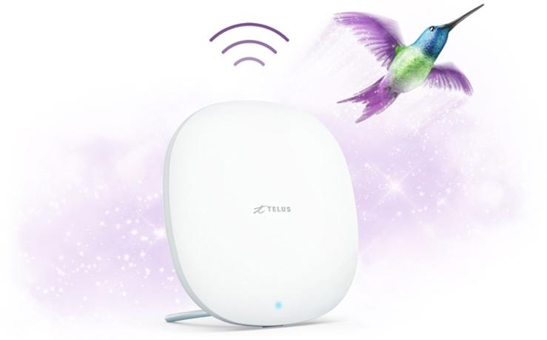
Powered by TELUS PureFibre The #1 Internet technology for speed and reliability.
Available in more than 110 communities, TELUS PureFibre provides the speed, reliability and capacity needed to support the growing bandwidth demands of connected home, security and health solutions for generations to come.
Best Internet
Best home coverage
Best TV
750 Mbps/750 Mbps symmetrical*
TELUS Boost Wi-Fi
Optik 4K with HDR
*In some locations:
950 down/750 up

Slide 9
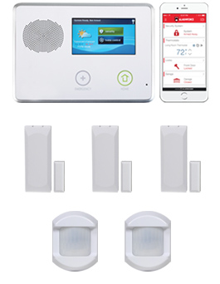
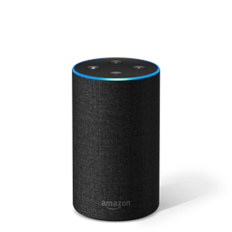
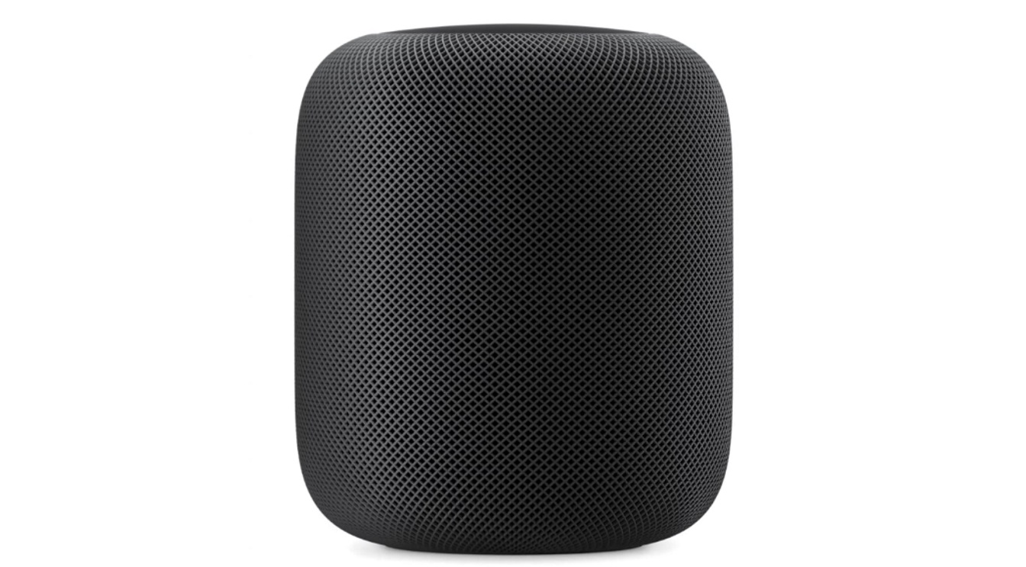
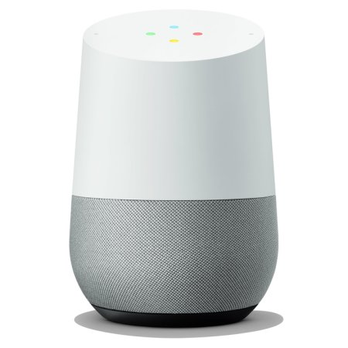
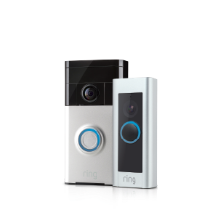
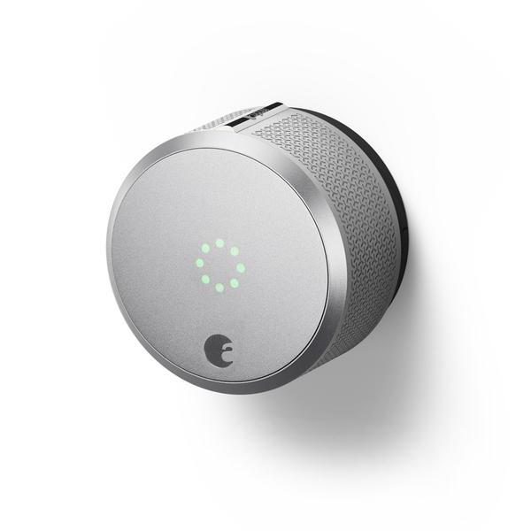
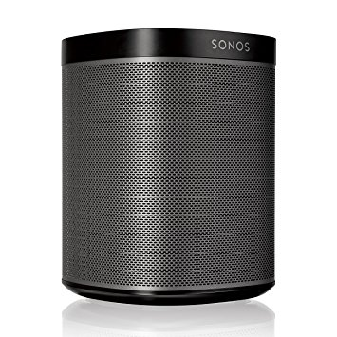
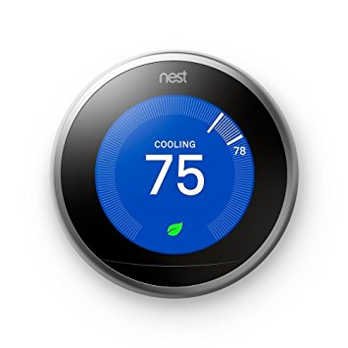
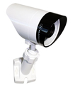
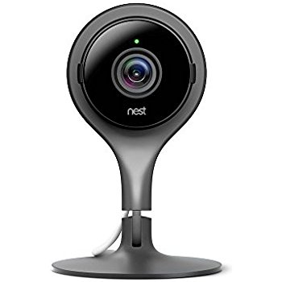
TELUS is positioned to offer incremental value beyond traditional services.
TELUS SmartHome Security is a home security solution that unlocks the potential of a fully customized connected home with seamless hardware integration and white-glove installation; all powered by the TELUS network.
DIY smart home solutions require time and effort to solution infrastructure (internet provider), platform (Homekit, Google, etc.) and compatibility between OTT smart home accessories.
TELUS offers a single, integrated solution, powered by Alarm.com

Slide 10
Landscape
HW Release
Management
6
Video Storage | Analytics
4
Firmware management for TV, HSIA, SHS
Distribution process
Just in time channel fill
7
Outdoor Wi-Fi
TELUS Cloud
Unlimited
AV Recording
Neighbourhood Watch
Video Analytics
5
8
Moves
Virtualized Network Features
“Works with”
9
Video Doorbell Service
Early Motion Detection
10
1
Fiber / Copper
Access
TV STB
2
Wi-Fi |
3
The home ecosystem

Slide 11
Challenges
Self-Install
Power
Supply
Integration
Dilemma
Cost
Complexity
The industry has to address these challenges and more…

Slide 12
Thank You

Slide 13
4. “The Connected Home - A Perspective from the Field” Roy Perry (Alarm.com)
Questions?

Slide 14
5. Research Update Obiorah Ike (ABB, Inc)
5.1 “Connected Home Roadmap” CHC Research
www.caba.org/research

Slide 15
5. Research Update Danny Sran (TELUS)
5.2 2019 CHC Landmark Research Topic?
Connected Home Cybersecurity and Privacy
Connected Home Digital Assistants
Smart Home as a Service
Task Force:
ABB, Inc. – Obiorah Ike
Acuity Brands, Inc. – Tucker Boren
Alarm.com, Inc. – Roy Perry
Control4 – Martin Plaehn
Kimberly-Clark Professional – Stephen Becker
TELUS – Danny Sran
UL – Brian Ferriol

Slide 16
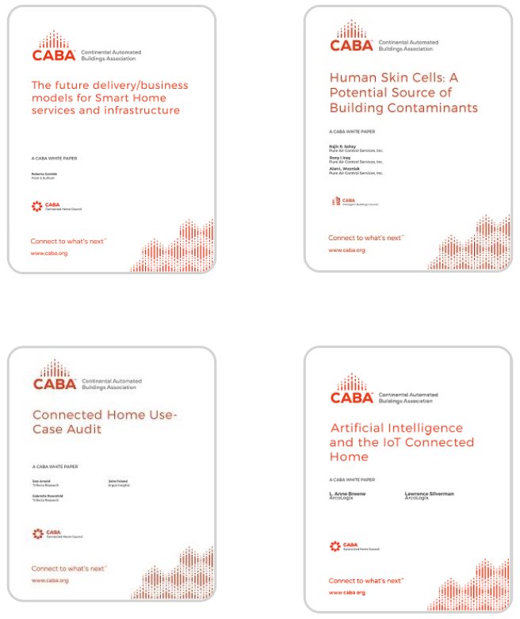
6. White Paper Sub-Committee Update Ken Wacks (Ken Wacks Associates)
6.1 Recently Completed:
www.caba.org/whitepapers

Slide 17
6. White Paper Sub-Committee Update Ken Wacks (Ken Wacks Associates)
6.2 In Progress: “IOT cyber security guidelines, standards and verification systems”
BC Hydro
AgeLight LLC
ARC Advisory Group
ArcoLogix LLC
BC Hydro
CANASA (Canadian Security Association)
CEDIA
Cimetrics, Inc.
Compass Intelligence, LLC
Consultant
Control4
CopperTree Analytics Inc.
CSA Group
Current, powered by GE
Domotz
eMcRey
exp US Services, Inc.
George Brown College
Honeywell International Inc.
Internet Society
Johnson Controls Inc.
Ken Wacks Associates
LonMark International
National Electrical Manufacturers Association (NEMA)
RYCOM Inc.
SPARQ Global
Sustainable Resources Management Inc.
Syska Hennessy Group, Inc.
TC9, Inc
The International Society of Automation
The Siemon Company
TrustCentral
TwelveDot Inc.
UL LLC

Slide 18
6. White Paper Sub-Committee Update Ken Wacks (Ken Wacks Associates)
All proposals and previously completed CHC White Papers can be downloaded at:
www.caba.org/whitepapers

Slide 19
7. New Business Andrew Glennie (CABA)
7.1 Featured CABA Member Benefit
The CABA Information Council identifies and reviews white papers and research for the CABA Information Series, the most authoritative source for technical information in the home and large building automation sectors. CABA Information Series reports are published both in the CABA Public Research Library and the CABA Member Research Library.
www.caba.org/cic

Slide 20
7. New Business Roy Perry (Alarm.com)
7.2 Other new CHC business?

Slide 21
8. Announcements Ron Zimmer (CABA)
8.1 Past Event Overview:
CES International 2019, Jan 8-11, Las Vegas, NV
8.2 Upcoming events:
The NAHB International Builders' Show (IBS), Feb 19-21, Las Vegas, NV
The Kitchen & Bath Industry Show (KBIS), Feb 19-21, Las Vegas, NV
Internet of Things World, May 13-16, Santa Clara, CA
CONNECTIONS, May 21-23, San Francisco, CA
CEDIA Expo, Sept 10-14, Denver, CO

Slide 22
9. Adjournment Roy Perry (Alarm.com)
Next CHC Meeting: April 2019
Continental Automated Buildings Association (CABA) caba@caba.org www.CABA.org
www.caba.org/chc
Connect to what’s next™

