Slide 1
Connected Home Council (CHC) Webinar
Tuesday, September 10, 2019, 12 NOON – 1:30 PM (ET)
Chair: Roy Perry (Alarm.com, Inc.)
Vice-Chair: Obiorah Ike (ABB, Inc.)
Vice-Chair: Danny Sran (TELUS)

Slide 2


1. Agenda
Greg Walker (CABA)
1. Agenda
2. Call to Order, Welcome, Introductions, about the CHC
3. Administrative
“Realizing the Vision of the Smart Home” (30 min) - Kevin Meagher (EAS Consulting)
5. Research Update
6. White Paper Sub-Committee Update
7. New Business
8. Announcements
9. Adjournment

Slide 3
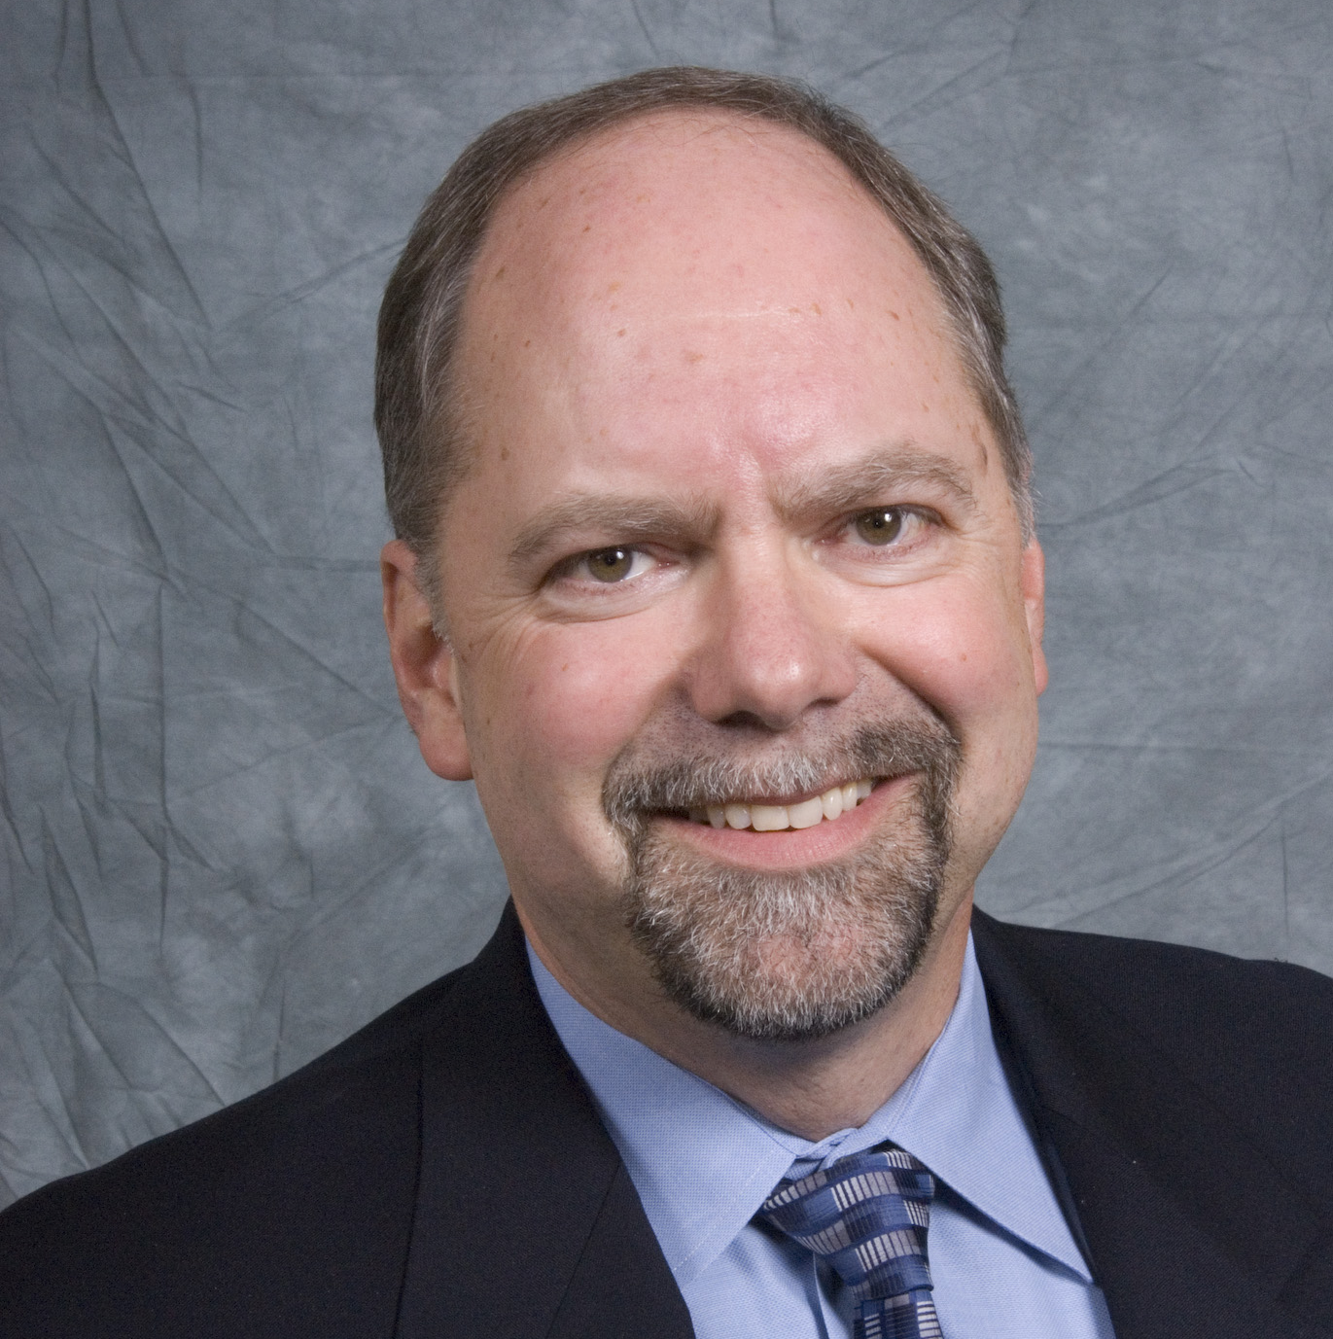

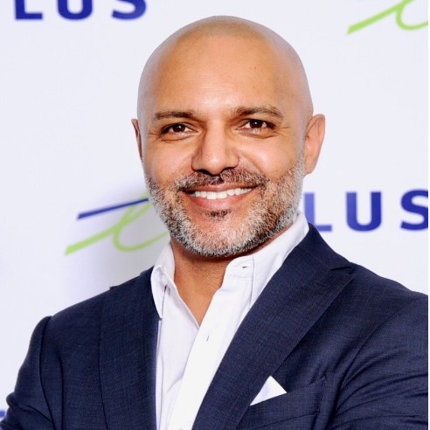
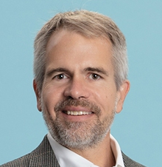




2. Call to Order, Welcome, Introductions, About the CHC
Roy Perry (Alarm.com, Inc.)
CHC Chair
Roy Perry
VP Ecosystem Alliances
Alarm.com
CHC Vice-Chair
Obiorah Ike
Product Marketing Manager
ABB Inc.
CHC Vice-Chair
Danny Sran
Mgr. Construction - New Growth Markets TELUS
Past CHC Chair
Jay McLellan
VP, Energy Management, Controls and Automation Leviton Manufacturing Co., Inc.
Established in 2004, the CABA Connected Home Council initiates and reviews projects that relate to connected home and multiple dwelling unit technologies and applications. The Council also examines industry opportunities that can accelerate the adoption of new technologies, consumer electronics and broadband services within the burgeoning connected home market.
www.caba.org/chc

Slide 4

3. Administrative
Roy Perry (Alarm.com, Inc.)
3.1 Motion to approve past CHC Minutes:
May 28, 2019
www.caba.org/chc

Slide 5
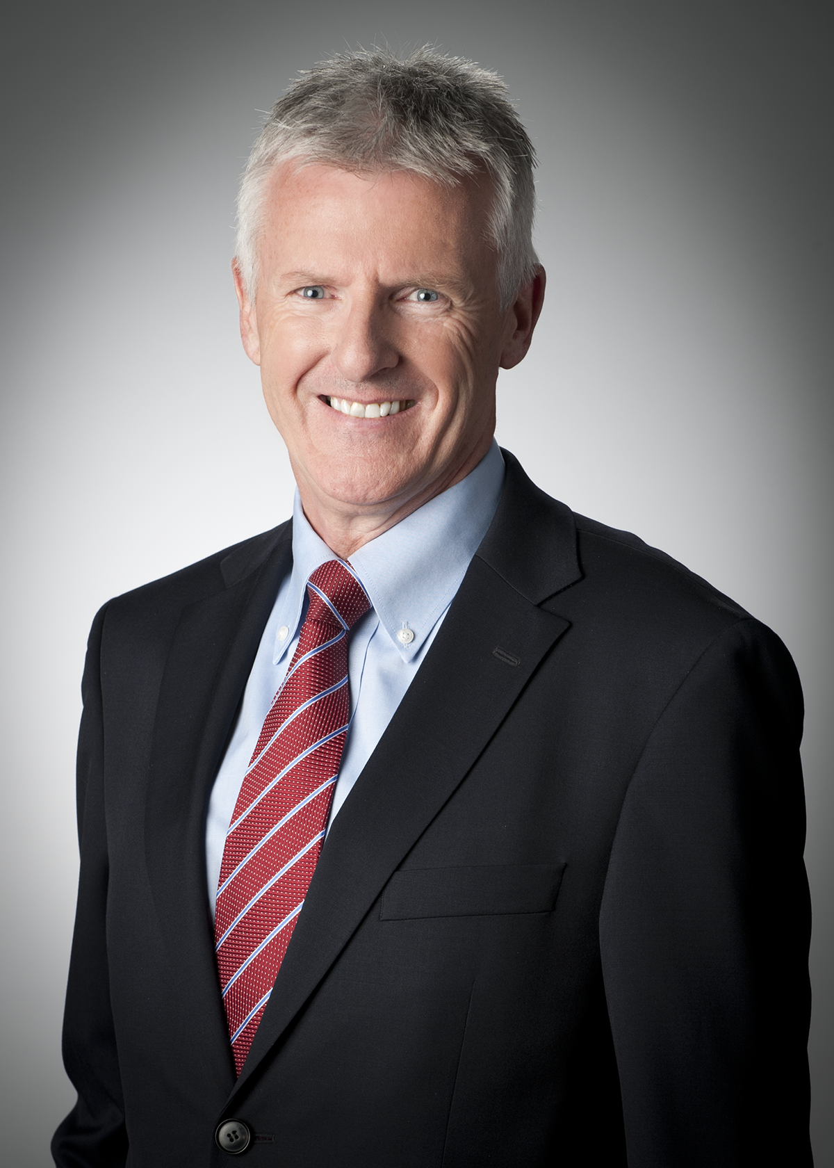
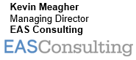
4. “Realizing the Vision of the Smart Home”
Danny Sran (TELUS)

Slide 6

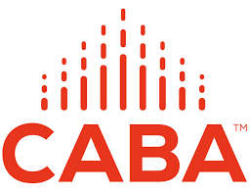
EAS Consulting Winning strategies for the IoT and Smart Home
CHC Meeting
10 Sept 2019
Kevin Meagher
Managing Partner
EAS Consulting
6

Slide 7
The Internet of Things
4th Industrial Revolution
Redefining industry boundaries
Creating a threat to traditional business models
Offers huge growth opportunities
The IoT will generate data that will enable industries to offer new, innovative, value added services with products.
Disruption is happening 10 times faster than during the Industrial Revolution, at 300 times the scale, with 3,000 times the impact.
McKinsey 2018
EAS Consulting
7

Slide 8
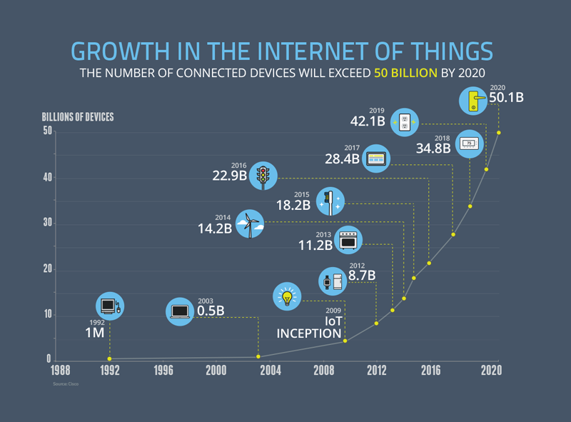
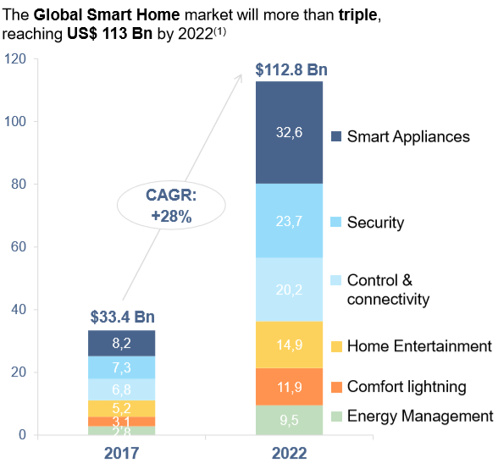
Market Size
The global Internet of Things (IoT) market is projected to reach $8.9T in 2020, attaining a 19.92% Compound Annual Growth Rate (CAGR). Cisco
EAS Consulting
8

Slide 9
Emerging Business Models
Point to Point
Curated
Open
Pro’s
The same benefits as point to point.
More services.
Better revenue options.
Easier to manage.
A better experience.
Con’s
Consumers locked into a fixed eco system.
Creates tension with device manufacturers.
More challenging to manage.
Pro’s
Ideal consumer solution.
The same benefits as curated.
Still more services.
Growth to embrace full IoT solutions.
Con’s
More complexity to deliver.
Still have tensions with device manufacturers.
Pro’s
Ownership of data.
Control of the UX.
Relationship with the consumer.
Simple to deploy and sell.
New revenues.
Con’s
Consumers have limited capability.
No interoperability.
Limited growth options.
EAS Consulting
9

Slide 10
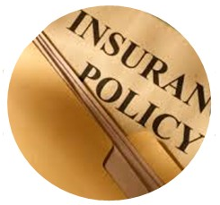






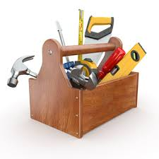
The Smart Home Opportunity
Data. Channels are recognizing the value of data from devices and they see it as a source of competitive advantage.
Consumer Engagement. There are opportunities to develop the customer relationship.
Services. There are opportunities to offer services that help to differentiate and create new revenue opportunities.
Add Value. There are ways to bundle more value; for example, installation, support, maintenance, and warranty offerings
Flood, Fire
Security
Reduce risk with monitoring and
Response
IoT Insurance
Products
Property, Commercial,
Health, Vehicles, Warranties
Home
Management
Automation, Analytics
Data
Services
AI, Analytics, Weather
Alerts, Advice Centre
Property
Services
Maintenance,
Appliances, and Support
Peace of
Mind
Engage and help consumers
EAS Consulting
10

Slide 11
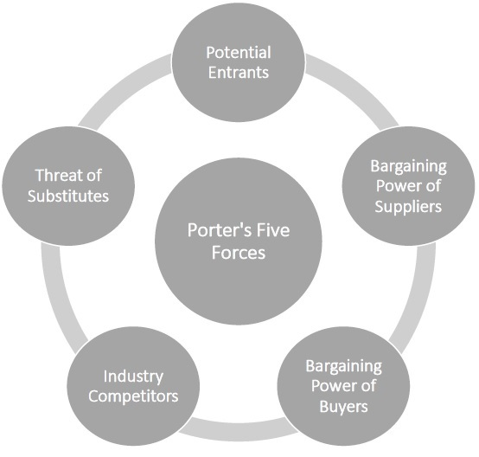
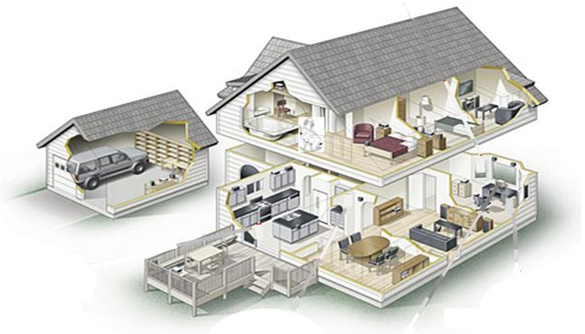
The Competitive Environment
Traditional Services...
want to adapt to protect their existing business, for example security
Service Providers...
want to increase ARPU and improve retention rates.
Retailers....
are working to use connectivity to develop the consumer relationship
Utilities
use connectivity to support Smart Grid/DR initiatives and connect with customers
Manufacturers....
aim to add more value to products and link direct to consumers
Infrastructure Companies
See strong growth in enterprise solutions for Cloud Services, AI and Big Data
Insurance Companies
want to reduce claims and improve consumer engagement
New entrants
want to use data and connectivity to launch new businesses
EAS Consulting
11

Slide 12



The Eco-System and Business Models
Consumer UX
3rd Party Services
Cloud
Service Provider
Home
EAS Consulting
12

Slide 13
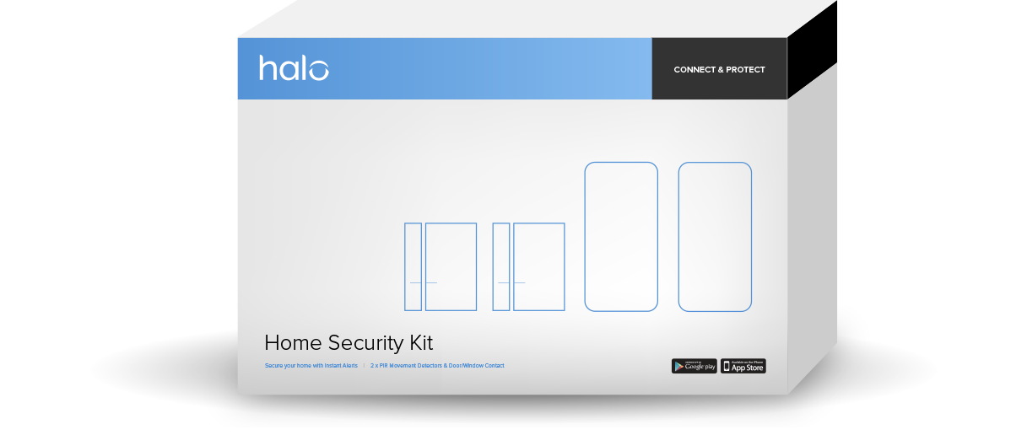
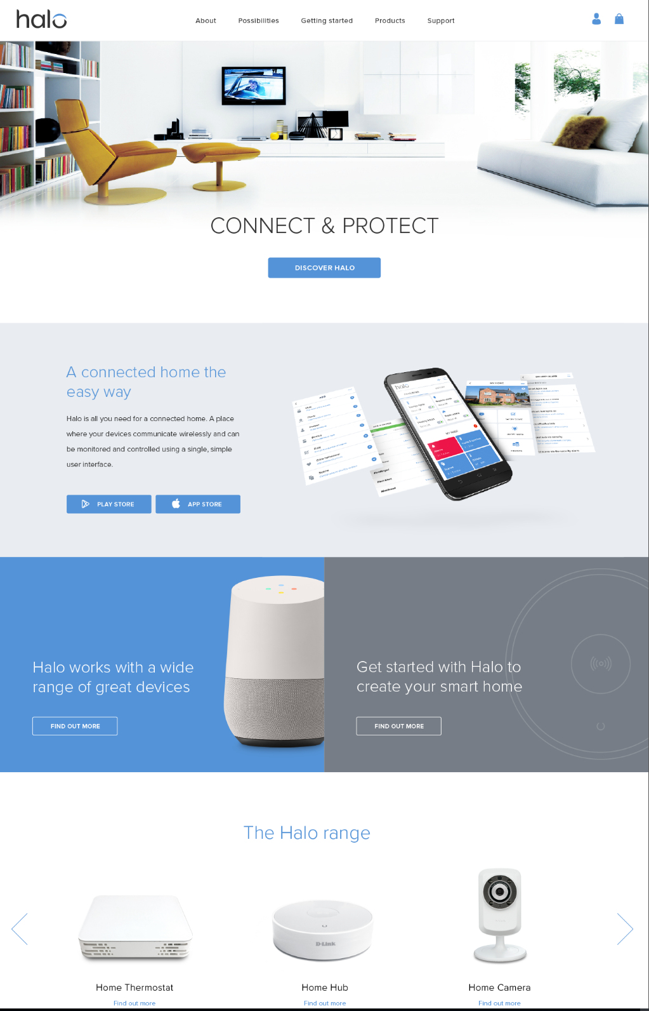

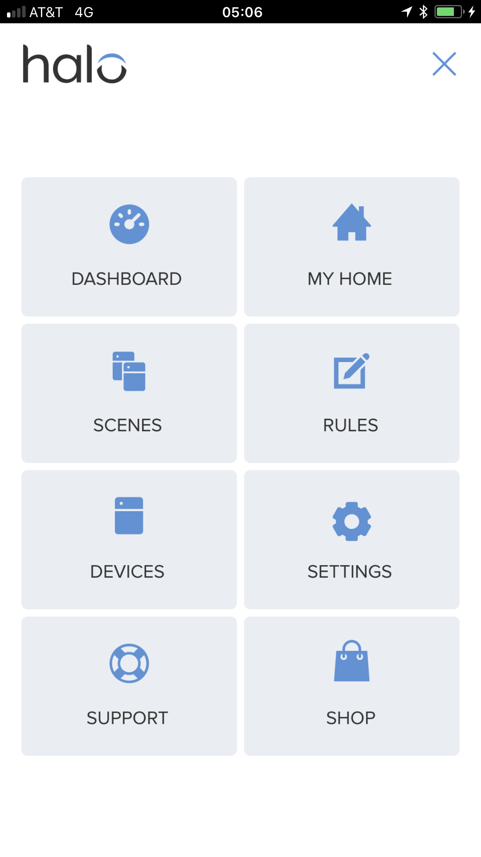

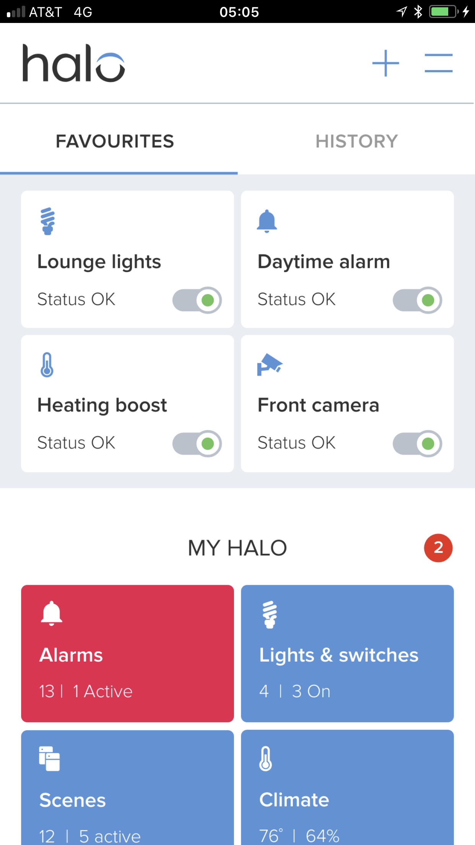

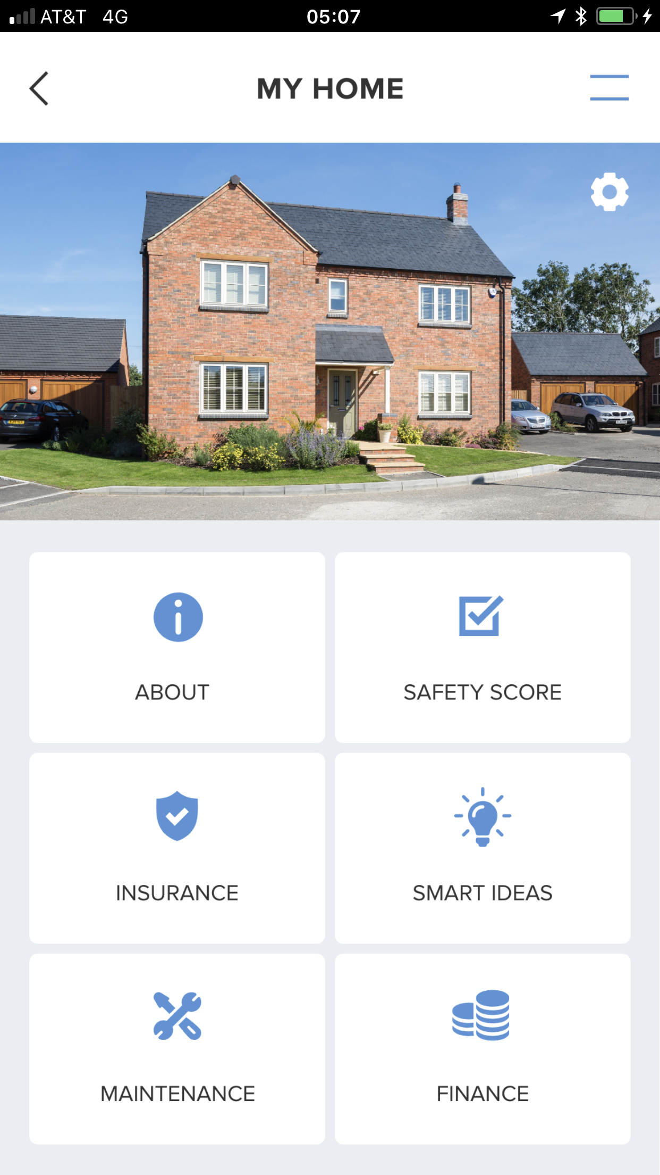
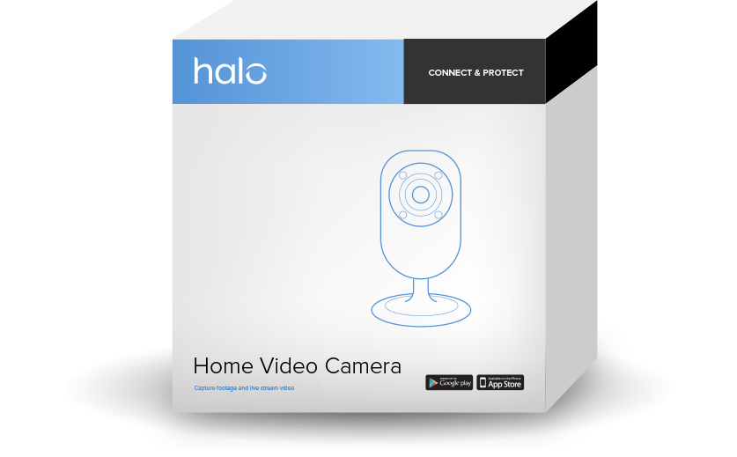
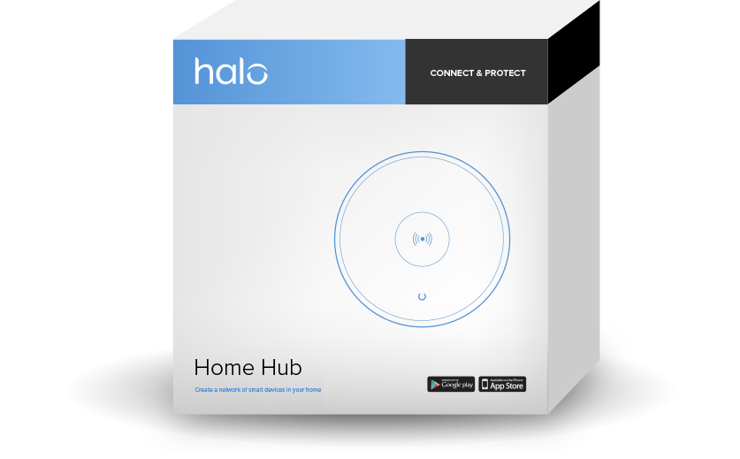
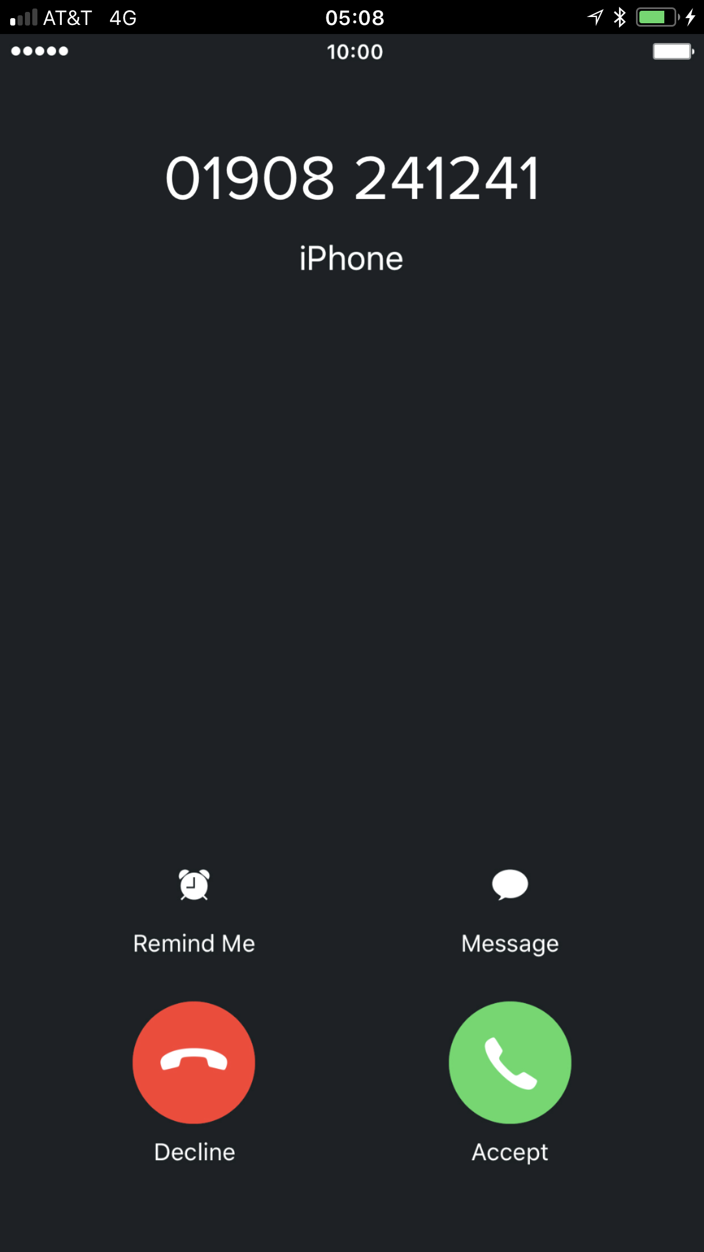
The Winning Models
Entry Level Smart Home Kits
Monitoring and support services that add value
Weather.com
Pro Monitoring
Trade Services
Focus on making homes safer, more efficient and easier to manage.
A curated solution open to other 3rd party devices
EAS Consulting
13

Slide 14
Challenges- a Lot of Moving Parts
SUPPORT SERVICES
Commercial Interests
Standards
Channels
Access to Data
Monetising Business Models
Forging Partnerships
Selling
Customer Focus
IoT DATA AND ANALYTICS
SMART HOME PRODUCTS AND SERVICES
Service Plans
Logistics
Partner Services
Customer
Support
EAS Consulting
14

Slide 15
Questions?

Slide 16
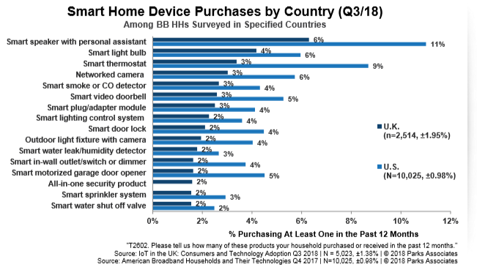
Consumer Drivers
The Key Value Proposition
Monitor and Control your home from anywhere.
Consumer Drivers
Peace of Mind
Efficiency and Savings
Convenience and Comfort
The value propositions are critical and research shows they change with demographics and location
EAS Consulting
16

Slide 17
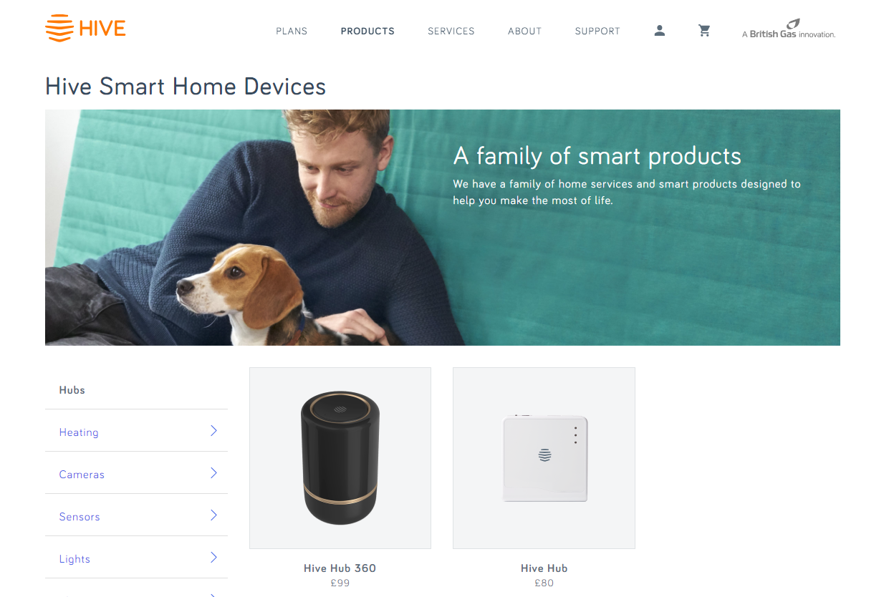
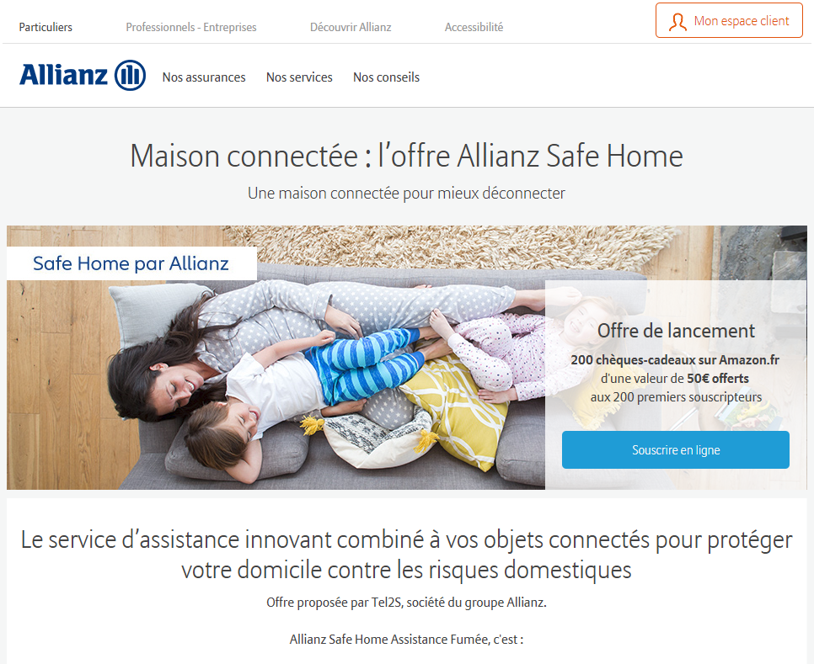
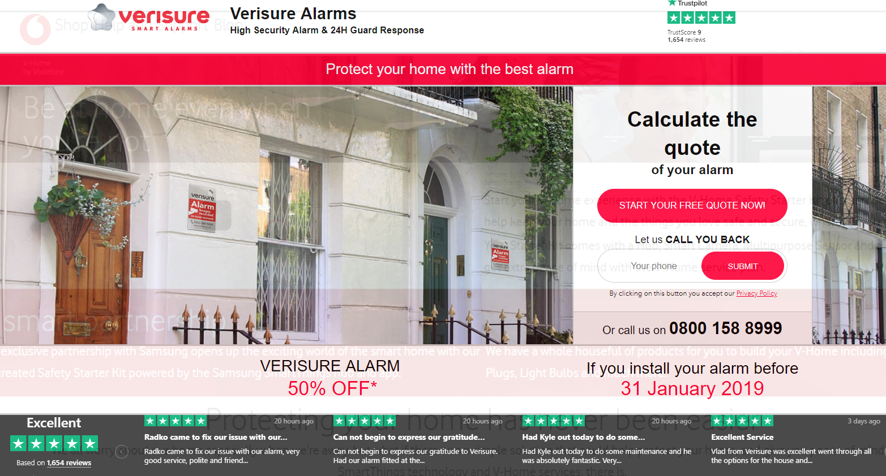
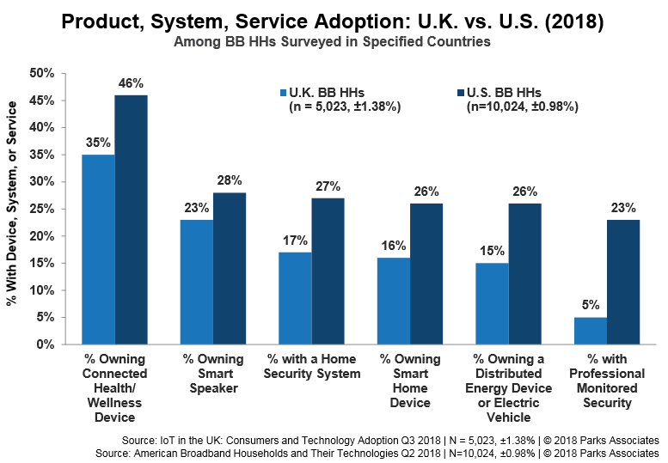
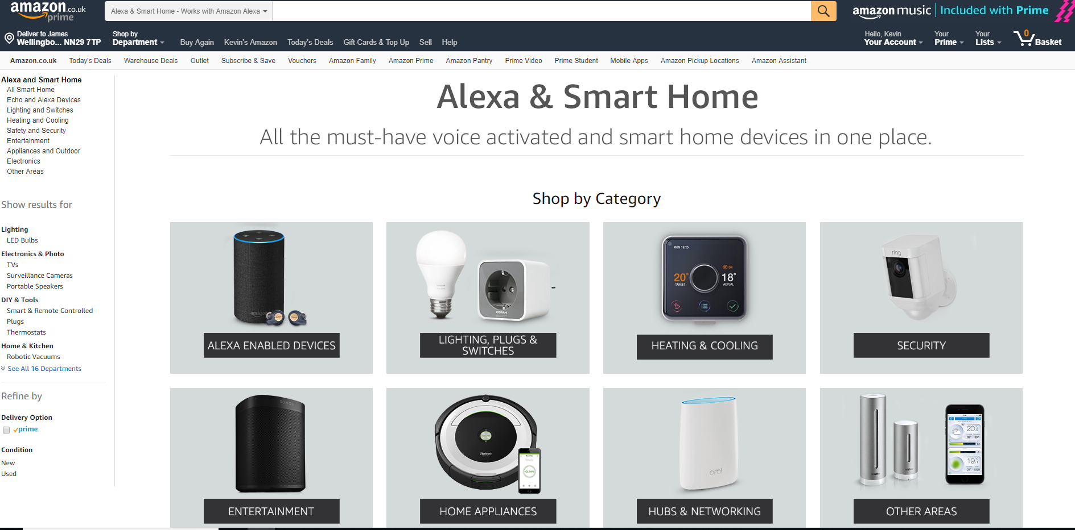
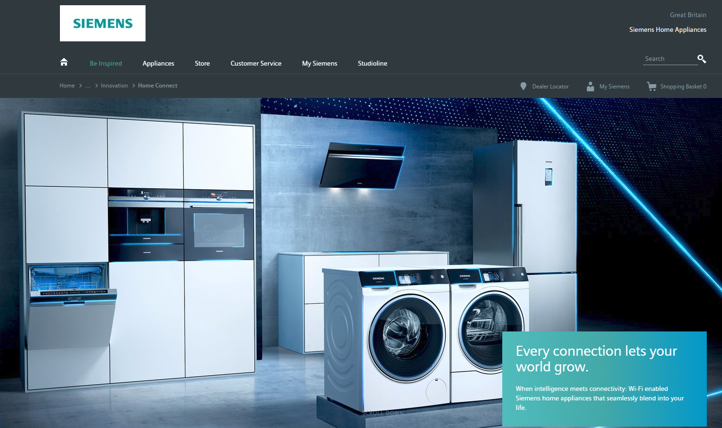
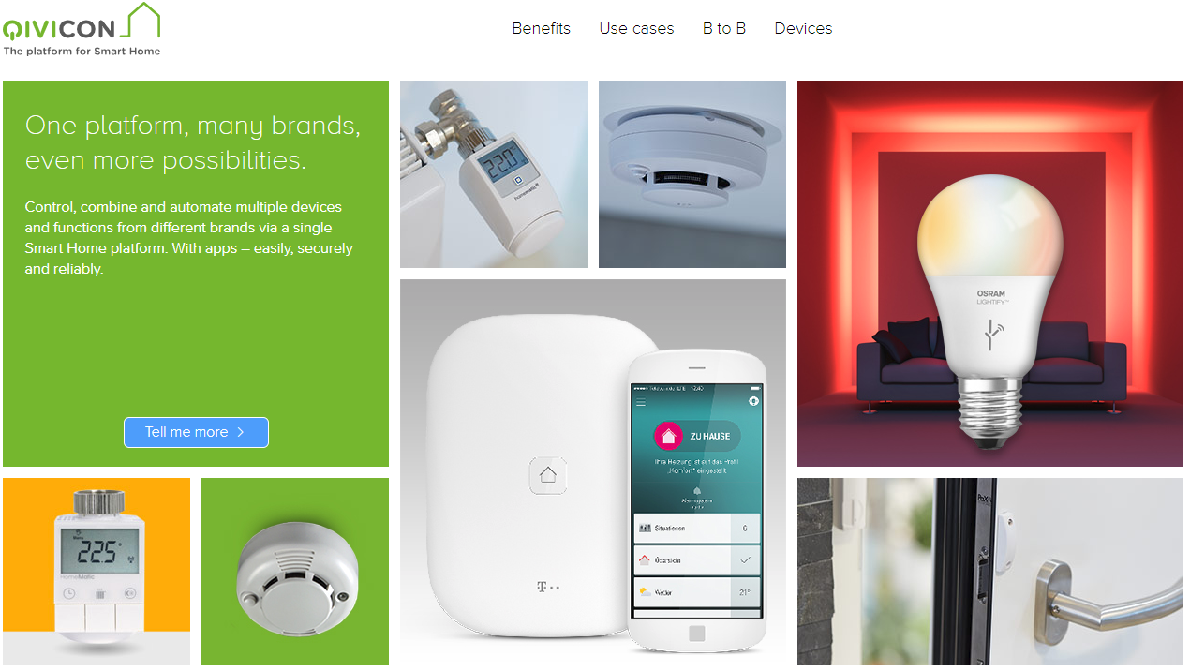
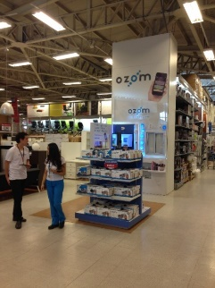
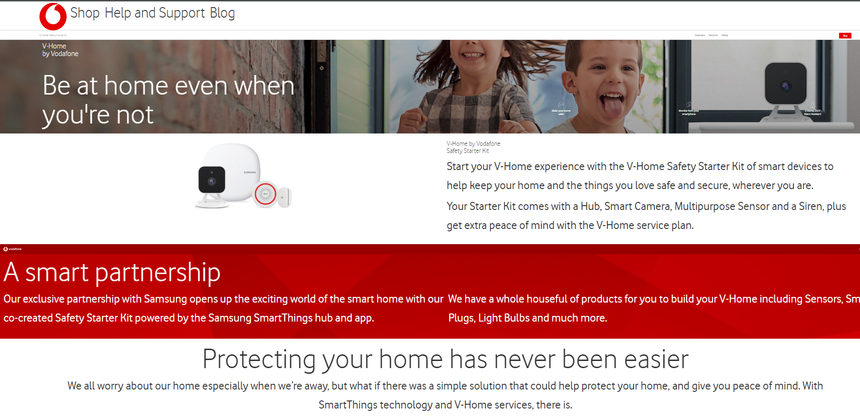
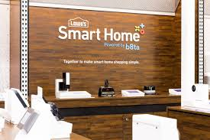
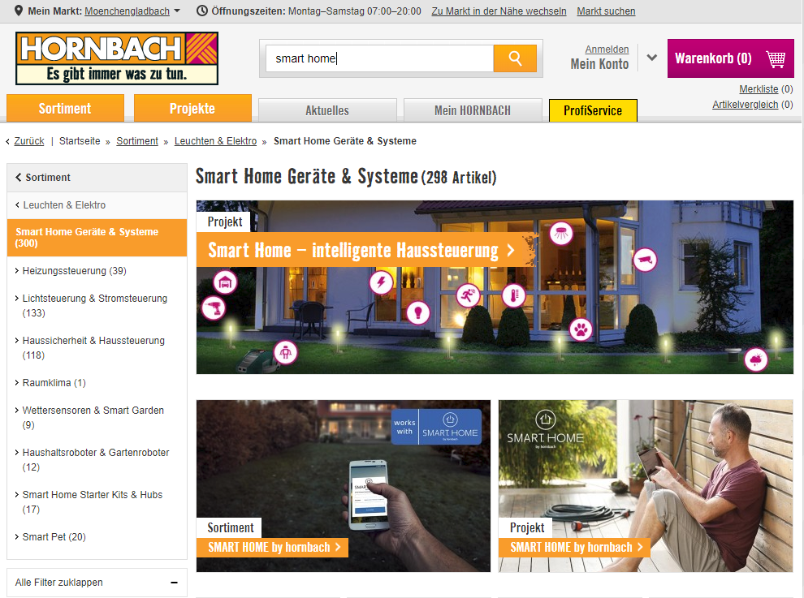
Current Trends and Developments
75% of connected home devices are provided by service providers (telcos, Utilities, Security Companies etc) McKinsey 2018
EAS Consulting
17

Slide 18
The Business Model
Twin-track approach with a B2B and B2C model there will be 2 different business models:
B2C. Create an offering through the channel to give insights, revenue, and create a benchmark in the market that would allow channel partners to run promotions. Aim to secure:
30% margin on product sales.
£30/base customer/annum.
B2B. White label the Halo offering to channel partners and aim to get:
Income from initial development. This will vary depending on the requirement but would typically be £100k.
5% margin on product. Aim to stay away from product supply and get customers to fund all working capital.
Managed service fee – typically, £1.50/user/month depending on features.
MOQ commitment to 30k users (£45k/month).
Pass-on any costs associated with other 3rd party services, for example, weather.com
EAS Consulting
18

Slide 19
Go-to-Market Plan
Focus on your own customers and prioritise entry into other channels
P&C
SME
Health
Insurers
‘Halo’
Hub
Product Set
App
Admin
Customer Support
Billing
Sales Website.
Service Providers
Cable
Satellite
Mobile
Offer it as a white Label Solution
Security Industry
Grey Market
Professional Channels
Warranties
Installation
Holiday Homes
Housing Associations
Service Industries
Sell Direct/ Indirect Halo Brand
Retailers/Resellers
Stores
Saga
Age Concern
Health
Insurance
Local Government
Health Authority
Own Customers
Swap/Upsell
EAS Consulting
CONFIDETIAL
19

Slide 20

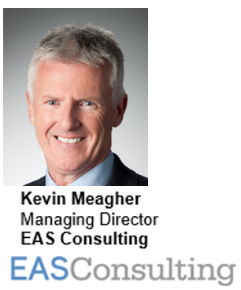
4. “Realizing the Vision of the Smart Home”
Danny Sran (TELUS)
Questions?

Slide 21
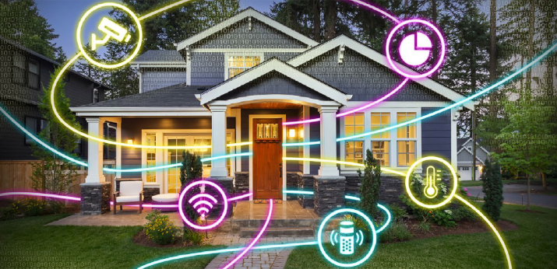
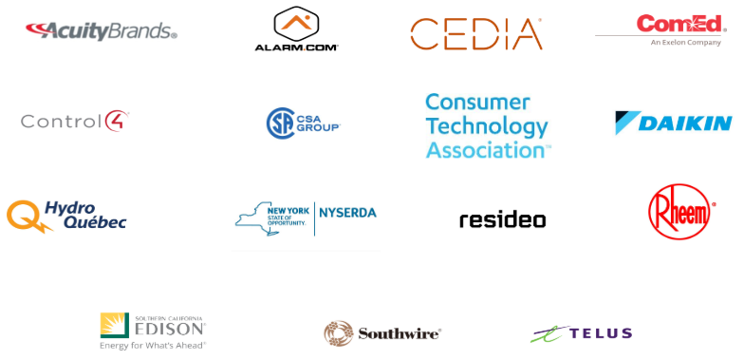
5. Research Update
Obiorah Ike (ABB, Inc)
5.1 “Smart Home as a Service” 2019 CHC Landmark Research
www.caba.org/research

Slide 22

6. White Paper Sub-Committee Update
Ken Wacks (Ken Wacks Associates)
6.1 Recently Completed:
“IoT Cyber Security Guidelines, Standards and Verification Systems”
Agelight Digital Trust Advisory Group
ARC Advisory Group
ArcoLogix LLC
Automation Standards Compliance Institute
BC Hydro
CANASA (Canadian Security Association)
Compass Intelligence, LLC
Consultant
Control4
CopperTree Analytics Inc.
CSA Group
Domotz
eMcRey
EXP
George Brown College
Honeywell International Inc.
Johnson Controls Inc.
Ken Wacks Associates
LonMark International
National Electrical Manufacturers Association (NEMA)
RYCOM Corporation
Sustainable Resources Management Inc.
Syska Hennessy Group
TC9, Inc
The Siemon Company

Slide 23

6. White Paper Sub-Committee Update
Ken Wacks (Ken Wacks Associates)
6.2 In Progress:
“Power over Ethernet (PoE) & Digital Electricity (DE) in Commercial and Multiple Dwelling Residential Buildings”
Somfy Systems, Inc. (Chair)
Contemporary Controls Systems, Inc.
LumenCache, Inc.
National Electrical Manufacturers Association (NEMA)
Public Services and Procurement Canada
Renesas Electronics America Inc.
Southwire Company, LLC
UL LLC

Slide 24
6. White Paper Sub-Committee Update
Ken Wacks (Ken Wacks Associates)
6.2 In Progress:
“The Ethics of AI and the IoT Connected Home”
ArcoLogix LLC (Chair)
Enbridge Gas Inc.
George Brown College
Hydro One Networks Inc.
Site 1001, Inc.
Sustainable Resources Management Inc.
Syska Hennessy Group, Inc.
Telecommunications Industry Association (TIA)

Slide 25
6. White Paper Sub-Committee Update
Ken Wacks (Ken Wacks Associates)
6.2 In Progress:
“Human Centric Lighting: Non-Energy Benefits of Lighting and its Smart Controls”
Human Centric Lighting Society (Chair)
ArcoLogix LLC
Control4
National Electrical Manufacturers Association
Syska Hennessy
UL LLC

Slide 26
6. White Paper Sub-Committee Update
Ken Wacks (Ken Wacks Associates)
6.2 In Progress:
“The Evolution of Integrating LiFi Technology into Smart Lighting and Control Systems for the Intelligent Building”
Wharton County Junior College (Chair)
Acuity Brands, Inc.
ArcoLogix LLC
Control4
National Electrical Manufacturers Association
Telecommunications Industry Association (TIA)

Slide 27


6. White Paper Sub-Committee Update
Ken Wacks (Ken Wacks Associates)
All proposals and previously completed CHC White Papers can be downloaded at:
www.caba.org/whitepapers

Slide 28
7. New Business
Roberta Gamble (Frost & Sullivan)
7.1 Frost & Sullivan Research Opportunity

Slide 29
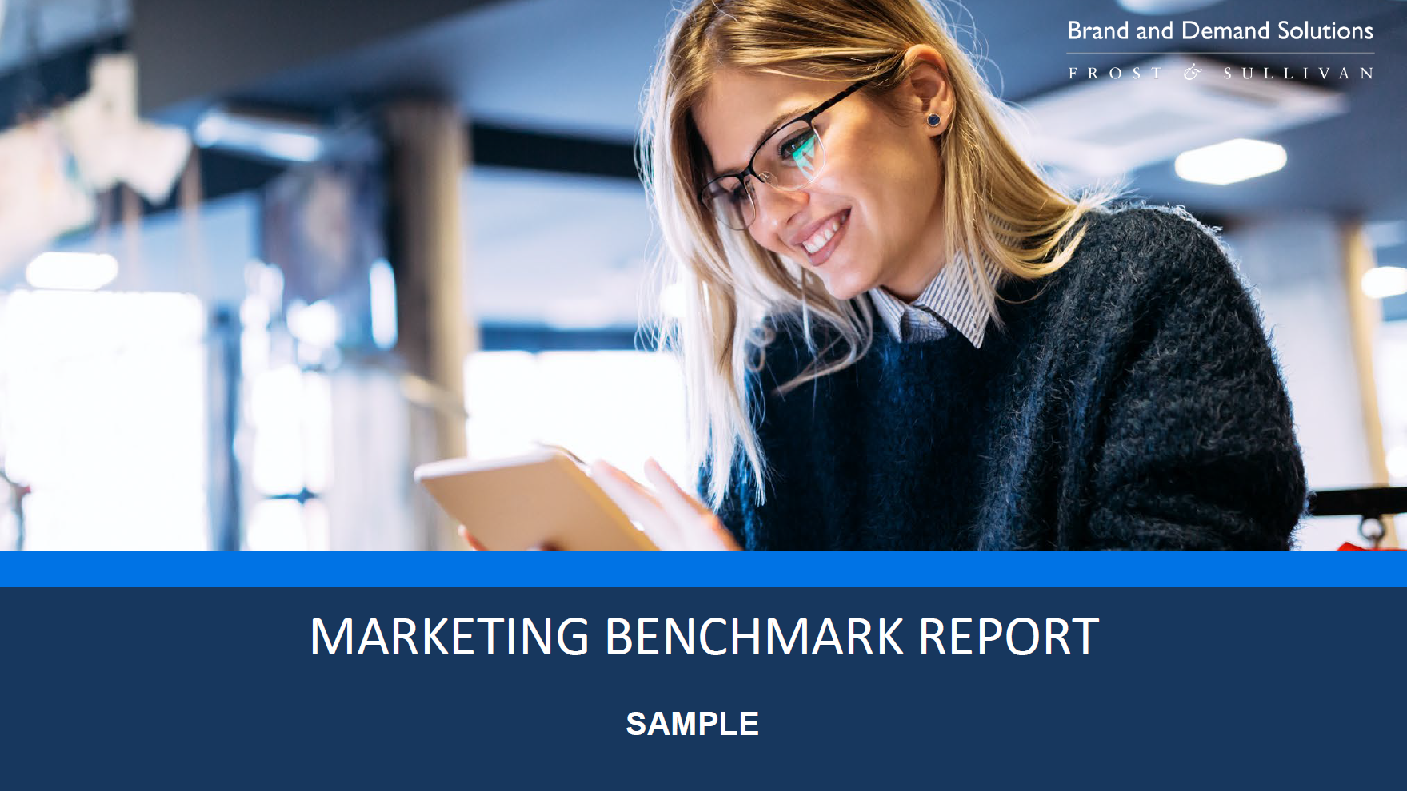

Slide 30
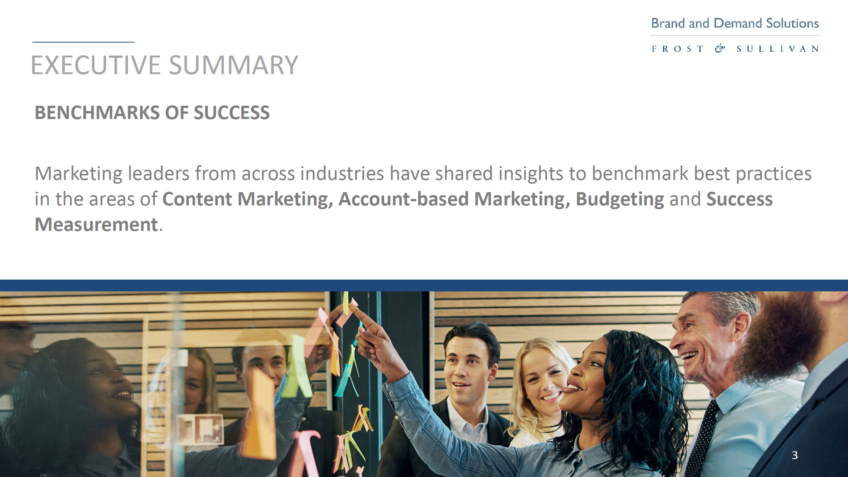

Slide 31

What is the Frost & Sullivan Benchmark Study?
20 minute interactive survey followed by 20+ page custom report within 2-3 weeks
Top level comparison of your spending activities and budge vs. goals and returns
How your marketing budget compares to others. Are you underfunded?
Where marketing departments are scaling up and what programs they're cutting back on
High level recommendations on how to drive greater returns

Slide 32
Sample slide – Confidential to CABA
MARKETING STRATEGIES: NON-DIGITAL TACTICS
We asked: Please indicate your level of investment this year for the following NON-DIGITAL tactics.
NON-DIGITAL TACTIC: Executive Events
YOUR RESPONSE

Slide 33
MARKETING STRATEGIES: NON-DIGITAL TACTICS
We asked: Please indicate your level of investment this year for the following NON-DIGITAL tactics.
NON-DIGITAL TACTIC: Account-based Marketing
YOUR RESPONSE
Did Not Know

Slide 34
Sample slide – Confidential to CABA
ACCOUNT-BASED MARKETING (ABM) STRATEGIES
Your Overall Top 3 Best Channels
Search Engine Marketing/ PPC/ Retargeting
Display Advertising (CPM)
Content Marketing
30%
30% of surveyed organizations selected Account-based marketing among the THREE BEST channels for generating a return on your investment.

Slide 35
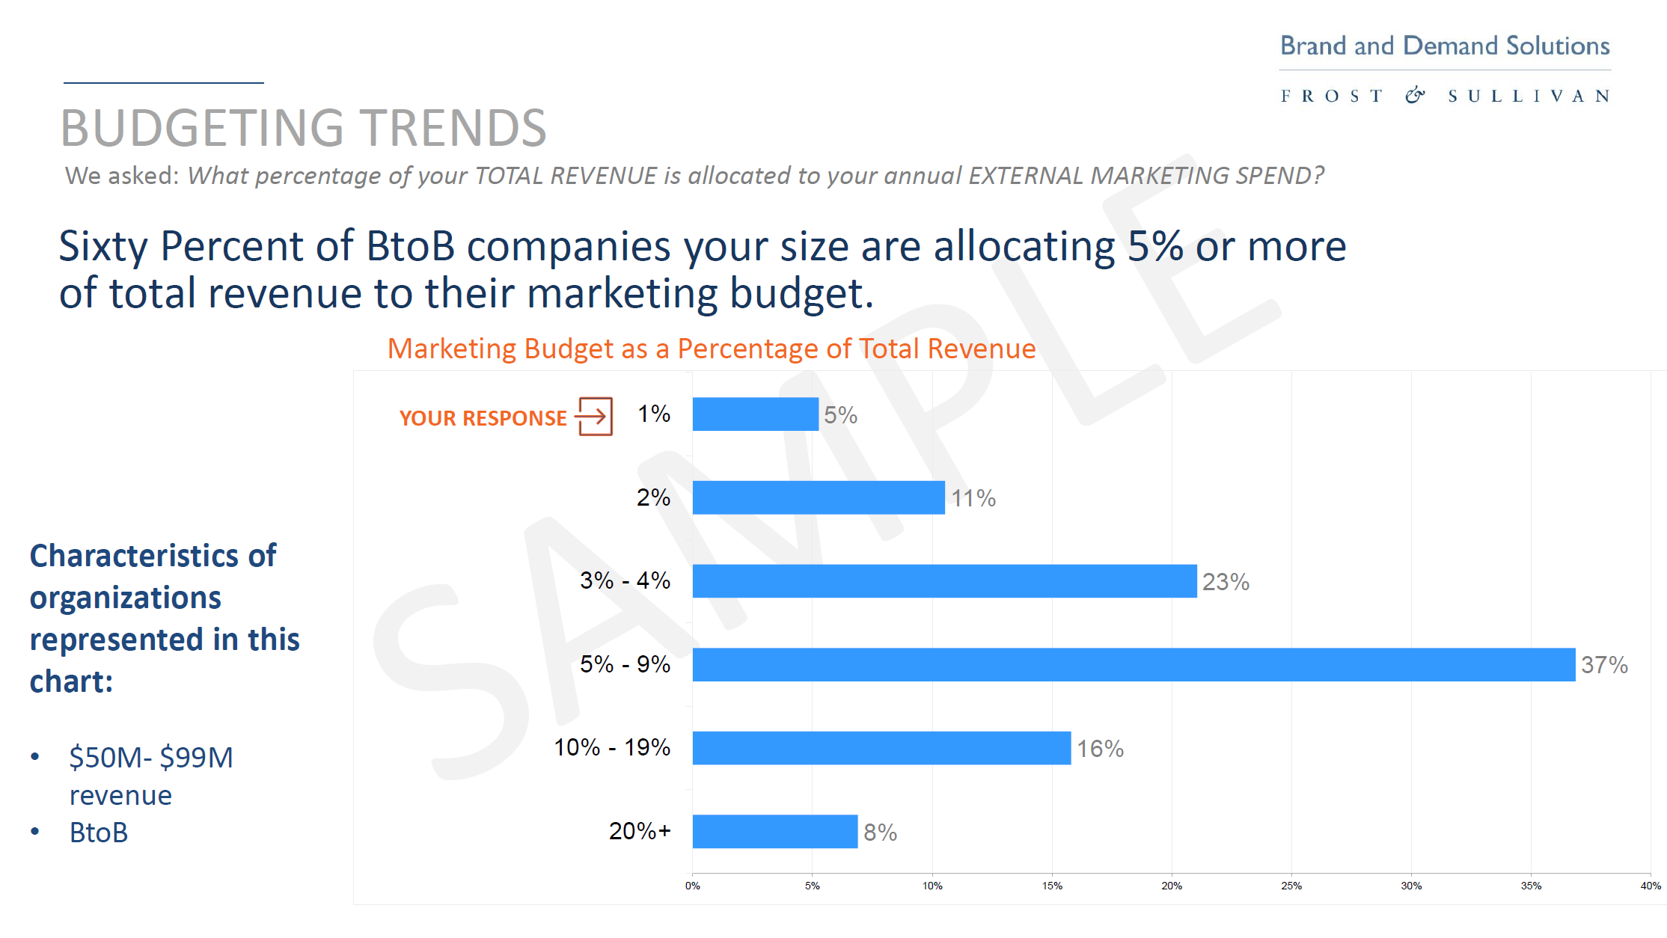
Sample slide – Confidential to CABA

Slide 36
Sample slide – Confidential to CABA
CONTENT STRATEGIES: CHALLENGES
We asked: What is your greatest content marketing challenge?
Right Time. Right Audience. Right Message.
YOUR RESPONSE

Slide 37
Sample slide – Confidential to CABA
SUMMARY & RECOMMENDATIONS
ABM was a not focus but it may be worth consideration
The key challenge was ROI on Content. This is common in the market but can be surmounted with good strategies
ABM-related activities such as executive events help connect with clients and prospects and learn about what resonates with their needs specifically, and to help develop stronger content that can help lead to more results
Leverage content collateral in new ways: build off of key data points from a white paper to create blog posts, infographics, short videos.

Slide 38
How to receive your free CABA-member marketing benchmark survey?
Contact:
Frost & Sullivan at maurice.okawaki@frost.com
or
CABA at walker@caba.org

Slide 39


7. New Business
Alice Rosenberg (Consortium for Energy Efficiency, CEE)
7.2. “Lighting & Homes for Tomorrow” competition
The Lighting for Tomorrow competition provides manufacturers the opportunity to push the industry forward by introducing high quality and innovative designs, contribute to the greater energy efficiency movement, and gain exposure for their brands and products among industry leaders and consumers alike. In particular, the exceptional products identified by the judging panel are heavily promoted by Lighting for Tomorrow for a full calendar year.
The competition is typically launched at the International Lighting Market in Dallas. The 2015-2017 competitions sought LED and OLED fixtures, LED replacement lamps, LED retrofit kits, and lighting control devices.
Lighting for Tomorrow is organized by the American Lighting Association (ALA), the Consortium for Energy Efficiency (CEE) and UL. The annual Lighting for Tomorrow competition was created in 2002 to recognize the best decorative, energy efficient lighting fixtures in the market. Since its inception, Lighting for Tomorrow has encouraged manufacturers to develop well designed, energy efficient lighting products with a specific goal of increasing the availability and market adoption of ENERGY STAR® certified residential lighting products.

Slide 40

7. New Business
Roy Perry (Alarm.com)
7.3 Other new CHC business?

Slide 41

8. Announcements
Ron Zimmer (CABA)
8.1 Past Event Overview:
Internet of Things World, May 13-16, Santa Clara, CA
CONNECTIONS, May 21-23, San Francisco, CA
8.2 Upcoming events:
CEDIA Expo, Sept 10-14, Denver, CO
SCTE-ISBE Cable Tec Expo, Sept 30-Oct 3, New Orleans, LA
Greenbuild, Nov 19-20, Atlanta, GA

Slide 42
9. Adjournment
Roy Perry (Alarm.com)
Next CHC Meeting: Late Nov / Early Dec 2019
Continental Automated Buildings Association (CABA)
caba@caba.org
www.CABA.org
www.caba.org/chc
Connect to what’s next™

